Slide 1

It’s Like Herding Cats: A Statewide Initiative to Address NGSS
Catherine M. Koehler, co-PI ECSU/CREC-TRMMS
Jeff Thomas, co-PI CCSU

Slide 2

Introduction – The Situation
Connecticut - #15 to adopt NGSS
Challenges with Implementation
  Training teachers – inservice & pre-service
  Curricular changes needed
  Assessment – grades? Who will write the questions?
  Administration/Evaluation of Science Teachers
  Implementation Timeline

Slide 3
Prior to NGSS Adoption
Dept. of Education MSP initiative
  Science – New Terrain Project (NTP) – 2013-2015
  Next Generation Science Exemplar (NGSX)
    Purpose: Introduce/Develop a pathway for training university faculty and teachers in 3 dimensional learning and storylining
  Participants in NTP:
    10 university science education faculty PLUS TFA
    HUB configuration included teachers
  2 Phases: 3-D Learning (phase 1); Curricular Development (Phase 2)

Slide 4
CoNSEPT
Connecticut Network of Science Education & Preservice Teachers
MSP Project extension of New Terrain Project
Purpose: Create a pipeline for training preservice science teachers (PTS) with the tools and skills of NGSS during science methods classes then pair them with trained NGSS inservice teachers during student teaching

Slide 5
CoNSEPT Proposed
Who is involved?
  IHE science education faculty, Cooperating Teachers, University Supervisors, Preservice Science Teachers
Why?
  To bring as many stakeholders responsible for PST training on board with NGSS
When will it happen?
  Phase 1: IHE PLC development; NGSX training teacher
  Phase 2: Write curricula; Following PST; develop a observation tool for NGSS
How will we know it worked?
  Assessment during student teaching – spring 2017
  Curriculum development by inservice teachers

Slide 6
IHE Faculty Leadership Development Academy
Goal: NGSS-aligned Professional Development Experiences –Facilitator Development:
Cooperating Teachers & IHE supervisors
Goal: NGSS-aligned Professional Development Experiences –Mentor Development:
Pre-service Teachers
Goal: NGSS-aligned Professional Development Experiences –Learner Understanding:
3-dimensional teaching and learning
3-dimensional teaching and learning
Outcomes & Deliverables
Novel science methods courses for preservice science teachers that Integrate elements of NGSX and ORTIS approaches;
Facilitators with expertise at leading NGSX (Units 1-6) and ORTIS PD models;
3-dimensional teaching and learning
Engineering Practices –ORTIS Introduction
Outcomes& Deliverables
Outcomes& Deliverables
A sustainable network of cooperating teachers and IHE supervisors of PST with experience of both NGSX and ORTIS approaches for the integration of NGSS-aligned science and engineering practices;
A network of K-12 and IHE Ambassadors that will support NGSS-aligned approaches to science education in CT.
A network of IHE Ambassadors for NGSS-aligned approaches to science education in CT.
A sustainable network of new teachers with experience of both NGSX and ORTIS approaches for the integration of NGSS-aligned science and engineering practices;
A network of preservice science teacher ambassadors that will support NGSS-aligned approaches to science education in CT.
Science Practices – NGSX Matter Pathway Review and NGSX Facilitator Pathway
Engineering Practices – ORTIS Introduction and ORTIS Facilitator
Science Practices – NGSX Matter Pathway
Science Practices – NGSX Matter Pathway
Engineering Practices –ORTIS Introduction
Experience facilitating NGSX and ORTIS approaches during summer institutes;
Develop a list of recommendations for the use of NGSX into pre-service teachers’ development;
CoNSEPT Storyline
Phase I
2016
Feb 2016
Sept 2016

Slide 7
IHE Faculty Participants (n=13)
Catherine Koehler, Southern CT State University (S)
Cindy Kern, Quinnipiac University (S)
Todd Campbell, University of Connecticut (S)
Joanna Badara, University of Bridgeport (E)
Marsha Bednarski, Central CT State University (E)
David Moss, University of Connecticut (E)
Jeanelle Day, Eastern CT State University (E)
Harry Rosvally, WCSU/Danbury School District (E)
Kristy Zetalk, WCSU/Danbury School District (S)
Rachel Smith, Teacher for America (E)
Lucy Howell, Teacher for America (E)
Rich Fritz, Alternative Route to Certification (S)
Bonnie Maur, Sacred Heart University (E)
Theresa Bruckerhoff, CERUS (external evaluator)

Slide 8
Developing an IHE Professional Learning Community (PLC) –
Phase 1-Part 1
  Framework for Phase 1/Part 1 – PLC Development for IHE
  Shared Beliefs, Values, and Vision
  Shared and Supportive Leadership
  Collective Learning and Its Application
  Supportive Conditions
  Shared Personal Practice (Hord & Sommers, 2008)

Slide 9
  Shared Beliefs, Values, and Vision
We felt responsible for training teachers in the State for NGSS
Most were trained in NGSX (New Terrain Project) - But we were never able to talk to each other
Funding became available through MSP
We all agreed to trust each other –
  ground rules were established quickly

Slide 10
  Shared and Supportive Leadership
SCSU was awarded the MSP project – 18 months (January 2016 – September 2017)
Used “bottom-up” leadership style to get buy-in
Shared leadership philosophy - collaboration
All Universities took part in hosting the meetings
BUT, It was like Herding Cats!!!

Slide 11
  Collective Learning and Its Application
Common training – NGSX –
  there were 2 more additions from New Terrain Project – seamless transition for all
Meeting time for PLC very productive!
  Shared commonalities in pedagogy
  Shared syllabi and assignments
  In the process of developing an observation tool
LIKE-MINDS –- PRODUCTIVE WORK!

Slide 12
  Supportive Conditions
Attending to relationships is key in PLC – Building Trust
Mutual respect for each participant – variety of educational backgrounds
Group believes that everyone has a valuable contribution to the project

Slide 13
Shared Personal Practice
Goals was a collective PST pipeline so every colleague voice and suggestion was acknowledged and respected
Trust in colleagues allows for safe space to share personal practices
Colleagues liked to share best practices;
  We all liked to revise our practices!
  This was a WIN-WIN for all!

Slide 14
Lesson Learned from PLC Work
Sharing is KEY to strong PLC
Inequity exists for training inservice teachers in NGSS protocol
Collaboration yields strength – Letter to Commissioner of Education in CT from Science Educator Consortium
Sharing experiences and resources
strengthens everyone

Slide 15
CoNSEPT: Phase I – Part 2
Cooperating Teachers & University Professors
Part 1: IHE PLC Work – February – June 2016
2 Summer Institutes
  Professional Learning for CT & US using NGSX protocol
15 school districts from CT
  30 cooperating teachers
  3 university supervisors

Slide 16
Teacher Participants by School District
(n=15)
Student Impact ~ 1000
Hamden
EO Smith/Mansfield
New Britain
Wethersfield
Glastonbury
Danbury
Mansfield
East Hartford
Stratford
West Hartford
Hartford
New Haven
Fairfield
Monroe
Ridgefield

Slide 17
CoNSEPT Phase 2
(October 2016 – Sept 2017)
Continue our work with Preservice Teacher Pipeline
  (Fall 2016 – Spring 2017)
Develop Storylines using Anchoring Phenomena
(Summer 2017)
Working with the CSDE and CT Science Center (ongoing)
SciCamps (Fall 2016 – Winter 2017)

Slide 18
SciCampCT 2016
WELCOME TO…
#SciCampCT

Slide 19

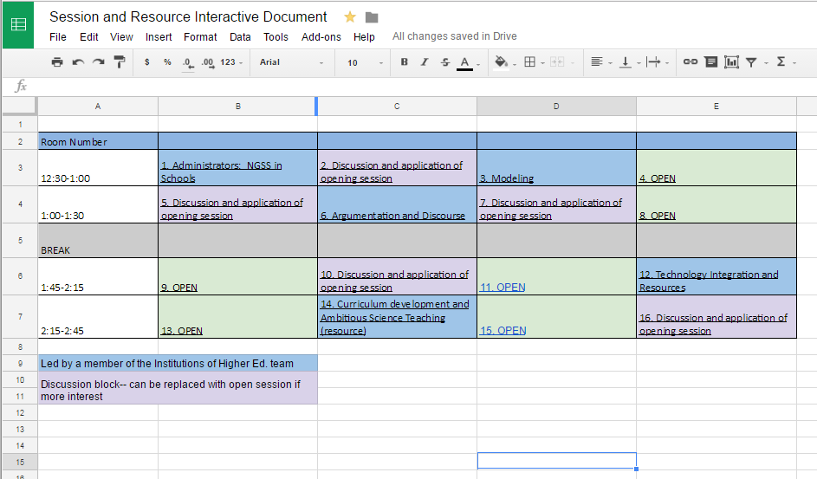
SciCamp “Unconfernece”
I’d like to collaborate on grounding my
units in culturally
responsive phenomena
- Rachel
Step 1: Co-create the Schedule
Step 2: Sort by themes
Step 3: Post final schedule,
assign rooms,
link google folders
Law of Two Feet
Notes:
Intro concept of unconference– led by teachers for teachers
This day is very driven by them and is geared towards collaboration and networking across districts to gain best practices to improve STEM education for all students
Step 1: cocreate schedule– already started. If you have not already– take a few post it notes…etc. put it on the interactive board (share, learn, collaborate)
This can be anything from big picture– like how is everyone balancing NGSS with CMTs?
To very discrete like- I want to collaborate specifically on getting a bank of ideas for culturally responsive phenomena and real world problems to ground my units in
Step 2: we will work on sorting the post-its by theme during the first block of the day and incorporating any new additions as they occur to you
Step 3: 11:00am- we will transfer these to the google interactive schedule, assign rooms and link their google folders so you can take notes and drop resources
11:15-11:30 we will share with you the schedule (you can also access it through the google drive or the QR code from the beginning, recommended if you want it on your phone as you move through the day)

Slide 20
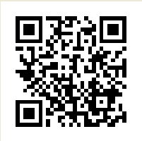
As you settle in…
1. Take a look at this
EdCamp101 video:
2. Grab a few post-it notes at your table
and, on each, write down…
  Something you’d like to share
  Something you’d like to learn
  Something you’d like to collaborate on
3. Put your post it on the board!
(someone will work on clustering by topic)
(Don’t be shy!)
I’d like to collaborate on grounding my
units in culturally
responsive phenomena
- Rachel

Slide 21
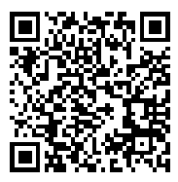
Our Co-Created Schedule
Here is our final schedule:
Remember, you are the facilitator
and the learner today!
Don’t forget to take notes and collect resources
We will meet back here at 2:45 to wrap-up and close out

Slide 22
Comments from Teacher Participants:
Connections
“I enjoyed the conversations in each session, learning about what other people are doing to implement NGSS!”
Opportunity for input from other districts.
Connecting with teachers and experts across the state.
My favorite part was the discussion in the time modeling session because it was organic and everybody shared.
Talking to positive teachers from other schools.

Slide 23
Comments from Teacher Participants:
New Knowledge about NGSS
Learning more about NGSS.
Getting reenergized to bring new NGSS ideas into the classroom.
I got to pick the brains of others on their approach to meeting NGSS expectations.
Seeing examples of NGSS units
Definitely am more comfort level in NGSS since it started 4 years ago

Slide 24
Comments from Teacher Participants:
Freedom to Choose Professional Learning
Collaborating and learning from other teachers because they can share how the ideas work with actual students.
I like the diversity of sessions offered
The sessions with small groups enabling all to bounce ideas off of and gain resources.
Moving rooms and seeing what is going on in the other schools
Loved how the workshops were created, set up and presented. Unconference was very cool

Slide 25
Comments from Teacher Participants:
Dislikes about SciCamp
Did not provide lunch
People complaining.
Challenges in getting online
Due to the nature of our current status of NGSS there were questions that were still left unanswered.
Deciding what I want to learn
Couldn’t get people to come
Last minute agenda changes

Slide 26
Comments from Teacher Participants:
Suggestions for next SciCamp
A little more organized and more help with online resources.
Better communication of meeting locations
One less session.
Assigning rooms all on the same floor.
Better Wi-Fi connection
I think just a morning session or afternoon session.
Get vendors to donate money for lunch giveaways……

Slide 27
Phase 3 for CoNSEPT
Introduce an elementary cohort to follow CoNSEPT protocol
  NGSX training for elementary teachers (fall 2017)
Revise curricula with elementary teachers using anchoring phenomena
Increase SciCamp presence in CT – 4 corners
Summer Institutes 2018: Curricular & Assessment development

Slide 28
Questions?
Contact Information:
Catherine Koehler: sissianne@aol.com

Slide 29
Data Collected for CoNSEPT Project
Collaborative Posters co-created by IHE members
Preservice Teacher Philosophy Statement
Pre-Post NGSS questionnaires for CT/US
SciCamp Questionnaires for Teachers
Reflection questions and project assessment questionnaires
NGSS Observation Protocol – in development
NGSS Unit Plan Rubric – in development

