Slide 1
College Credit Opportunities
The early pathway to college success
Bristol Eastern High School
Notes:
This presentation provides information to both students and their parents on opportunities to earn college credit while a student at Bristol Eastern.

Slide 2
Overview
Advanced Placement (AP)
UConn Early College Experience (ECE)
College Career Pathways (CCP)
Project Lead The Way (PLTW)
Tunxis Community College,
High School Partnership Program
Notes:
We will be discussing the various ways college credit can be earned through our Advanced Placement courses, known as AP; the UCONN Early College Experience courses (ECE); the College & Career pathways (CCP); the Project Lead the way program for students interested in engineering careers and finally the high school partnership with Tunxis Community College.

Slide 3

Notes:
The opportunities help our students experience the rigor of a college course, which, in turn, helps them prepare for courses taken at 2 - year or 4- year college programs. It also helps with the transition from high school to the rigors of college academics.

Slide 4
English Course Map, sample
Grade Level | Course Options based on requirements met & teacher recommendation (ACC = Accelerated; ACA = Academic)
Grade 12 | AP Literature | AP Language & Composition | English 4, ACA
Grade 11 | AP Language & Composition | English 3, ACC | English 3, ACC or ACA AP Lang & Comp
Grade 10 | English 2, ACC | English 2, ACC or ACA | English 2, ACC or ACA
Grade 9 | English 1, ACC or ACA | English 1, ACC or ACA | English 1, ACC or ACA
Grade 8 | ELA, Accelerated or Academic
Notes:
This slide gives an example of how the AP English courses generally fit into a student’s schedule.

Slide 5
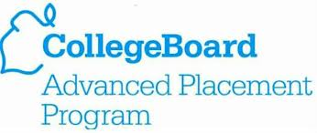
Notes:
The AP program is really managed by College Board. It is the same organization which handles the PSAT’s, SAT’s, ACT’s, and also partners with Khan Academy.

Slide 6
Advanced Placement (AP)
High school students engage in college-level work
Achievement exams are used to allow students to enter college with advanced standing
Exams are offered in 37 subjects with almost 4 million exams taken in 2013...
Notes:
Read the bullets as provided on the slide

Slide 7
Placement vs. Credit
Some colleges award “credit” towards your college degree for qualifying AP Exam grades.
Some colleges award “advanced placement.” This means you can skip introductory courses, enter higher-level classes, and/or fulfill general education requirements.
Notes:
Read the slides

Slide 8
CCSU v. UConn Credit Awarded
Course | CCSU Minimum Score | Credits Awarded | UConn Minimum Score | Credits Awarded
Chemistry | 3 | 4 credits Chem 161/162 w/lab | 4 | 8 credits Chem 1127Q and 1128Q
English Lit or Language | 3 | 3 credits English 110 Freshman Comp | 4 | 4 credits English 1011 Seminar in Writing
Psychology | 3 | 3 credits Psy 112 General Psychology | 4 | 3 credits Psych 1000
Calculus AB | 3 | 4 credits Math 152 Calculus I | 4 | 4 credits Math 1131Q
US History | 3 | 3 credits Hist 161 American History to 1877 | 4 | 3 credits History 1502
Notes:
The numbers on this slide were updated as of 1. 16.17. For CCSU a score of 3 on the AP exams and a 4 for UCONN will provide 3 college credits. Most college courses are worth 3 credits. (Some courses can be as low as 1 or over 3, depending upon the course. Usually a student needs 120 credits to graduate, but this depends upon the individual major and university requirements).

Slide 9
AP Courses Available in
Bristol Public High Schools
Studio Art
English Literature
English Language
AP Seminar * & Research
Calculus AB & BC
Music Theory *
Biology
Chemistry *
*Open to 9th or 10th grade
Microeconomics *
Physics 1 and Physics C
Spanish
Statistics
Human Geography *
US History *
US Government *
Psychology *
Environmental Science
World History
Notes:
Bristol high schools offer a variety of AP courses. Some are open to 10th graders. AP Human Geography can be taken in ninth grade.

Slide 10
WHY take AP Classes?
Demonstrate college readiness
Challenge yourself
Get a head start on college level work
Develop study habits
Achieve at the college level with daily guidance from your teacher
Notes:
Why take AP classes - (read the list)

Slide 11
Students who complete AP classes...
Show college admissions officers they are serious students who can succeed at college level work
Show themselves that they are capable of achieving in rigorous courses!!
Notes:
Read the slide

Slide 12

EXPERIENCE
Notes:
Bill

Slide 13
UConn “ECE”
UConn Early College Experience (ECE) is an opportunity for students to take UConn courses while still in high school:
  Equivalent to the same course at UConn
  Taught on the high school campus by high school instructors who have been certified as adjunct faculty members at UConn
  Exam & final grades reported to UConn
Notes:
Read the slide

Slide 14
UConn ECE Courses at BEHS
Department | BEHS Course | UConn Equivalent
Math | Calculus AB/UConn Calculus BC/UConn | Math 1131Q (Semester 1) Math 1132Q (Semester 2)
Science | Physics AP/UCONN Physics C Elec. & Mag Physics C Mechanics | PHYS 1201Q PHYS 1401Q PHYS 1402Q
English | English Literature AP/UConn | ENGL 1011
Family Consumer Science | Individual & Family Development | HDFS 1070
Taken together
Notes:
These are the list of ECE courses available at BE

Slide 15
Cost & Savings
No AP Fee when taking an AP/UConn course!
For courses taken and passed:
Typical course at UConn $1,400 - $1,900
Taken as an ECE course $125 - $160
Fee waivers are available for eligible students
Notes:
Updated 1/6/17 - You save money by taking the ECE courses vs. AP, but we encourage you to take both.

Slide 16
Benefits to students
Exposure to college level curriculum
Opportunity to earn college credit at a significantly reduced cost
Have access to UConn online libraries and resources
Can purchase tickets to UConn events at student prices
Notes:
Read the slide

Slide 17
Earning and Transferring Credit
Students earning a “C” or better will earn credit with UConn
Credit must be transferred from UConn to other colleges...
  http://ece.uconn.edu/research/
ECE credit transfers at an 87% rate
Notes:
Read the slide - I encourage you to click on the website for more information...

Slide 18

College Career Pathway (CCP)
courses with
Tunxis Community College
Notes:
Next, let’s talk about the partnerships with Tunxis Community College

Slide 19
What is CCP?
Courses taught on the high school campus by high school instructors who have been certified as adjunct faculty members at Tunxis Community College
Allows students to earn free college credits by taking college classes in high school
College credits are awarded by Tunxis Community College
Notes:
Read the slide

Slide 20
How is CCP credit earned?
Students must earn an average of 75 or higher in the course to receive the credit
Credits may transfer to Connecticut State Universities, as well as other schools
Notes:
Read the slide

Slide 21
What courses are offered?
Accounting 1 & 2
Early Childhood Education 1 & 2
You will hear more information about other partnerships with Tunxis Community College later in this presentation!
Notes:
Read the slide

Slide 22
How do you earn credit?
Complete an application while enrolled in any of the potential credit-bearing courses.
  Discuss with your guidance counselor
  Receive an application from your teacher
Notes:
There is a process to earn credit (read the slide)

Slide 23
What’s the next step?
Sign up for a dual-enrollment course for 2019-2020!
Once enrolled in the course at BEHS, complete a dual-enrollment application provided by your teacher.
Notes:
Here are the next steps - read the slide. The Career and Technical Department Chair, Mrs. Jacques or your school counselor can help you with this process.

Slide 24

Notes:
Project Lead the Way is a great program for our future engineers.

Slide 25

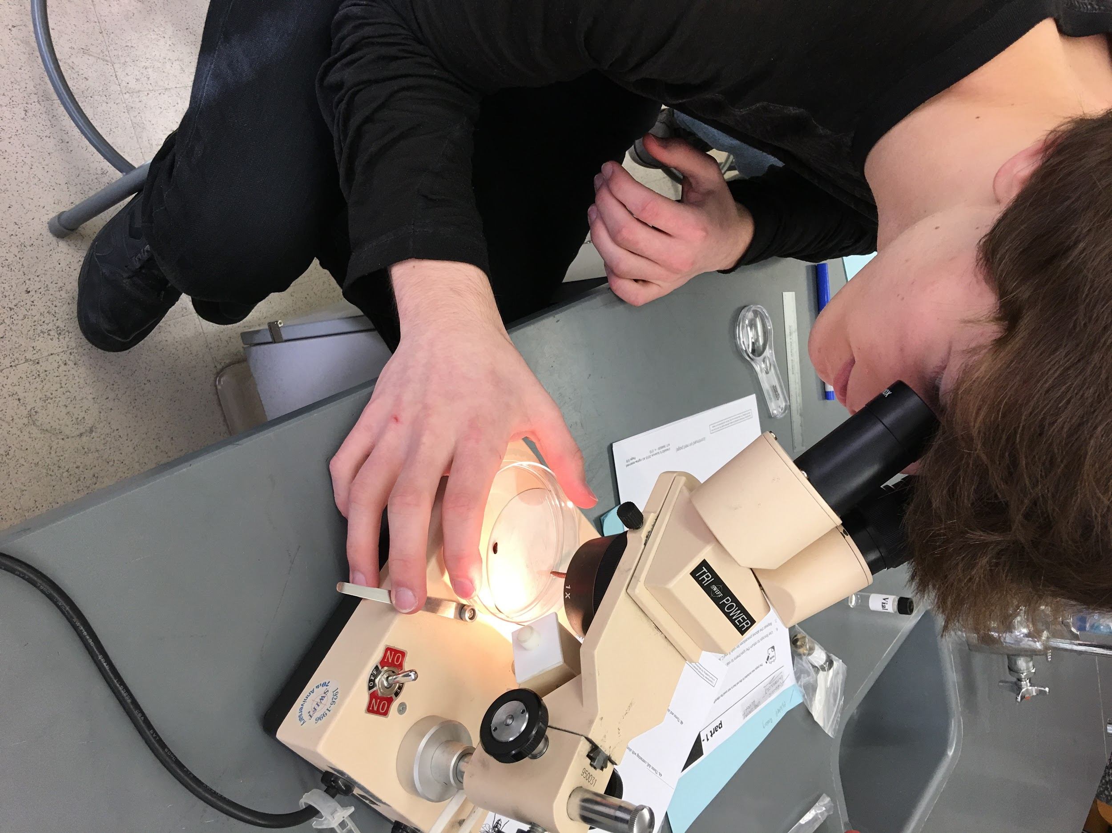
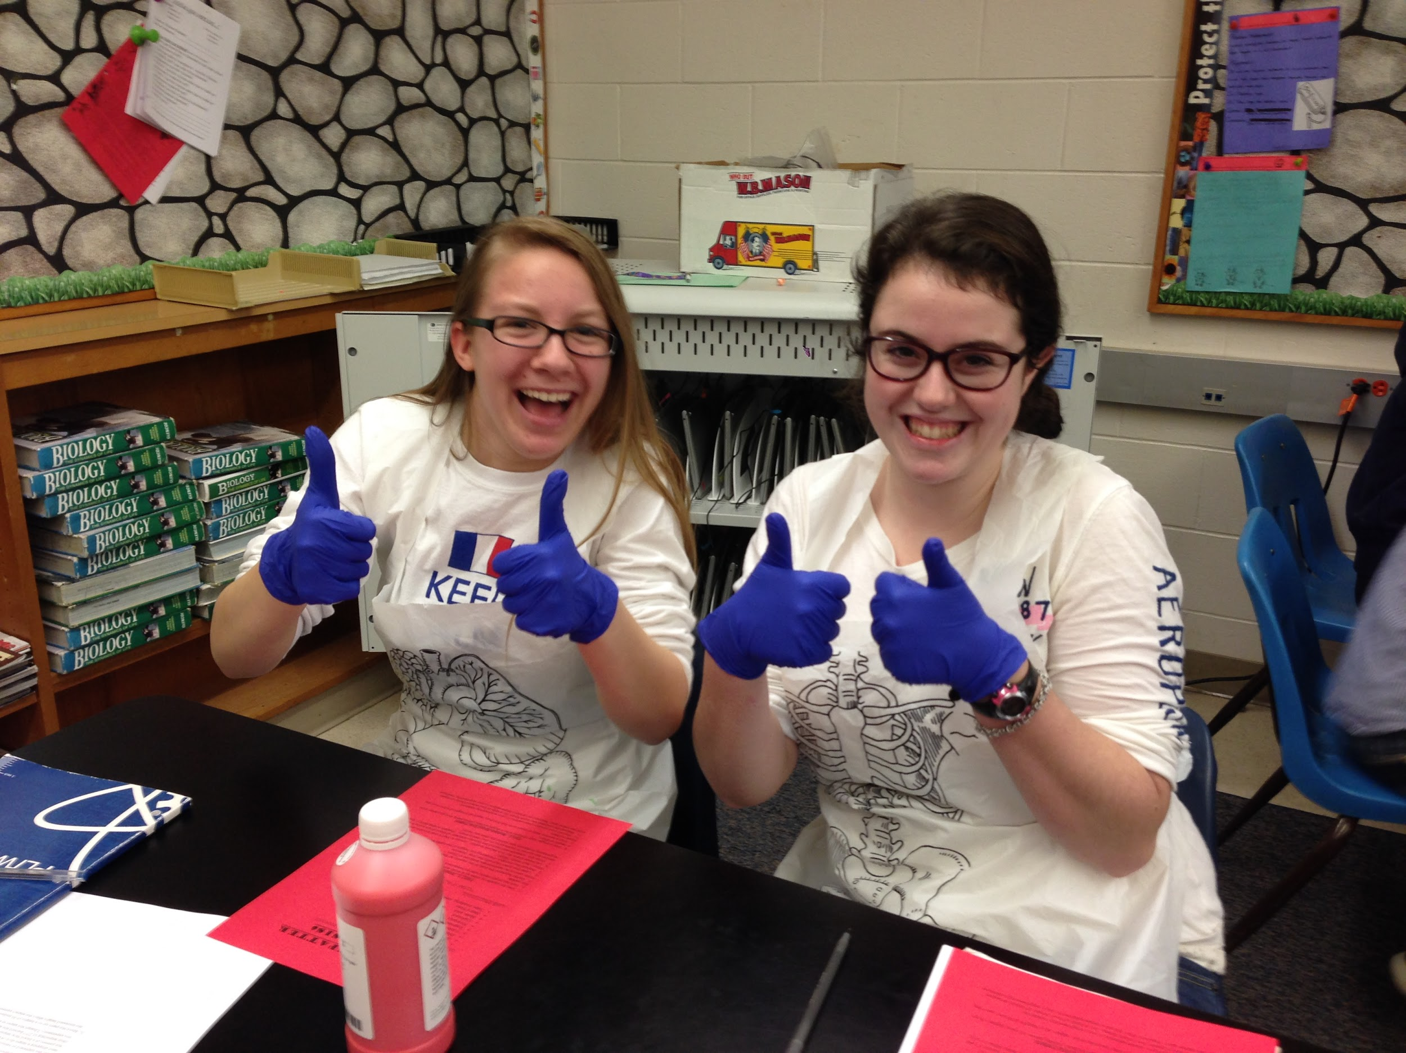
Project Lead the Way
A national curriculum launched in 1997 in recognition that the demand for skilled workers in science, technology, engineering, and math (STEM) is closely linked to global competitiveness.
Notes:
Read the slide

Slide 26
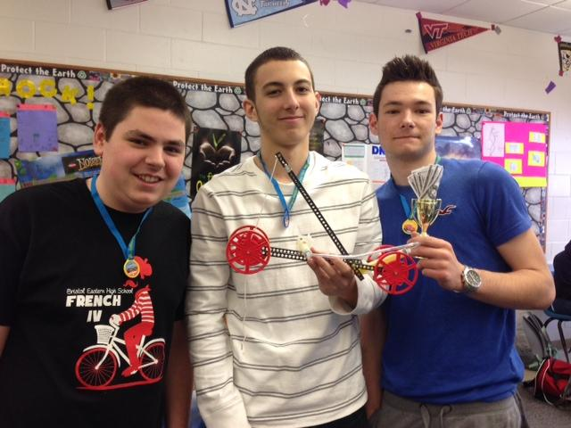
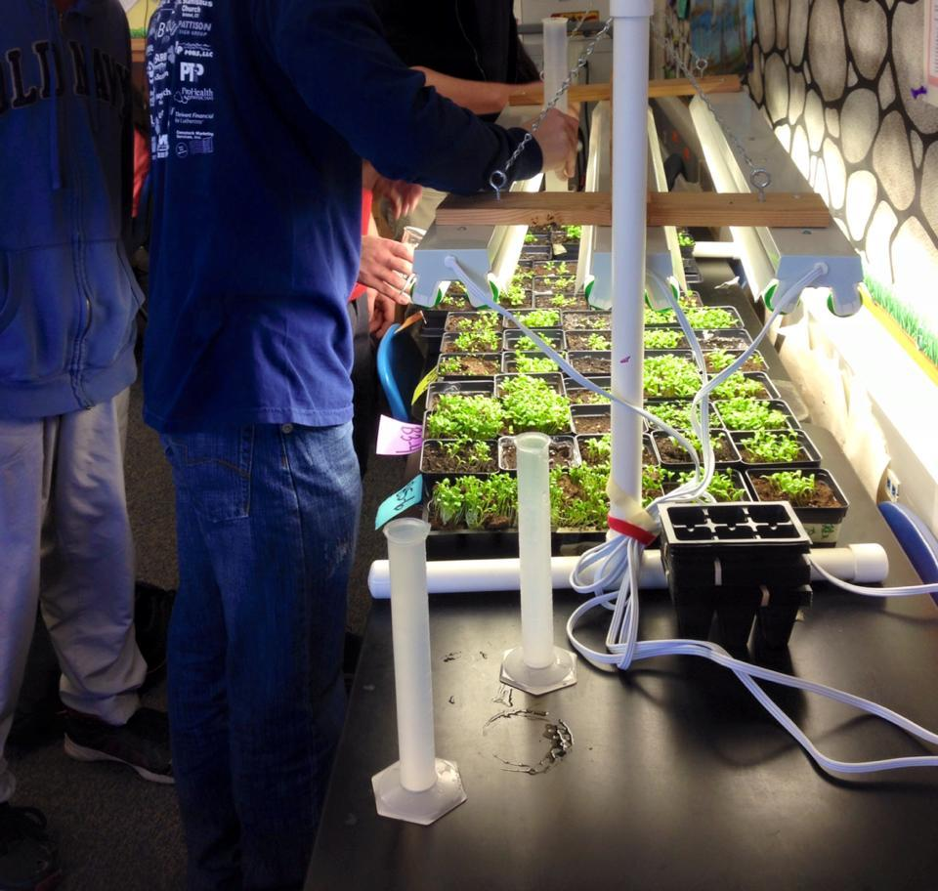
Project Lead the Way...
...to a population ready to handle jobs in STEM careers:
Science - what exists in the natural world
Technology - modification of natural world
Engineering - application to natural world
Mathematics - an exact language to
communicate about the natural world
Notes:
Read the slide

Slide 27

Fastest growing fields in need of educated professionals...
Engineers: chemical, mechanical, aerospace, electrical, and many more!
Computer Security Analyst
Software Developer
Medical professionals
Notes:
Read the slide (in blue)

Slide 28
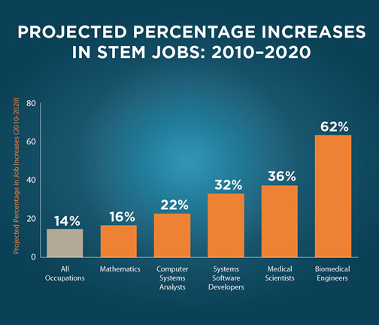
Notes:
There is a growing number of STEM jobs.

Slide 29
PLTW Classes
Full year classes, 1.0 credit each
  Activity, project, and problem-based courses
  Students apply what they know, identify problems, find unique solutions, and lead their own learning to solve global issues
National curriculum
Affiliated with the University of New Haven, and RIT, and other universities by course
Notes:
Read the slide

Slide 30
PLTW Course Offerings at BEHS
Introduction to Engineering Design
Principles of Engineering
Digital Electronics
Civil Engineering and Architecture
Notes:
Read the slide

Slide 31
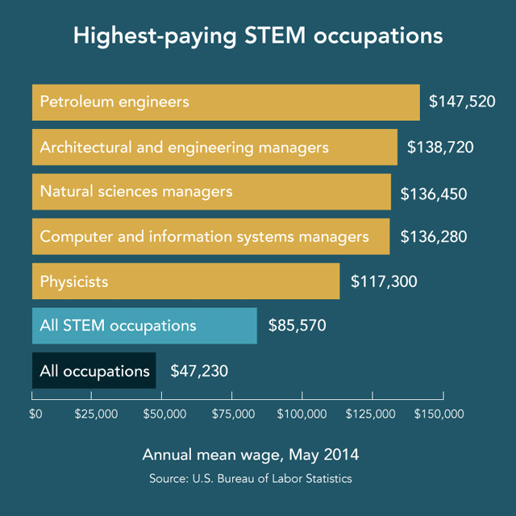
"... Leadership tomorrow depends on how we educate our students today—especially in science, technology, engineering, and math."
President Barack Obama, September 16, 2010
Notes:
Careers in STEM are very lucrative. These are examples of the salaries in various highest paying STEM occupations. (Read the quote by Obama)

Slide 32
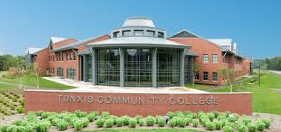
Tunxis Community College
High School Partnership Program
Notes:
The high school partnership program at Tunxis is another way to earn college credit.

Slide 33

What is it?
Every Fall and Spring Semester, Tunxis Community College provides area students with an opportunity to enroll in a course on campus or online for free!
Transportation and book expenses are the student’s responsibility
Admission depending on availability of class seats and funding from the college
Notes:
Read the slide

Slide 34
Eligibility
High school Juniors and Seniors
“B” or better average
Recommendation by School Counselor
Placement Test (Accuplacer)
Notes:
There are eligibility requirements in order to participate.

Slide 35
Course Selection
Once accepted to the program, students will work with the Director of Admissions at Tunxis Community College to choose a course.
Notes:
Read the slide

Slide 36
College credit
Credit is earned at Tunxis
If attending Tunxis after high school, the credit remains with them
BEHS will accept .50 credit per class
Credit may transfer to other colleges & universities (fees may apply)
Notes:
Read the slide

Slide 37
For more information on any of these college credit opportunities...please contact your school counselor.
Notes:
Read the slide.

