Slide 1


What’s for Breakfast?
Meeting the Meal Pattern Requirements
for the School Breakfast Program
Connecticut State Department of Education
Bureau of Health/Nutrition, Family Services and Adult Education
Notes:
Room Set-up (see “Training Agenda” in section 1 of your Instructor Guide).
Participant handout packets placed at each table.
One set of USDA PFS samples placed on each table.
Music playing as participants enter (use Pandora).
Registration table with sign-in and name tags – make sure all participants sign in.
Parking lot posted.
Getting Started – Review Trainer Agenda
Welcome and presenter introductions.
Conduct Inclusion Activity (see “Inclusion Activity” in Section 1 of your Instructor Guide).
Provide a brief overview of the handout packet (see list of handouts in “Binder Contents” in Section 1 of your Instructor Guide). Emphasize that the “Resources for School Meals” handout includes a list of key Web sites and resources for the National School Lunch Program (NSLP) and School Breakfast Program (SBP). Mention that the bolded resources are key resources for schools to use.
INSTRUCTOR NOTES: Be familiar with all participant handouts (section 4 of the Instructor Manual) and review all instructor resources (section 6 of the Instructor Manual).

Slide 2



Objectives
Understand the meal pattern requirements for breakfast
Identify noncreditable Foods
Understand the four dietary specifications and identify resources to implement them
Understand how to implement Offer versus Serve (OVS) and identify reimbursable meals
Gain confidence in ability to provide staff training and communicate information about SBP requirements
Notes:
Take a look at your agenda. We have five main objectives for today’s workshop. This workshop is intended to help you:
understand the meal pattern requirements for breakfast including the meal pattern components, serving sizes and specific crediting criteria;
identify noncreditable foods, i.e., foods that do not contribute to the meal pattern;
understand the four dietary specifications (nutrition standards) that school breakfasts must meet and resources to help to implement them;
understand how to implement Offer versus Serve (OVS) and identify reimbursable meals; and
gain confidence in your ability to provide staff training and communicate information about the SBP requirements to food service colleagues, school staff, students and families.
Throughout the workshop, we will have several interactive activities to help you understand and apply the concepts you are learning today. We will also show you where to find resources that provide additional information.
INSTRUCTOR NOTES: Have participants take out their agenda handout.

Slide 3

Learning Expectations
Give feedback
Remain positive
On task
Unplug
Participate
Notes:
To help everyone get the most from this workshop, we would like to set some learning expectations for the group.
Give feedback: Let us know if you have a question, need more information, if we are going too quickly or if you need a break. We want you to have a comfortable learning experience.
Remain positive. We understand that the USDA requirements can be challenging and that change is difficult. We ask that you keep a positive attitude and remember the reasons for the meal pattern changes – to improve the health and learning of our nation's children.
On task: Please stay on task. We ask that you please refrain from side conversations that are not related to the workshop content or activities, so as not to disrupt the learning environment for your colleagues. We will allow plenty of time for questions and conversation during the activities and throughout the workshop. We will also provide a “parking lot” if there are questions we don't have time to address or if we don’t know the answers.
Unplug: Please silence your cell phones and refrain from texting. If you need to text or make a call, please step outside so as not to be distracting to others.
Participate: Be involved in the workshop and activities and take charge of your own learning. We encourage you to ask questions.
Let’s get started!

Slide 4

Test Your School Breakfast
Meal Pattern IQ!
Group 1: Milk and Noncreditable Foods
Group 2: Grain
Group 3: Fruits
Group 4: Dietary Specifications (Nutrition Standards)
Notes:
We’re going to start with an activity to test your school breakfast meal pattern IQ. This activity focuses on what we know about the meal pattern requirements for the SBP.
INSTRUCTOR NOTES:
Write the group number and topic on chart paper (Group 1 Milk and Noncreditable Foods, Group 2 Grains, Group 3 Fruits, Group 4 Dietary Specifications). Post each paper in different sections of the room. Have markers available in each section.
Divide participants into four groups by counting off by fours. Each group goes to the corner with their flip chart paper.
Ask participants to leave all their handouts on the table.
As a group, participants have 5 minutes to identify everything they know about their topic. The person with the brightest color top is the recorder and writes all information on chart paper. The person with the longest hair is the reporter.
When the chimes ring, time is done and each group brings their list to post next to each other in the front of room or a visible location that all participants can see. Everyone sits back down at their original table.
At the beginning of each section, ask the group reporter to present their information then share the slides that apply to that section.

Slide 5
OVERVIEW OF
SBP MEAL PATTERN
Notes:
Let’s look at an overview of the SBP meal pattern.
INSTRUCTOR NOTES: Ask participants to take out their handout on the breakfast meal pattern.

Slide 6

SBP Meal Pattern Overview
Food-based menu planning approach
Three age/grade groups (K-5, 6-8 and 9-12)
Daily and weekly requirements
Weekly dietary specifications
(nutrition standards)
Notes:
Let’s look at a brief overview of the general requirements for breakfast.
There is one food-based menu planning approach. This approach simplifies menu planning, serves as a teaching tool to help children choose a balanced meal and ensures that students nationwide have access to key food groups recommended by the Dietary Guidelines.
Schools use three same age/grade groups for planning breakfasts and lunches: grades K-5, 6-8 and 9-12. These age/grade groups provide age-appropriate meals.
There are daily and weekly serving size requirements for each food component in the meal patterns.
There are also weekly dietary specifications (nutrition standards) for calories, saturated fat and sodium. In addition, all foods must contain zero trans fat.

Slide 7
SBP Meal Pattern Overview
All grains must be whole grain-rich (WGR)
Fruits component is at least 1 cup
Vegetable substitution rules
Limits on juice
Notes:
This slide shows an overview of the general meal pattern requirements for breakfast that took effect in school year 2014-15 (July 1, 2014). We will discuss each of these in more detail throughout today’s workshop.
All grains offered at breakfast must be WGR.
The fruits component requires at least 1 cup of fruits daily to all age/grade groups.
Schools may offer vegetables in place of fruits at any time, but must comply with certain requirements. Starchy vegetables may be offered on any day if the weekly menu includes at least 2 cups of non-starchy vegetables (dark green, red/orange, beans and peas or other vegetable subgroups).
Full-strength juice (fruit and vegetable) is limited to no more than half of the weekly fruits component.

Slide 8
SBP Meal Pattern Overview
Students must take at least ½ cup of fruit (or vegetable) for offer versus serve (OVS)
Target 1 sodium restriction (through school year 2015-16)
Notes:
If a school implements offer versus serve, students are required to take at least
½ cup of fruit, or vegetable substitution, to make a meal reimbursable.
Schools must meet the first sodium target for school meals based on the average weekly sodium content of daily breakfast menus. This target is through school year 2015-16.

Slide 9
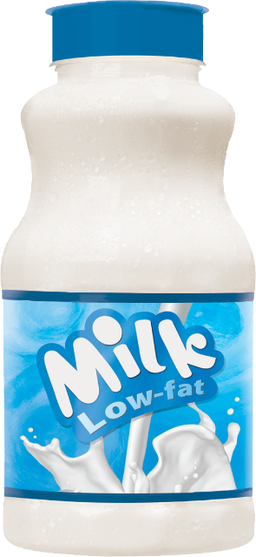

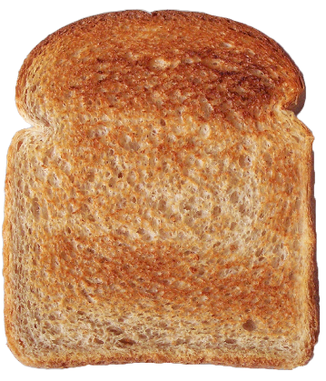
Minimum DAILY Requirements
(All Grades)
Grains | Fruits | Milk *
1 ounce equivalent (oz eq) | 1 cup | 1 cup
* Low-fat unflavored or fat-free unflavored or flavored milk
Notes:
Each breakfast must contain daily and weekly amounts of three components: grains, fruits and milk. The chart on this slide provides an overview of the required daily meal components and amounts for both five-day and seven-day weeks. We will review each of the meal pattern components individually in a few minutes.
The minimum daily requirements are the same for all three grade groups: 1 ounce equivalent of grains, 1 cup of fruits and 1 cup of milk, which must be low-fat unflavored or fat-free unflavored or flavored milk.
INSTRUCTOR NOTES: All meals patterns are available on the CSDE’s Meal Patterns Web page (http://www.sde.ct.gov/sde/cwp/view.asp?a=2626&q=333770 for five-day weeks and http://www.sde.ct.gov/sde/cwp/view.asp?a=2626&q=334100 for seven-day weeks):
Five-day week: http://www.sde.ct.gov/sde/lib/sde/pdf/deps/nutrition/sbp/breakfast.pdf
Seven-day week: http://www.sde.ct.gov/sde/lib/sde/pdf/deps/nutrition/sbp/7daybreakfast.pdf
One Connecticut school operates on a four-day week. The four-day week meal patterns are found at http://www.sde.ct.gov/sde/cwp/view.asp?a=2626&q=334318.

Slide 10
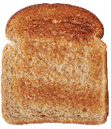

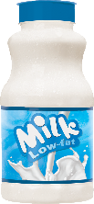
Minimum WEEKLY Requirements
Five-day Week
Food Components | Grades K-5 | Grades 6-8 | Grades 9-12
Grains (oz eq) | 7-10* | 8-10* | 9-10*
Fruits (cups) | 5 | 5 | 5
Milk (cups) | 5 | 5 | 5
* No maximum weekly grain limit
Notes:
This slide shows the weekly amounts for a five-day week. The weekly amounts for fruits and milk are simply the sums of the minimum daily amounts.
The weekly amounts for grains include minimums that are greater than the sum of the minimum daily amounts. However, the maximum limit is not required.

Slide 11
Minimum WEEKLY Requirements
Seven-day Week
Food Components | Grades K-5 | Grades 6-8 | Grades 9-12
Grains (oz eq) | 10-14* | 11-14* | 12.5-14*
Fruits (cups) | 7 | 7 | 7
Milk (cups) | 7 | 7 | 7
* No maximum weekly grain limit
Notes:
This slide shows the weekly amounts for a seven-day week. The weekly amounts are more since there are two more days in the week.
INSTRUCTOR NOTES: When you do the inclusion activity at the beginning of the workshop, you will find out if anyone is from residential child care institutions (RCCIs). Let participants know that this presentation includes the meal pattern requirements for both five-day and seven-day weeks. If there are no RCCIs, tell participants that since no one is using seven-day menus, we will skip the information and slides for seven-day weeks.
If there are no participants from RCCIs, skip this slide.

Slide 12
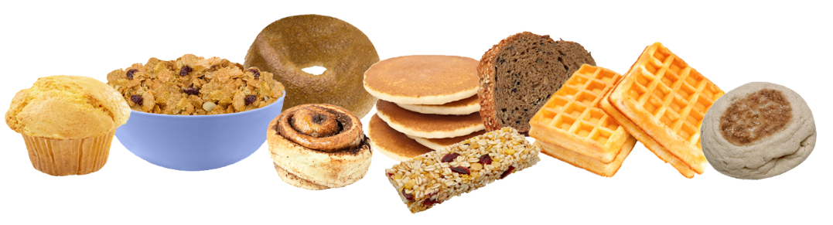
Calculating Minimum WEEKLY
Requirements for Grains
Weekly total is calculated based on the SMALLEST SERVING offered each day
When menus offer a variety of daily grain choices with DIFFERENT SERVING SIZES (ounce equivalents), must consider weekly minimums
Notes:
The weekly serving of grains at breakfast is determined by adding the ounce equivalents of all daily offerings. Menu planners must calculate the weekly total based on the smallest grain serving (ounce equivalents) offered each day.
For example, if the menu offers two daily grain choices that include a 1 ½-ounce equivalent item and a 2-ounce equivalent item, the menu planner must count the
1 ½-ounce equivalent item toward the weekly total.
It is important to review all grain choices over the week for compliance with the minimum weekly requirements.
When offering different serving sizes of grains or meat/meat alternates each day or over the week, menu planners must pay careful attention to the daily choices.

Slide 13
Example of Weekly Grain Calculation
Acceptable Breakfast Menu for Grains
GRAINS FOR ALL GRADES 6-8
DAILY REQUIREMENT: 1 ounce equivalent WEEKLY REQUIREMENT: 8 ounce equivalents
Daily Choices | OUNCE EQUIVALENTS OFFERED |  |  |  |  |  | Meets Minimum Weekly Requirement?
 | Monday | Tuesday | Wednesday | Thursday | Friday | TOTAL
Choice 1 | 2 | 1.5 | 1.5 | 2 | 2 | 8 | YES
Choice 2 | 1.5 | 1 | 1.75 | 2 | 2
Choice 3 | 1.75 | 2 | 2 | 2 | 2.5
Notes:
This slide shows an example of a breakfast menu that meets the weekly requirements for grains for grades 6-8. The menu planner offers three different sizes of grains each day. Each choice provides at least the minimum daily requirement of 1 ounce equivalent and the weekly total provides the minimum weekly requirement.
Remember that the weekly total is calculated based on the smallest serving (ounce equivalents) offered each day. In this example, the weekly total of the smallest daily serving (1.5 ounce equivalents on Monday, 1 ounce equivalent on Tuesday, 1.5 ounce equivalents on Wednesday, 2 ounce equivalents on Thursday and 2 ounce equivalents on Friday) is 8 ounce equivalents, which is the same as the minimum required 8 ounce equivalents of grains for grades 6-8.

Slide 14
Example of Weekly Grain Calculation
Unacceptable Breakfast Menu for Grains
GRAINS FOR GRADES 9-12
DAILY REQUIREMENT: 1 ounce equivalent WEEKLY REQUIREMENT: 9 ounce equivalents
Daily Choices | OUNCE EQUIVALENTS OFFERED |  |  |  |  |  | Meets Minimum Weekly Requirement?
 | Monday | Tuesday | Wednesday | Thursday | Friday | TOTAL
Choice 1 | 2 | 1.5 | 1.5 | 2 | 2 | 8 | NO
Choice 2 | 1.5 | 1 | 1.75 | 2 | 2
Choice 3 | 1.75 | 2 | 2 | 2 | 2.5
Notes:
This slide shows an example of a breakfast menu that does not meet the weekly requirements for grains for grades 9-12. The menu planner offers three different sizes of grains each day. While each choice provides at least the minimum daily requirement of 1 ounce equivalent, the weekly totals do not provide the minimum weekly requirement.
Remember that the weekly total is calculated based on the smallest serving (ounce equivalents) offered each day. In this example, the weekly total of the smallest daily serving (1.5 ounce equivalents on Monday, 1 ounce equivalent on Tuesday, 1.5 ounce equivalents on Wednesday, 2 ounce equivalents on Thursday and 2 ounce equivalents on Friday) is 8 ounce equivalents, which is less than the minimum required 9 ounce equivalents of grains for grades 9-12.

Slide 15
Dietary Specifications
(Nutrition Standards) for Breakfast
School Years 2014-15 through 2016-17
Daily Amount Based on Weekly Average
NUTRIENTS | GRADES K-5 | GRADES 6-8 | GRADES 9-12
Calories | 350-500 | 400-550 | 450-600
Saturated Fat | < 10 % | < 10 % | < 10 %
Sodium * | ≤ 540 mg | ≤ 600 mg | ≤ 640 mg
Trans Fat | Nutrition label or manufacturer specifications must indicate zero grams of trans fat per serving
* First sodium target through June 30, 2017
Notes:
In addition to the required meal pattern components, lunches must also meet what the USDA calls dietary specifications (nutrition standards). This chart shows the dietary specifications for breakfast. These nutrition standards are based on the weekly average of all meals served, whether for a five-day or seven-day week.
The weekly dietary specifications include calories, saturated fat and sodium. In addition, all foods and ingredients used in school meals must contain zero grams of trans fat.
We will look at these nutrition standards in more detail later on, but we need to keep them in mind as we think about the types of food served in each meal pattern component.
INSTRUCTOR NOTES: Do not review this slide in any detail. It will be addressed later on.

Slide 16

MILK COMPONENT
Notes:
Let’s look at each of the meal pattern components for breakfast in more detail, starting with milk.

Slide 17
Milk Component
Milk at Breakfast (cups) *
Grades | FIVE-DAY WEEK |  | SEVEN-DAY WEEK
 | Daily | Weekly* | Daily | Weekly*
K-5 | 1 | 5 | 1 | 7
6-8 | 1 | 5 | 1 | 7
9-12 | 1 | 5 | 1 | 7
At least two different varieties of low-fat (1%) unflavored or fat-free unflavored or flavored
Notes:
This chart shows the daily and weekly milk requirements for each grade group over a five-day and seven-day week.
The daily requirement is 1 cup for all grades. The weekly milk quantity is 5 cups for a five-day week and 7 cups for a seven-day week. These are the minimum requirements. Larger amounts of milk may be served if meals do not exceed the weekly limits for calories, saturated fat and sodium.
Schools must offer at least two different milk choices, which include flavor variety and fat content. For example:
fat-free milk and fat-free chocolate milk;
low-fat milk and skim milk; or
nonfat milk, low-fat plain milk and fat-free chocolate and strawberry milk.
INSTRUCTOR NOTES: If there are no participants from RCCIs, do not review the information for seven-day weeks.

Slide 18
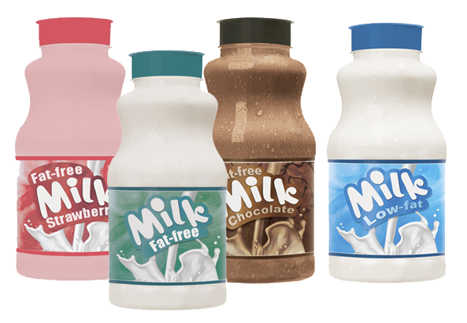
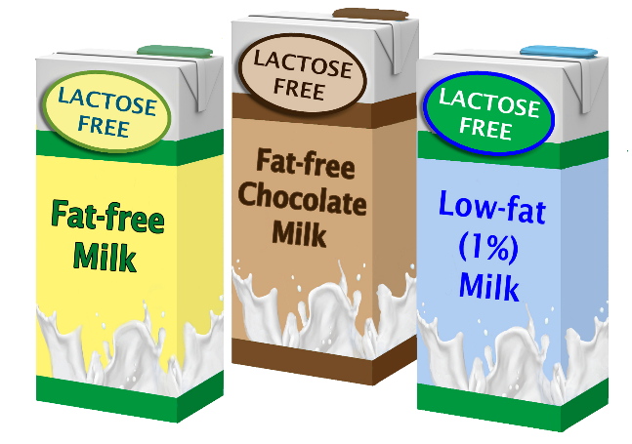
Allowable Milk Options
Must offer AT LEAST TWO different choices
  FAT-FREE (unflavored
  or flavored)
  LOW-FAT (unflavored only)
  Lactose-reduced or
  lactose-free FAT-FREE (unflavored or flavored)
  Lactose-reduced or lactose-free LOW-FAT (unflavored only)
Notes:
The daily requirement is 1 cup for all grades. The weekly milk quantity is 5 cups for a five-day week and 7 cups for a seven-day week. These are the minimum requirements. Larger amounts of milk may be served if meals do not exceed the weekly limits for calories, saturated fat and sodium.
Schools must offer at least two different milk choices, which include flavor variety and fat content. For example:
fat-free milk and fat-free chocolate milk;
low-fat milk and skim milk; or
nonfat milk, low-fat plain milk and fat-free chocolate and strawberry milk.
Allowable milk options for school meals include:
Fat-free (unflavored or flavored), also called “nonfat” or “skim” milk;
Low-fat (unflavored only);
Lactose-reduced or lactose-free fat-free (unflavored or flavored); and
Lactose-reduced or lactose-free low-fat (unflavored only).
Whole milk and reduced fat (2%) milk cannot be served. The only exemption is dietary accommodations for disabled children whose disability results in a special dietary need, documented by a medical statement signed by a licensed physician.
The milk requirements also apply to children ages 3-4 (preschoolers) in the NSLP.

Slide 19


Milk Substitutions
REQUIRED for children with disabilities (medical statement from physician)
OPTIONAL for children without disabilities (written parent request)
  lactose-free or lactose-reduced
  milk (unflavored low-fat or
  unflavored/flavored fat-free)
  nondairy milk substitutes that
  meet the USDA nutrition
  standards for fluid milk substitutes
www.sde.ct.gov/sde/lib/sde/pdf/deps/nutrition/nslp/crediting/milk_sub.pdf
Notes:
As a reminder, milk substitutions are required for children with disabilities, based on a medical statement from a recognized medical authority. These substitutions do not need to meet the meal pattern requirements for milk.
Schools have the option to offer milk substitutions for children without disabilities based on a written parent/guardian request that identifies the medical or other special dietary need that restricts the child’s diet. If schools choose to allow milk substitutions for children without disabilities, they must offer one or more of the following:
lactose-free or lactose-reduced milk (unflavored low-fat or unflavored/flavored fat-free); and
nondairy milk substitutes that meet the USDA nutrition standards for fluid milk substitutes.
Milk substitutes must meet the USDA nutrition standards for fluid milk substitutes. They must also be included in the weekly averages for the dietary specifications.
Schools should have a written policy for milk substitutions that is communicated to parents. Implementation of this policy must be consistent throughout the district.
INSTRUCTOR NOTES: A recognized medical authority is a state-licensed health care professional authorized to write medical prescriptions under state law, and recognized by the State Department of Public Health. In Connecticut, recognized medical authorities include physicians, physician assistants, doctors of osteopathy and advanced practice registered nurses (APRNs), i.e., nurse practitioners, clinical nurse specialists and certified nurse anesthetists who are licensed as APRNs. Child Nutrition Programs cannot accept medical statements that are not signed by one of the preceding recognized medical authorities. More information on the requirements for milk substitutions is available in the CSDE’s handout, Allowable Milk Substitutions for Nondisabled Children in the USDA School Nutrition Programs. It is available on the Web site shown on the bottom of this slide. Remind participants that the yellow bar at the bottom of the slide indicates a link to a resource reading the content addressed in that slide.

Slide 20

Milk Substitutions
Juice and water CANNOT be offered as milk substitutes for nondisabled children
Notes:
As a reminder, juice and water cannot be offered as milk substitutes for nondisabled children. They do not have the same nutritional value as milk.

Slide 21
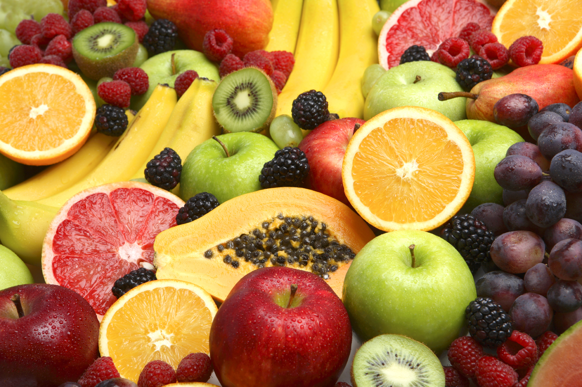
FRUITS COMPONENT
Notes:
That concludes our review of the milk component.
Ask participants: Before we move on to the fruits component, are there any questions about the milk component?

Slide 22
Fruits Component
Fruits at Breakfast (cups) *
Grades | FIVE-DAY WEEK |  | SEVEN-DAY WEEK
 | Daily | Weekly* | Daily | Weekly*
K-5 | 1 | 5 | 1 | 7
6-8 | 1 | 5 | 1 | 7
9-12 | 1 | 5 | 1 | 7
Includes vegetable substitutions that comply with requirements
Notes:
This chart shows the daily and weekly fruits requirements for each grade group over a five-day and seven-day week.
The daily fruits requirement is 1 cup for all grades.
The weekly fruits quantity is 5 cups for a five-day week and 7 cups for a seven-day week. These are the minimum requirements.
Larger amounts of fruits may be served if meals do not exceed the weekly limits for calories, saturated fat and sodium.
The fruits component at breakfast includes vegetable substitutions, if they meet specific requirements.

Slide 23
Allowable Fruits
Fresh
Frozen (with or without added sugar)
Canned in juice/light syrup
Dried
Notes:
Fruit may be offered in several different forms. These forms include fresh, frozen with or without added sugar, canned in juice or light syrup, and dried.
Frozen fruits with added sugar should be used in moderation to keep the average school meal within the weekly calorie ranges.
INSTRUCTOR NOTES:
The USDA regulations previously required that that frozen fruit was without added sugar, with an exemption allowed through school year 2014-15. However, in January 2014, the USDA made this exemption permanent (79 FR 327). Frozen fruit can contain added sugar.
.

Slide 24
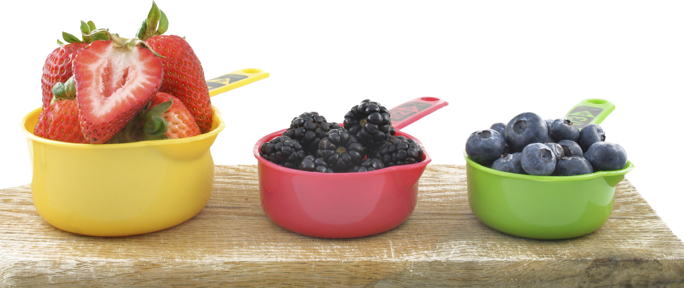
Serving Sizes of Fruits
Menu planner determines SERVING SIZES and NUMBER of servings
Minimum of ⅛ CUP to count toward daily total
Notes:
The menu planner determines the serving sizes and the number of servings of fruits needed to meet the meal pattern requirement (½ cup of fruits daily for grades K-5 and 6-8, and 1 cup of fruits daily for grades 9-12).
A minimum of ⅛ cup must be served to count toward the total requirements, with the rest of the minimum required portion coming from other fruits in the meal.
When we talk about offer versus serve later on, you will see that you may want to consider using ½-cup serving sizes as the basis for all fruits.

Slide 25
Serving Sizes of Fruits
Can offer COMBINATION of various fruits to meet daily total
All servings based on ACTUAL VOLUME SERVED, except dried fruit
Notes:
You can serve smaller portions of fruits to meet the total fruits requirement. For example, for grades K-5 and 6-8, you can choose to offer a combination of various fruits to total the required ½ cup serving of fruits, e.g., ¼ cup of peaches and ¼ cup of applesauce.
The menu planner determines the number of fruits offered, keeping in mind that the smallest creditable amount is ⅛ cup.
All servings are based on the actual volume served except for dried fruit. Volume is the measure of the space of food in a container (e.g., tablespoons, cups, pints, gallons) versus weight (e.g., ounces and pounds).

Slide 26
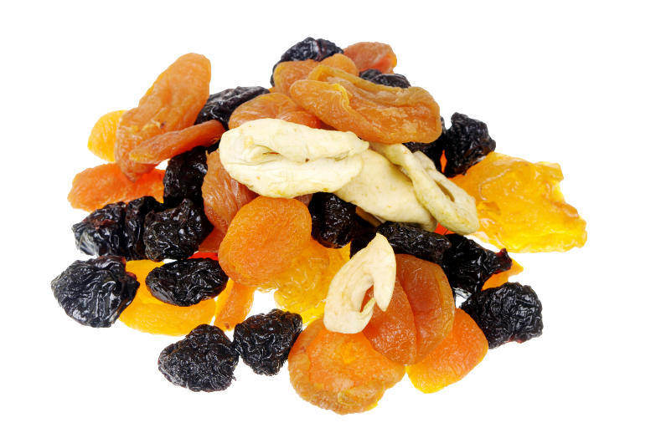
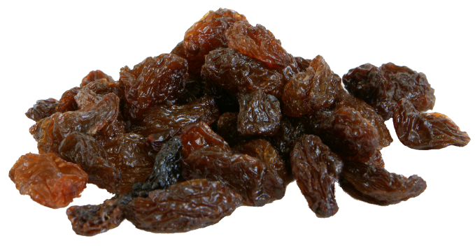
Dried Fruit
  Credits at TWICE the volume served
    ¼ cup of dried fruit equals ½ cup of the fruits component
    ½ cup of dried fruit equals 1 cup of the fruits component
Notes:
Dried fruit credits based on twice the volume served, e.g., ¼ cup of dried fruit equals
½ cup of the fruit component and ½ cup of dried fruit equals 1 cup of the fruit component.

Slide 27
Serving Sizes of Fruits
Larger amounts may be served if meals meet weekly DIETARY SPECIFICATIONS (limits for calories, saturated fat and sodium)
Notes:
Larger amounts of fruits may be served if the average weekly meals meet the dietary specifications (nutrition standards) for the specific grade group, including limits for calories, saturated fat and sodium and zero trans fat.
We will review the dietary specifications for school breakfasts in more detail later on.

Slide 28
Crediting Considerations for Fruits
  Pureed Fruits
  Fruit Juice
  Fruit Smoothies
Notes:
There are some additional considerations for determining how to count fruits toward the meal pattern requirements. Let’s look at the requirements for pureed fruits, fruit juice and fruit smoothies.

Slide 29
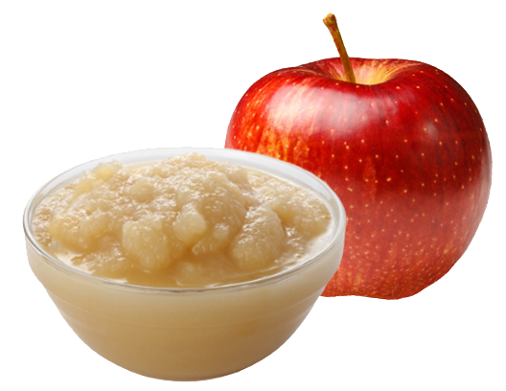
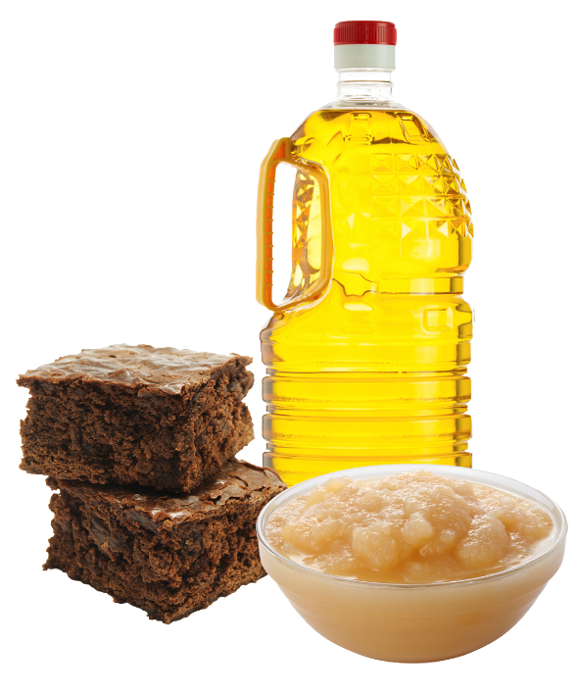
Pureed Fruits
Must be RECOGNIZABLE,
e.g., pureed foods made
from ONE fruit such as
applesauce
Do NOT credit when used to improve the NUTRIENT PROFILE of a food, e.g., applesauce used to replace oil in muffins
Notes:
Pureed foods made from one fruit such as applesauce are recognizable creditable fruits and can count toward the fruits component if the serving size is at least ⅛ cup of fruit (the minimum creditable amount). Pureed fruit credits based on the actual volume served.
For example, we measure applesauce based on the amount that fills up ½ cup by volume, not the amount of apples needed to make the applesauce.
Pureed fruit does not credit toward the fruits component when it is used to improve the nutrient profile of a food, such as applesauce used to replace the oil in muffins.
The USDA emphasizes the importance of the nutrition education aspect of school nutrition programs, which includes the goal of helping children easily recognize the key food groups that contribute to a healthy meal.

Slide 30

Fruit Juice
Must be pasteurized 100%
FULL-STRENGTH fruit juice without added sugar
  100% juice
  (not from concentrate)
  100% juice from concentrate
Juice concentrates cannot credit when used as an INGREDIENT in foods or beverages
Notes:
Fruit juice must be pasteurized 100 percent full-strength juice and can be either 100% juice not from concentrate or 100 percent juice from concentrate.
Ask participants: How do you know that a juice is 100 percent? Look for the name of the full-strength fruit juice on the label to include the words “juice” or “full-strength juice” or “100 percent juice” or “reconstituted juice” or “juice from concentrate.”
Juice concentrates can be used only when reconstituted with water to 100 percent full-strength juice and can be credited in the forms of liquid or frozen juice only. Therefore, juice cannot credit toward the fruits component when used as an ingredient in another food or beverage product.
For example, gelatin made with juice concentrate and water does not credit as juice since the fruit juice is no longer in the form of liquid or frozen juice. The Food Buying Guide provides additional crediting information.

Slide 31
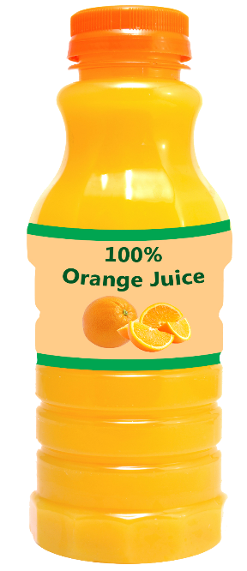
Weekly Juice Limit for Breakfast
Limited to no more than HALF of weekly fruit offerings
½ cup can be served DAILY
All Grades
Length of Week | Required Weekly Fruit Servings | Maximum Weekly Juice Contribution *
Five Days | 5 cups | 2 ½ cups
Seven Days | 7 cups | 3 ½ cups
* Includes all fruit and vegetable juice
Notes:
No more than half of the weekly fruit offerings may be in the form of juice. This chart shows the maximum weekly contribution of fruit juice for all grade groups based on the daily meal pattern requirement for 1 cup of fruits.
For a five-day week, juice cannot count for more than 2 ½ cups.
For a seven-day week (e.g., residential child care institutions), juice cannot count for more than 3 ½ cups.
Since the minimum daily fruits requirement is 1 cup for all grades, this means that schools can offer ½ cup of juice daily as part of assorted fruit choices at breakfast. However, remember that whole fruits and vegetables provide more nutrition than juice and should be served most often, as recommended by the Dietary Guidelines.
If a school served more than 1 cup of fruits daily, the maximum amount of juice that can be served also increases. For example:
if the menu planner offers 1 ½ cups of fruits daily, then ¾ cup (6 fluid ounces) of juice could be served daily; and
if the menu planner offers 2 cups of fruits daily, then 1 cup (8 fluid ounces) of juice could be served daily.
INSTRUCTOR NOTES: If there are no participants from RCCIs, do not review the information for seven-day weeks.

Slide 32

Juice Limit Includes
Fresh, frozen and made
from concentrate
Frozen juice pops made
from 100 percent juice
Pureed fruits/vegetables
in fruit/vegetable smoothies
Juice from canned fruit served in 100 percent juice, unless the canned fruit is drained
Notes:
The weekly juice limit is calculated based on the amount of fruits that students are allowed to select at a given meal, regardless of the number of options or variety of fruits available.
Menu planners must calculate the menu’s compliance with the weekly juice limit separately for fruits by dividing the total weekly amount of fruit juice that students can select by the total weekly fruit offerings.
When calculating the total amount of juice that students can select, menu planners must count all sources of 100 percent juice served during the week. This includes:
juice that is fresh, frozen or made from concentrate;
frozen juice pops made from 100 percent juice;
pureed fruits or vegetables in fruit/vegetable smoothies; and
juice from canned fruit served in 100 percent juice, unless the canned fruit is drained.
Canned fruit in light syrup or water does not count toward the weekly juice limit.

Slide 33
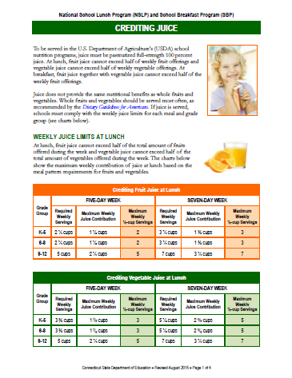
Crediting Juice
www.sde.ct.gov/sde/lib/sde/pdf/deps/nutrition/nslp/crediting/credit_juice.pdf
Notes:
The CSDE’s Crediting Juice handout provides guidance on crediting juice in the NSLP and SBP. It is available on the CSDE’s Meal Patterns Web page, at the link indicated on the slide.

Slide 34
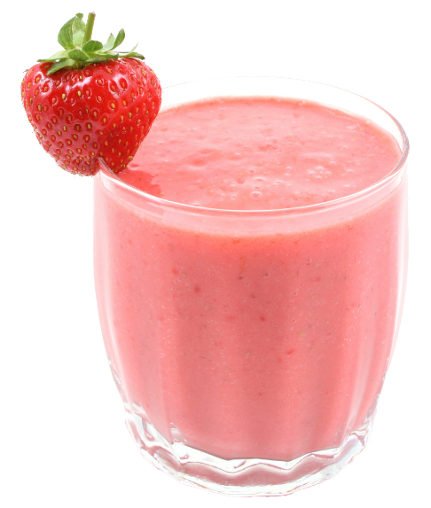
School-made Fruit Smoothies
Milk must be low-fat (1%) unflavored or fat-free
unflavored or flavored
  Credits as fluid MILK if 1 cup
  Must still offer MILK VARIETY
  on serving line
Pureed fruits/vegetables credit only as JUICE, based on volume of pureed fruits/vegetables
  Counts toward weekly juice limit
Notes:
Ask participants: How many of you currently serve school-made smoothies as part of reimbursable school meals or would like to serve them in the future?
There are specific crediting requirements for school-made smoothies, which can be either pre-made or made to order. If school-made smoothies consist of pureed fruits/vegetables mixed with milk, it must be low-fat (1%) unflavored or fat-free unflavored or flavored. The milk may credit toward the fluid milk requirement at lunch if it is the full serving (1 cup). Amounts less than 1 cup do not credit. When smoothies are offered on the serving line in school meal programs, the fluid milk component must also be offered on the serving line to meet the requirement for a variety of milk options for the NSLP.
Pureed fruits/vegetables in school-made smoothies credit only as juice toward the daily and weekly meal pattern requirements for fruits/vegetables. Crediting is based on the actual volume of pureed fruits/vegetables per serving, as documented by the standardized recipe. Menu planners must count pureed fruits/vegetables in beverages with all other juices toward the weekly juice limit (no more than half of the weekly fruits/vegetables component).
INSTRUCTOR NOTES: If no one serves smoothies as part of reimbursable meals, skip the next three slides on smoothies and let participants know they can refer back to these slides if they choose to serve smoothies in the future. CSDE Operational Memorandum 13-154, February 10, 2015, describes the requirements for crediting smoothies. It is available on the CSDE’s Operational Memo Web page, at the link indicated on the slide.

Slide 35
School-made Fruit Smoothies
Yogurt and soy yogurt credit
as MEAT ALTERNATE
Other ingredients CANNOT
credit but must count toward
weekly dietary specifications
  Grains such as oatmeal
  Other M/MA, e.g., peanut butter
Operational Memorandum 13-15: www.sde.ct.gov/sde/LIB/sde/pdf/DEPS/Nutrition/OPmemos/15/OM_13-15.pdf
Questions and Answers Regarding Crediting of Smoothies in Child Nutrition Programs www.sde.ct.gov/sde/LIB/sde/pdf/deps/nutrition/nslp/crediting/QASmoothies.pdf
Notes:
Yogurt and soy yogurt in school-made smoothies credit as a meat alternate at breakfast and lunch.
Grains and meat/meat alternates (except yogurt during breakfast service) cannot credit when served in smoothies.
Schools can include additional ingredients in smoothies such as grains (e.g., oatmeal) and meat/meat alternates (e.g., peanut butter) to improve flavor and consistency. While these ingredients cannot count toward the meal pattern requirements they must count toward the dietary specifications. They must contain zero trans fat and their inclusion cannot cause the menu to exceed the average weekly limits for calories, saturated fat and sodium.

Slide 36
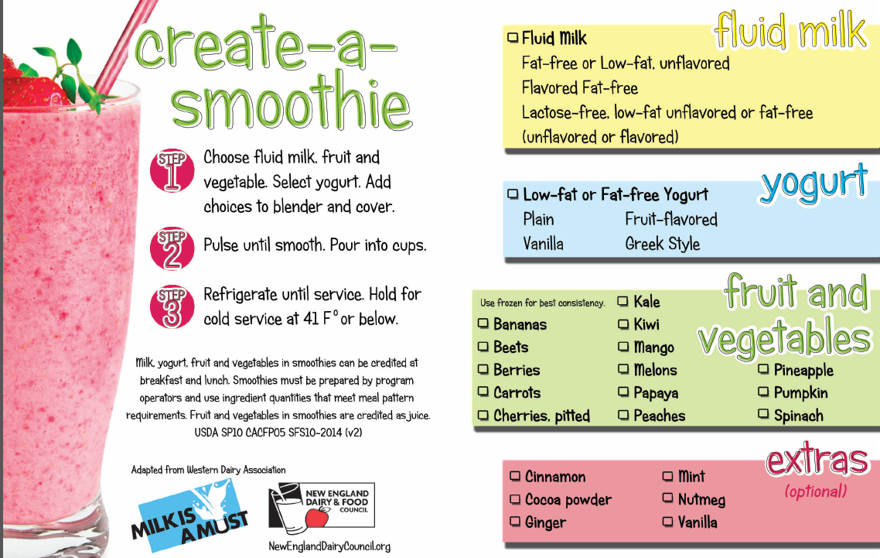
Smoothie Recipe Booklet
www.newenglanddairycouncil.org/media/SmoothieRecipeBooklet2015.pdf
Notes:
The New England Dairy & Food Council (NEDFC) has a smoothie recipe booklet with useful information and recipes for creating your own school-make smoothies. You can download this information from the link indicated on this slide.

Slide 37
School-made Fruit Smoothies
Must INFORM students about the components included by listing the type of smoothie on the menu and serving line signage
TODAY’S MENU
Strawberry and
yogurt smoothie
Notes:
The school meal regulations require schools to identify the food components offered to students. Schools serving smoothies should inform students about the components included by listing the type of smoothie on the menu and serving line signage, e.g., “strawberry and yogurt smoothie.”
INSTRUCTOR NOTES:
Commercial smoothies do not meet the USDA requirements for fluid milk or yogurt because they do not comply with the FDA’s standard of identity for milk or yogurt. Commercial smoothies made with pureed fruit may credit only toward the fruits component, counting only as juice. The product label should include a statement regarding the “percent juice content,” which is required by the Food and Drug Administration(FDA) for beverages made with fruit puree.

Slide 38
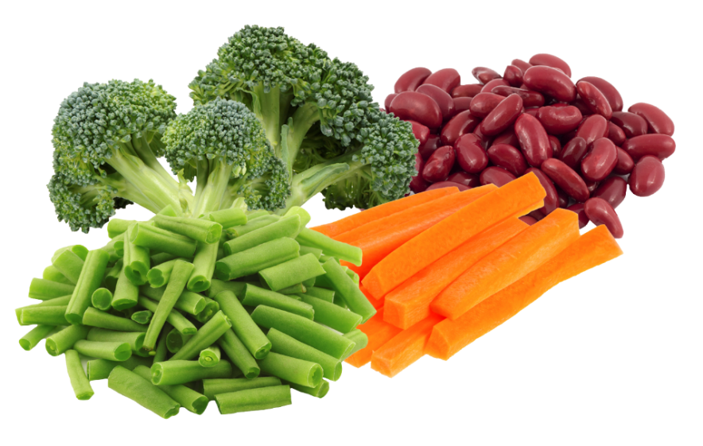
Vegetable Substitutions
May be substituted for fruit if at least 2 CUPS per week are from
  dark green subgroup
  red/orange subgroup
  beans and peas
  (legumes) subgroup
  “other” subgroup
May offer starchy vegetables if weekly menu includes AT LEAST 2 CUPS of nonstarchy vegetables
Notes:
Vegetables may be substituted for fruits at breakfast if at least two cups per week are from the dark green, red/orange, beans and peas (legumes) or “other” vegetable subgroups.
Starchy vegetables may be offered on any day if the weekly menu includes at least two cups of nonstarchy vegetables.
These are the same five subgroups found in the lunch meal pattern.
INSTRUCTOR NOTES:
If the breakfast menu meets all meal pattern requirements, schools may offer starchy vegetables (such as hash browns) as an extra if the menu fits within the weekly dietary specifications. Vegetables offered as extras (not as a substitute for fruits) do not need to meet the SBP requirement to offer at least two cups of nonstarchy vegetables when substituting vegetables for fruits. In addition, vegetables that are offered as extras do not count as a food item for OVS. This means that students who choose hash browns as an extra item must have three other breakfast items on the tray for a reimbursable meal, including at least ½ cup of fruits.

Slide 39
Vegetables at Breakfast Sample Menu
Monday | Tuesday | Wednesday | Thursday | Friday
CHOOSE 1 | CHOOSE 1 | CHOOSE 1 | CHOOSE 1 | CHOOSE 1
Hard-boiled egg with whole-wheat toast OR Whole-grain cereal and mini corn muffin | WGR French toast Sticks with syrup OR Whole-grain cereal and graham Crackers | Breakfast burrito OR Whole-grain pancakes with strawberry sauce | Peach smoothie* with whole-grain muffin *Try our new breakfast smoothie made with fruit, milk and yogurt! OR Whole-grain cereal and whole-wheat toast | Whole-wheat sesame bagel with cream cheese OR Apple cinnamon oatmeal
CHOOSE 1 OR 2 (Limit of 1 juice) | CHOOSE 1 OR 2 (Limit of 1 juice) | CHOOSE 1 OR 2 (Limit of 1 juice) | CHOOSE 1 OR 2 (Limit of 1 juice) | CHOOSE 1 OR 2 (Limit of 1 juice)
Orange juice Assorted fruits Hash brown potatoes | Fruit cup Orange wedges Carrot sticks | Salsa Banana Apple juice | Applesauce Raisins Celery sticks with hummus dip | Cucumber slices Melon wedge Assorted fruit juice
CHOOSE 1 | CHOOSE 1 | CHOOSE 1 | CHOOSE 1 | CHOOSE 1
Milk Choice * | Milk Choice * | Milk Choice * | Milk Choice * | Milk Choice *
* Low-fat (1%) unflavored or fat-free unflavored or flavored milk
Take at least one fruit or vegetable each day to make a meal!
Notes:
This slide shows an example of a breakfast menu that includes vegetable substitutions.
Notice in this example that the hash brown potatoes (starchy vegetables) are offered on Monday and the nonstarchy vegetables are offered on Tuesday through Friday.
You can offer starchy vegetables on any day of the week as long as the remaining days of the week include at least 2 cups of nonstarchy vegetables.

Slide 40
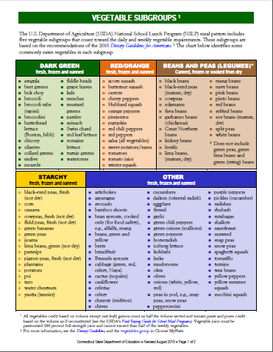
Vegetable Subgroups
www.sde.ct.gov/sde/lib/sde/pdf/deps/nutrition/nslp/crediting/vegetable_groups.pdf
Notes:
The CSDE’s Vegetable Subgroups handout provides information on what vegetables belong to each subgroup. It is available at the link indicated on this slide.

Slide 41
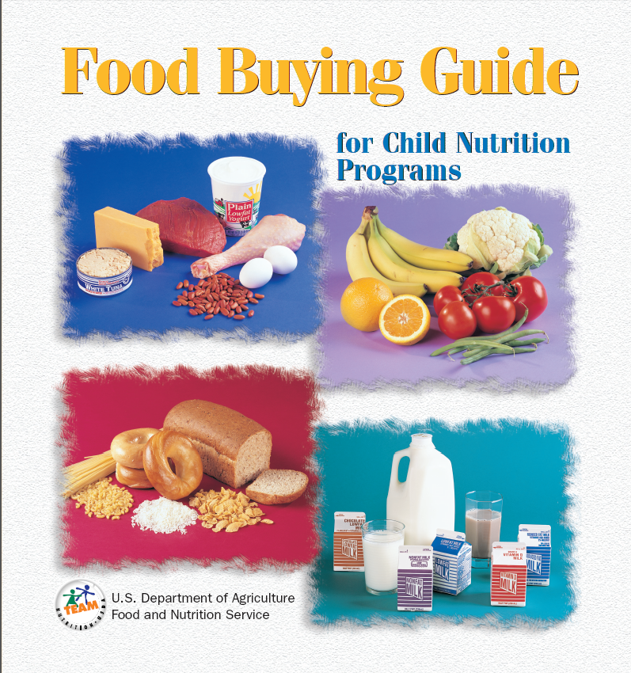
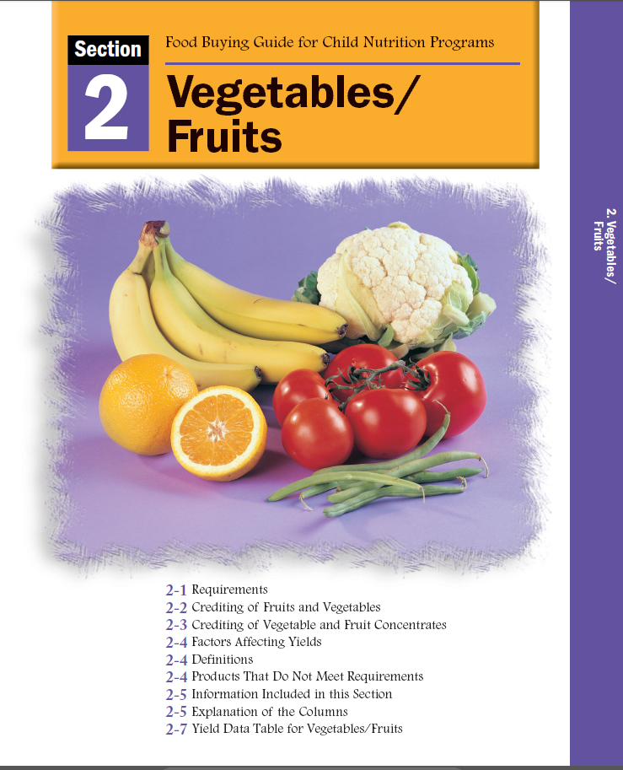
Crediting Information for Fruits
Revised online sections to separate fruits and vegetables
www.fns.usda.gov/tn/food-buying-guide-school-meal-programs
Notes:
Menu planners should use the USDA’s Food Buying Guide for Child Nutrition Programs to determine how to credit fruits.
Ask participants: For example, how do you know how much of an orange to serve to provide ½ cup of fruit? If you put orange wedges in a 5.5-ounce souffle cup you are NOT meeting the ½ cup requirement unless you are serving the entire orange and it is the correct size.
One orange is not necessarily ½ cup of fruit. It depends on the size of the fruit. The Food Buying Guide tells us that a 138-count orange equals ½ cup of fruit and a
125-count orange or 113-count orange equals 5/8 cup of fruit. The Food Buying Guide also tells us that there is no whole orange that provides a full 1 cup of fruit.

Slide 42
Crediting Information for Vegetables
Revised online sections to separate vegetables and fruits
www.fns.usda.gov/tn/food-buying-guide-school-meal-programs
Notes:
Remember that menu planners should use the USDA’s Food Buying Guide for Child Nutrition Programs to determine how to credit vegetables.

Slide 43


Menu Planning Quiz for Fruits
Does each planned serving count as ½ cup of the FRUITS component?
Product 1
Worksheet 1
½ cup of fresh fruit
YES
Notes:
Take out worksheet 1 – Menu Planning Quiz for Fruits and Vegetables. For this activity, we are only working with Part 1 (fruits). We will get to part 2 (vegetables) later on.
We will take this quiz together as a group.
For each ½-cup serving of fruit listed, indicate whether it counts as ½ cup of fruit.
INSTRUCTOR NOTES:
Do this activity with all participants together as one large group. Read each item, e.g., “1/2 cup of fresh fruit,” then wait for participants to answer. After they have answered, click to bring in the answer on the slide.
Refer to answer key for worksheet 1.

Slide 44

Menu Planning Quiz for Fruits
Does each planned serving count as ½ cup of the FRUITS component?
Product 2
Worksheet 1
½ cup of canned fruit in juice
YES

Slide 45
Menu Planning Quiz for Fruits
Does each planned serving count as ½ cup of the FRUITS component?
Product 3
Worksheet 1
½ cup of canned fruit in light syrup
YES

Slide 46
Menu Planning Quiz for Fruits
Does each planned serving count as ½ cup of the FRUITS component?
Product 4
Worksheet 1
½ cup of canned fruit in heavy syrup
No
  Canned fruit must be in juice or light syrup

Slide 47
Menu Planning Quiz for Fruits
Does each planned serving count as ½ cup of the FRUITS component?
Product 5
Worksheet 1
½ cup of dried fruit
No
  Dried fruit counts as TWICE the volume served (½ cup equals 1 cup)

Slide 48
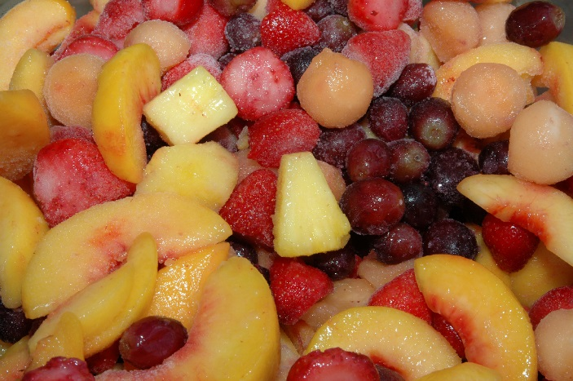
Menu Planning Quiz for Fruits
Does each planned serving count as ½ cup of the FRUITS component?
Product 6
Worksheet 1
½ cup of frozen fruit without added sugar
YES

Slide 49
Menu Planning Quiz for Fruits
Does each planned serving count as ½ cup of the FRUITS component?
Product 7
Worksheet 1
½ cup of frozen fruit with added sugar
YES

Slide 50

Menu Planning Quiz for Fruits
Does each planned serving count as ½ cup of the FRUITS component?
Product 8
Worksheet 1
½ cup of fruit juice
YES
  However, juice cannot count for more than HALF of the weekly fruits component

Slide 51
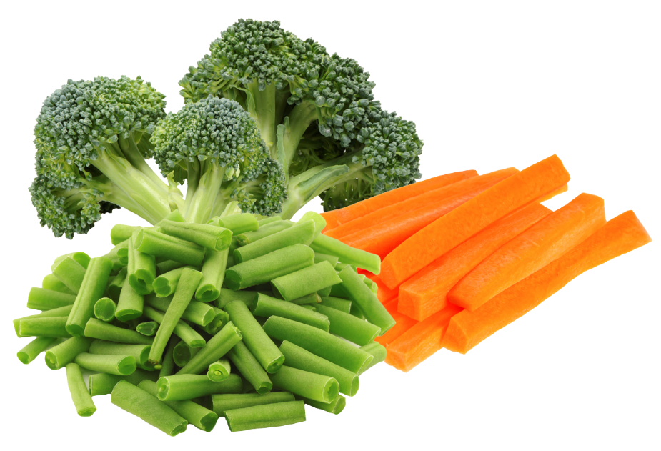
Menu Planning Quiz for Fruits
Does each planned serving count as ½ cup of the FRUITS component?
Product 9
Worksheet 1
½ cup of red/orange, dark green or “other” fresh, frozen or canned vegetables
YES

Slide 52
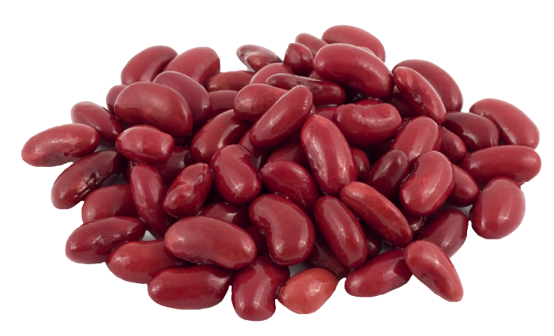
Menu Planning Quiz for Fruits
Does each planned serving count as ½ cup of the FRUITS component?
Product 10
Worksheet 1
½ cup of legumes, e.g., kidney beans, black beans
YES

Slide 53
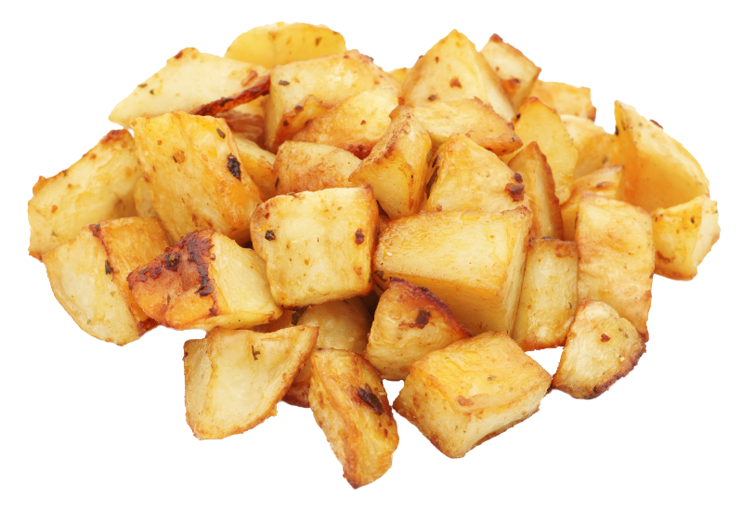
Menu Planning Quiz for Fruits
Does each planned serving count as ½ cup of the FRUITS component?
Product 11
Worksheet 1
½ cup of potatoes, e.g., hash browns
YES
  However, only if weekly menu includes AT LEAST 2 CUPS of NONSTARCHY vegetables

Slide 54
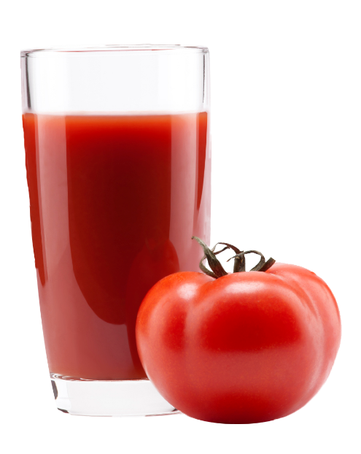
Menu Planning Quiz for Fruits
Does each planned serving count as ½ cup of the FRUITS component?
Product 12
Worksheet 1
½ cup of vegetable juice
YES
  However, the combined total of all juice (fruit and vegetable) cannot be more than HALF of the weekly fruits component

Slide 55
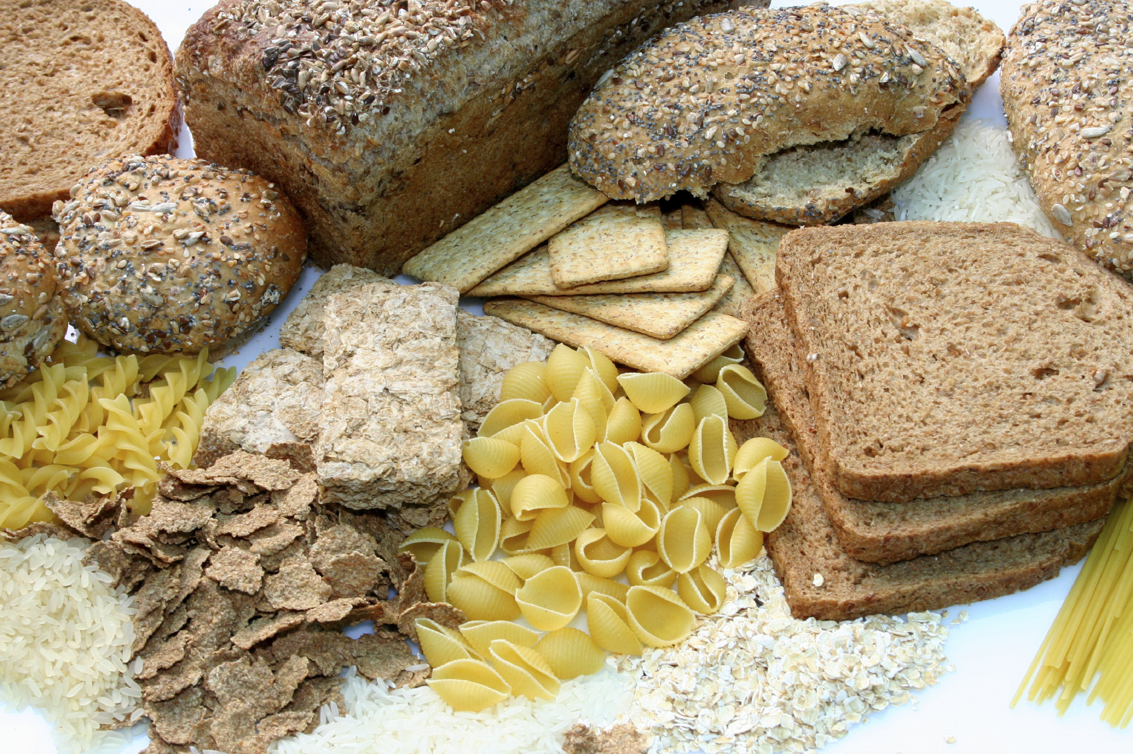
GRAINS COMPONENT
Notes:
Ask participants: Before we move on to the grains component, what questions do you have about the vegetables component?
The grains component is the most challenging meal component to understand because it is more complicated than the other components. Today, we will focus on the basic requirements for crediting grains but we will not be doing any grains crediting calculations.
Two important handouts for you to consult include the CSDE’s handouts, “Criteria for Whole Grain-rich Foods” and the USDA Whole Grain-rich Ounce Equivalents chart (next two slides). You have these handouts included in your handout packets.
For more information, you can consult the grains section of the CSDE’s Menu Planning Guide for School Meals. This resource is listed on your handout, “Resources for School Meals.”

Slide 56
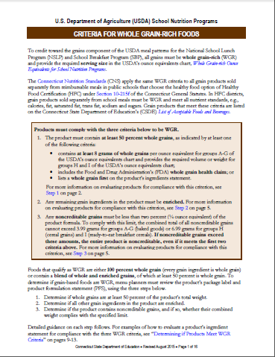
Criteria for Whole Grain-rich Foods
www.sde.ct.gov/sde/lib/sde/pdf/deps/nutrition/nslp/crediting/wgrcriteria.pdf
Notes:
This slide shows the CSDE’s handout, “Criteria for Whole Grain-rich Foods,” which summarizes the criteria for determining whether a food meets the USDA whole grain-rich requirement. It is available on the CSDE’s Crediting Foods Web page, at the link indicated on this slide.

Slide 57
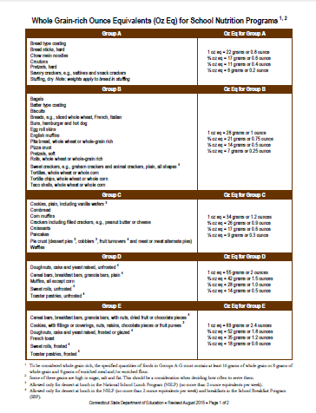
Whole Grain-rich Ounce Equivalents
www.sde.ct.gov/sde/lib/sde/pdf/deps/nutrition/nslp/crediting/grainsozeq.pdf
Notes:
This slide shows the ounce equivalents chart. You have it as a handout in your packets, and it is available on the CSDE’s Crediting Foods Web page, at the link indicated on this slide.

Slide 58
Grains Component
Grains at Breakfast (Oz Eq) All grains must be whole grain-rich
Grades | FIVE-DAY WEEK |  | SEVEN-DAY WEEK
 | Daily | Weekly* | Daily | Weekly*
K-5 | 1 | 7-10 | 1 | 10-14
6-8 | 1 | 8-10 | 1 | 11-14
9-12 | 1 | 9-10 | 1 | 12.5-14
* Must meet weekly minimum but not maximum
Notes:
This chart shows the daily and weekly grain requirements for five-day and seven-day weeks. Effective with school year 2014-15, all grains must be WGR.
The daily requirement is 1 ounce equivalent for all grades.
The weekly requirement for a five-day week is a minimum of 7 ounce equivalents for grades K-5, 8 ounce equivalents for grades 6-8 and 9 ounce equivalents for grades 9-12. The weekly requirement for a seven-day week is a minimum of 10 ounce equivalents for grades K-5, 11 ounce equivalents for grades 6-8 and 12.5 ounce equivalents for grades 9-12.
On some days menu planners must include more than 1 ounce equivalent so the weekly menus meet the minimum weekly requirement. For example, for a five-day week, offering 1 ounce equivalent every day provides 5 ounce equivalents weekly, which is below the minimum weekly requirement of 7 ounce equivalents.
Schools cannot offer less than the minimum weekly grains requirement but the maximums are not required. You will still see them on the meal pattern because the regulations for the meal pattern have not changed. Schools should continue to use the weekly maximums as a planning tool to assist in offering balanced meals that meet the calorie, sodium and saturated fat requirements. If menus are planned to regularly include larger amounts of grains, they might not comply with the weekly calorie limits and dietary specifications.
INSTRUCTOR NOTES: If there are no participants from RCCIs, do not review the information for seven-day weeks.

Slide 59
Two Requirements for Grain Products
  Must be WHOLE GRAIN-RICH (WGR)
    100% whole grain
    At least 50% whole grain
  Must meet MINIMUM serving size
Notes:
There are two requirements that all grains must meet to be served in the SBP.
All grains offered at breakfast must be WGR. WGR foods include products that are 100 percent whole grain (every grain in the product is a whole grain) and products that are at least 50 percent whole grain.
Products that are at least 50 percent whole grain must also meet some additional requirements to be considered WGR, which we will review in a minute.
In addition, all grains must meet the minimum serving sizes specified in the SBP meal pattern. We will look at each of these requirements in more detail.

Slide 60
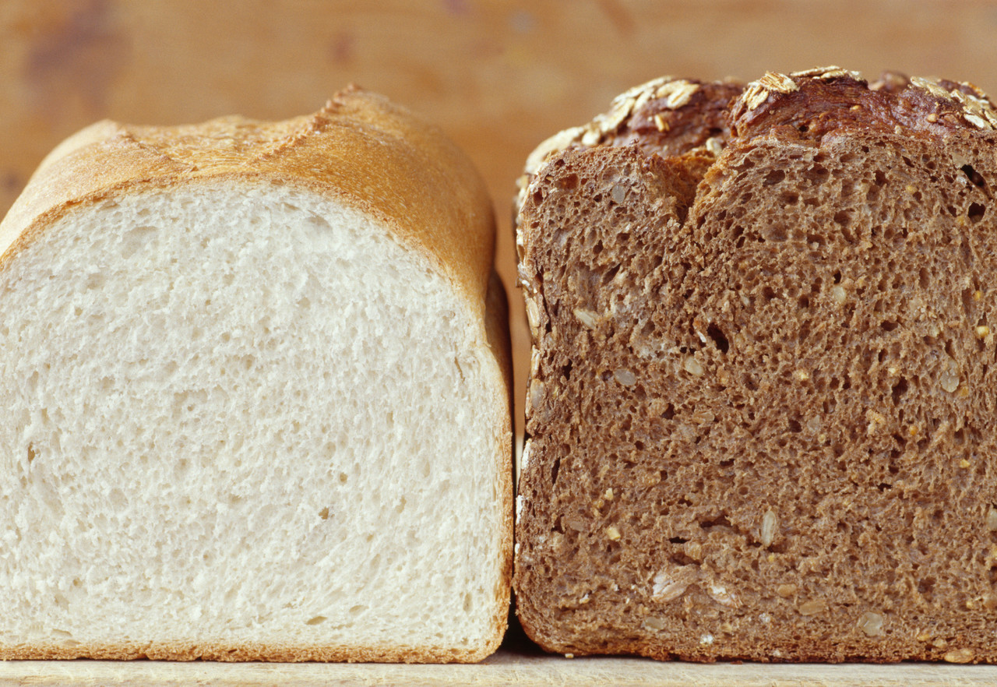
WGR Definition
  AT LEAST 50% whole grains by weight
    whole grain is FIRST ingredient
    if WATER is first ingredient, whole grain
    is SECOND ingredient
  Any other grain ingredients are ENRICHED
  Any noncreditable grains are LESS THAN 2%
Notes:
It is important to understand the USDA definition of WGR so you can identify grain products that comply with this requirement. To meet the definition of WGR, a grain product must meet three criteria:
Contains at least 50 percent whole grains by weight. This means that a whole grain is the first ingredient or if water is the first ingredient, the second ingredient must be a whole grain.
Any remaining grain ingredients are enriched.
Any noncreditable grain ingredients are less than 2 percent of the product formula.
The product must meet all three criteria to be considered whole grain-rich. Let’s take a look at each of these three criteria in more detail.

Slide 61
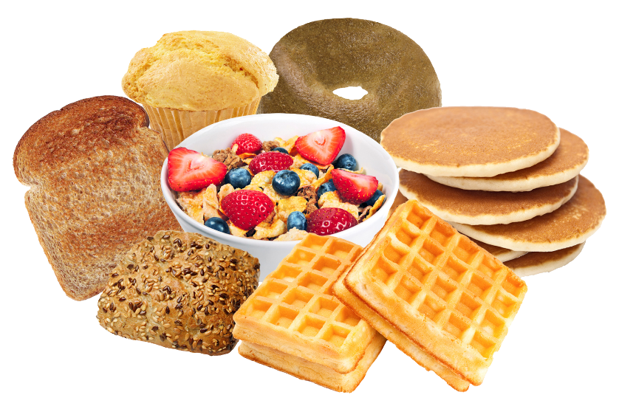

WGR Definition Criterion 1
At least 50% WHOLE GRAINS
  GRAIN-BASED PRODUCTS,
  e.g., breads, cereals,
  waffles, muffins
  Whole grain is FIRST
  ingredient listed
  COMBINATION FOODS, e.g., breakfast burrito and
  breakfast pizza
    Whole grain is FIRST GRAIN ingredient listed
Notes:
The first criterion is that the product contains at least 50 percent whole grains by weight. There are several methods to determine whether a product is at least 50 percent whole grains, but we will focus on the easiest and most practical method. This method is what we recommend schools use.
If a product lists a whole grain first on the product’s ingredients statement, with an exception for water, it contains at least 50 percent whole grains. The USDA allows an exemption for the definition of whole-grain products. If the first ingredient of a grain product is water, a whole grain may be listed as the second ingredient and still meet the whole grain-rich criteria. This is based on the Dietary Guidelines definition of whole grain-rich products.
If the food item is a grain-based product (such as breads, cereals, waffles and muffins), it must have a whole grain listed as the first ingredient by weight on the ingredient label.
If the food item is a mixed dish product (such as pizza, lasagna or breaded chicken nuggets) a whole grain must be the primary grain ingredient by weight. In other words, a whole grain is the first GRAIN ingredient that appears in the list after any other nongrain ingredients.

Slide 62
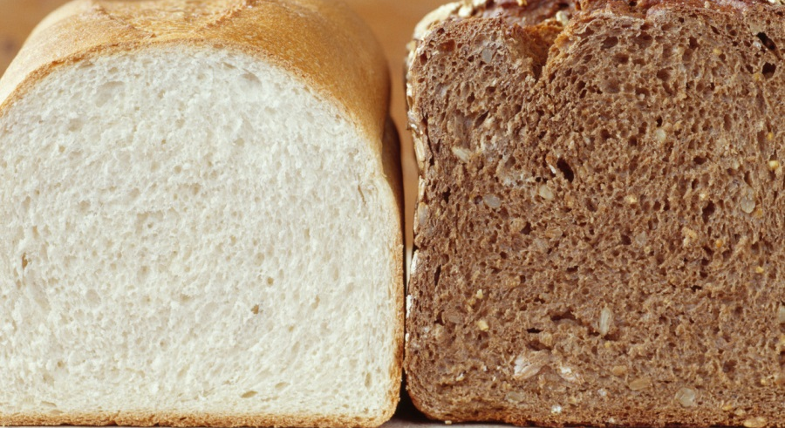
Is it a Whole Grain?
  Look for the word
  “WHOLE” e.g., whole
  corn, whole rye,
  whole-wheat flour
Grains without “whole” are usually not whole grains, e.g., corn, rye flour, wheat flour
  Require manufacturer documentation (PFS)
  EXCEPTIONS: Some grains do not state “whole” but are whole grains
Notes:
Ask participants: What are whole grains? Whole grains are grains that consist of the entire kernel, including the starchy endosperm, the fiber-rich bran and the germ. Whole grains are nutrient rich, containing vitamins, minerals, fiber and antioxidants. All grains start out as whole grains, but many are processed to remove the bran and germ (e.g., white bread, white rice), which also removes many of the nutrients.
How do you determine whether a grain is a whole grain? Labeling and advertising is often confusing and misleading, making people think that many foods are whole grain when they are not. Careful label reading is needed.
If a grain is listed in the ingredient statement without the word “whole,” the product might not be whole grain, e.g., corn, rye flour and wheat flour. The menu planner must obtain additional information from the manufacturer to determine if grains with these terms are whole grains.
If you see “whole” corn, “whole” rye flour and “whole” wheat flour, you know it is a whole grain. If you don’t see the word “whole,” you will need additional documentation from the manufacturer to determine if these grains are whole, i.e., a product formulation statement (PFS).

Slide 63
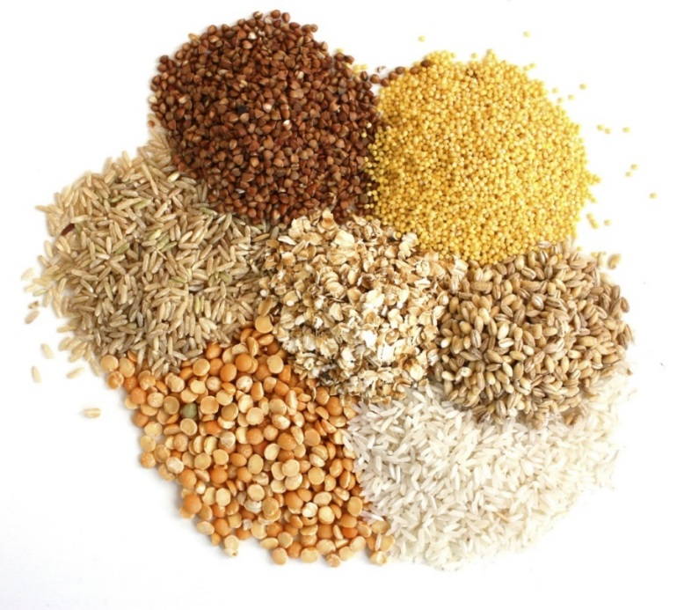
Examples of Exceptions*
BERRIES or GROATS (e.g., wheat berries or oat groats) OATS or OATMEAL (old-fashioned, quick-cooking, instant) Amaranth Brown rice Brown rice flour Buckwheat Graham flour Millet Quinoa Triticale Teff Sorghum
* These grains do not state “whole” in their description but they are whole grains
Notes:
However, there are exceptions. Some grain products do not state “whole” in their description but they are whole grains. These include the grain ingredients listed on this slide, such as oat groats, brown rice, millet and quinoa.
INSTRUCTOR NOTES: Mention just a few examples. Do not review all of the grains on the slide.

Slide 64
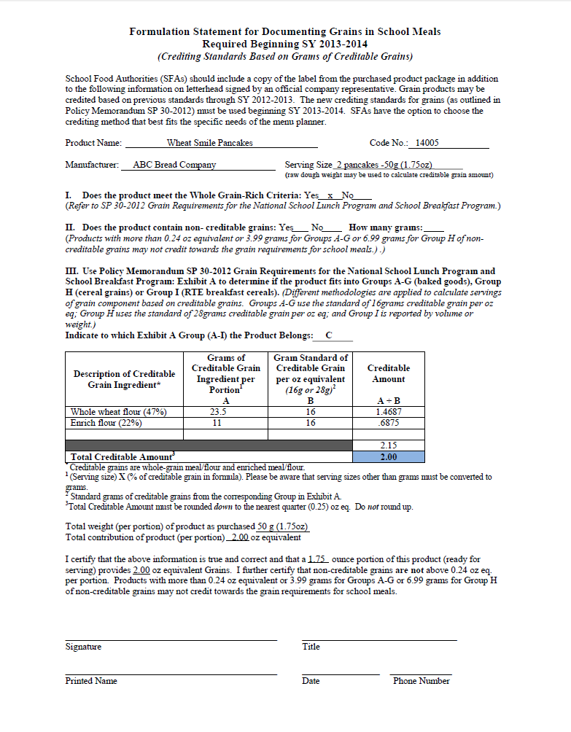
USDA Product Formulation Statement (PFS) for Grains
http://www.sde.ct.gov/sde/cwp/view.asp?a=2626&q=333796
Notes:
Ask participants: How many of you are familiar with product formulation statements? What is the difference between it and a Child Nutrition (CN) label?
This slide shows the USDA’s sample PFS for grains. Product formulation statements are developed by manufacturers to provide specific information about their products. They generally include a detailed explanation of what the product contains and the amount of each ingredient in the product by weight. However, unlike CN labels:
there is no standard information required for product formulation statements (each company can decide what to include);
they are not approved or monitored by the USDA; and
they do not provide any warranty against audit claims for reimbursable meals.
Product formulation statements are available for many types of food products. CN label are only for meat/meat alternate products, but can include information on grains, fruits and vegetables if they are part of the meat/meat alternate product.
There is a packet of all the USDA sample product formulation statements on your table. The USDA has developed product formulation statements with completed samples for the grains, meat/meat alternates, vegetables and fruits. If you receive a PFS from a manufacturer, it must include the same information on the USDA sample PFS forms. These are available on the USDA’s Web site, which you can link to from the CSDE’s Crediting Foods Web page at the address indicated on the bottom of the slide.

Slide 65
Whole Grain or Not Whole Grain?
That is the question….
Worksheet 2
Amaranth
Brown rice
Buckwheat groats
Bulgur (cracked wheat)
Cornmeal
Couscous
Degerminated cornmeal
Graham flour
Grits
Instant oatmeal
Long-grain white rice
Yes
Yes
Yes
Yes
No
No
No
Yes
No
Yes
No
Notes:
It is important for menu planners to be able to read ingredients and identify whole grains. Let’s see how well we do at identifying whether these terms are whole grains or not. We will take this quiz together as a group.
Take out worksheet 3 – Whole Grain or Not Whole Grain. For each grain listed, we will indicate either “yes” it is a whole grain, or “no” it is not a whole grain.
INSTRUCTOR NOTES:
Do this activity with all participants together as one large group. Read each term and ask participants to indicate “yes,” it’s a whole grain or “no,” it is not whole grain.
Refer to answer key for worksheet 2. In the interest of keeping to the time schedule, don’t review the entire explanation for each term unless someone asks for more information.
Modification: If time is short, select a few of the questions.

Slide 66
Whole Grain or Not Whole Grain?
That is the question….
Worksheet 2
Millet flakes
Pearled (pearl) barley
Quinoa
Rolled oats
Rye berries
Semolina
Wheat flour
White whole-wheat flour
Whole-grain barley
Whole-wheat flour
Yes
No
Yes
Yes
Yes
No
No
Yes
Yes
Yes

Slide 67
Examples of Whole-Grain Products and Ingredients *
BARLEY dehulled barley dehulled-barley flour whole barley whole-barley flakes whole-barley flour whole-grain barley whole-grain barley flour BROWN RICE brown rice brown rice flour | CORN masa (whole corn treated with lime) whole corn whole-corn flour whole cornmeal whole-grain corn flour whole-grain grits whole-ground corn OATS oat groats oatmeal, including old-fashioned, quick-cooking and instant rolled oats whole oats whole-oat flour | RYE whole rye rye berries whole-rye flour whole-rye flakes
* This list is not all-inclusive
Notes:
This chart lists examples of grain products and ingredients that are whole grains. This list may not contain all possible representations of whole grain ingredient names on food labels.
If one of these terms is listed first on the ingredients statement, the product meets the requirement for at least 50 percent whole grain.
If a whole grain is not the first ingredient but the combined weight of all whole grain ingredients is more than the weight of the first ingredient, the product meets the requirement for at least 50 percent whole grains.
To be whole grain-rich, remember that the product must also meet the other two requirements (any other grains are enriched and any noncreditable grains are less than 2 percent).
This information is contained in the CSDE’s handout, “Criteria for Whole Grain-rich Foods,” which summarizes the criteria for determining whether a food meets the USDA WGR requirement. You have it in your handout packet and it is also available on the CSDE’s Crediting Foods Web page, at the link indicated on the slide.
INSTRUCTOR NOTES: Hold up the handout so participants can see it.

Slide 68
Examples of Whole-Grain Products and Ingredients *
WHEAT (RED) bulgur (cracked wheat) bromated whole-wheat flour cracked wheat crushed wheat entire-wheat flour graham flour sprouted wheat sprouted wheat berries stone ground whole-wheat flour toasted crushed whole wheat wheat berries whole bulgur whole durum flour whole durum wheat flour | WHEAT (RED), continued whole-grain bulgur whole-grain wheat whole wheat whole-wheat flour whole-wheat pastry flour whole-wheat flakes WHEAT (WHITE) whole white wheat whole white wheat flour WILD RICE wild rice wild rice flour | LESS COMMON GRAINS amaranth buckwheat, buckwheat groats einkorn emmer (farro) Kamut® millet quinoa sorghum (milo) spelt teff triticale
* This list is not all-inclusive

Slide 69
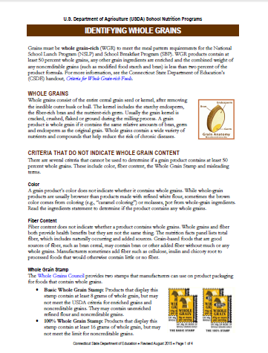
Identifying Whole Grains
www.sde.ct.gov/sde/lib/sde/pdf/deps/nutrition/nslp/crediting/identifyingwg.pdf
Notes:
For more information on how to identify whole grains, refer to this handout. It is available on the CSDE’s Crediting Foods Web page, at the link indicated on this slide.

Slide 70
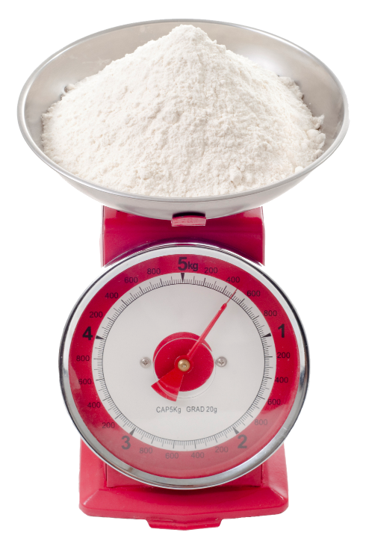
Products with Flour Blends
PFS must indicate that
whole grain content is AT LEAST 8 GRAMS per ounce equivalent (groups A-G) OR
weight of whole grain is MORE THAN FIRST INGREDIENT listed after flour blend
Water, FLOUR BLEND [whole-wheat flour, enriched flour (wheat flour, niacin, reduced iron, thiamine mononitrate, riboflavin, enzyme, folic acid)], brown sugar….
Notes:
When products contain a flour blend grouped together with parentheses, e.g., “flour blend (whole wheat flour, enriched flour),” the menu planner must obtain a PFS from the manufacturer that documents the weight of each creditable grain ingredient.
The PFS must indicate that either the whole grain content is at least 8 grams per ounce equivalent (groups A-G) or that the weight of the whole grain is more than the first ingredient listed after the flour blend.
This slide shows an example of a flour blend listed in the ingredients statement.

Slide 71
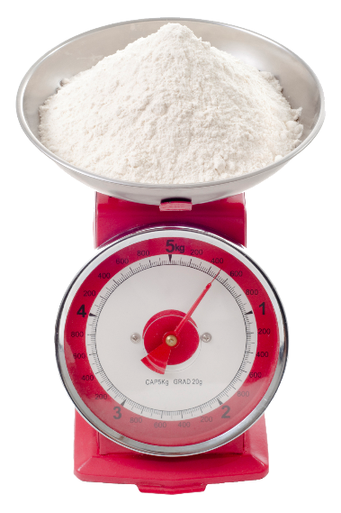
Products with Flour Blends
SAMPLE PRODUCT
Ingredient | Percentage of Total Product Weight
Flour Blend | 40% | Whole wheat flour = 25% Enriched Flour = 15%
Brown sugar | 30%
Water, FLOUR BLEND [whole-wheat flour, enriched flour (wheat flour, niacin, reduced iron, thiamine mononitrate, riboflavin, enzyme, folic acid)], brown sugar….
Notes:
From the ingredients statement, the menu planner can tell that the total weight of the flour blend (whole-wheat flour and enriched flour) is more than the weight of the brown sugar. However, the menu planner cannot tell the weight of each individual ingredient in the flour blend.
For example, if the flour blend is 40 percent of the product’s total weight (25 percent whole-wheat flour and 15 percent enriched flour) and sugar is 30 percent, the whole-wheat flour is not the greatest ingredient by weight. To determine if this product meets the criteria for at least 50 percent whole grains, the manufacturer’s PFS must document that the weight of the whole-wheat flour is more than the weight of the brown sugar.

Slide 72
WGR Definition Criterion 2
Any Other Grains are ENRICHED
Enriched grains contain FIVE NUTRIENTS added within limits specified by FDA
THIAMIN (vitamin B1, thiamin mononitrate, thiamin hydrochloride)
RIBOFLAVIN (vitamin B2)
NIACIN (vitamin B3, niacinamide)
FOLIC ACID (folate)
IRON (reduced iron, ferrous sulfate)
Notes:
The second criterion is that any other grains in the product are enriched. Enriched grains are refined grains (such as wheat, rice and corn) and grain products (such as cereal, pasta and bread) that have vitamins and minerals added to replace the nutrients lost during processing.
Enriched products are not nutritionally equivalent to whole-grain products because enrichment does not replace all the nutrients, fiber and other health-enhancing substances originally present in the whole grain.
Enriched grains have five nutrients added within limits specified by the Food and Drug Administration (FDA):
thiamin (vitamin B₁, thiamin mononitrate, thiamin hydrochloride);
riboflavin (vitamin B₂);
niacin (vitamin B₃, niacinamide);
folic acid (folate); and
iron (reduced iron, ferrous sulfate).
INSTRUCTOR NOTES: Do not read all of the alternate names for each nutrient. Use the terms thiamin, riboflavin, niacin, folic acid and iron, and explain that the other terms in parenthesis are other names for these nutrients that may be found on food labels.

Slide 73
Sample Label with Enriched Flour
Ingredients: Whole wheat flour, enriched flour (wheat flour, niacin, reduced iron, thiamine mononitrate, riboflavin, folic acid) ….
Notes:
This slide shows an example of an ingredients statement that contains enriched flour. You can tell it is enriched because it states “enriched” and list the five enrichment nutrients in parentheses.
To determine whether a product is enriched: check the label for the term “enriched,” e.g., “enriched flour” or check the ingredients statement for the five enrichment nutrients, e.g., “flour, niacin, ferrous sulfate, thiamine mononitrate, riboflavin, folic acid.” If the ingredients statement includes all five nutrients (iron, thiamin, riboflavin, niacin and folic acid), the product is enriched.
Not all refined products are enriched. For example, when corn is processed into cornmeal, the germ of the grain is removed. Unless the product indicates “enriched cornmeal” or the ingredients statement lists all five enrichment nutrients, the product is not enriched.

Slide 74
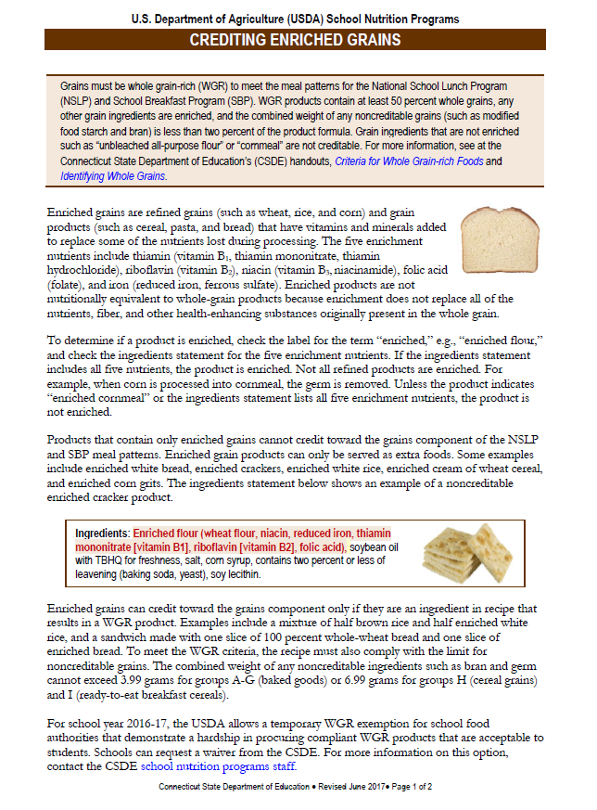
CSDE Resource
Crediting Enriched Grains
www.sde.ct.gov/sde/lib/sde/pdf/deps/nutrition/nslp/crediting/enrichedgrains.pdf
Notes:
This handout provides information on how to identify enriched grains. It is available on the CSDE’s Crediting Foods webpage, at the link indicated on this slide.

Slide 75
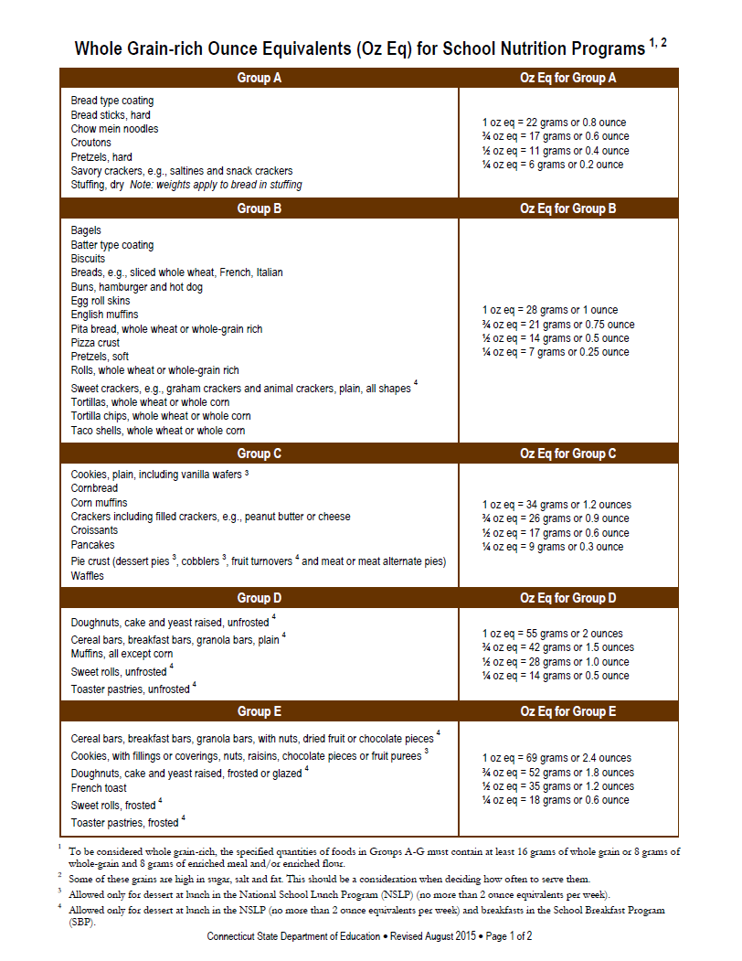
WGR Definition Criterion 3
Limit for NONCREDITABLE GRAINS
Combined total of all noncreditable grains must be LESS THAN 2% of product formula
    3.99 grams for groups A-G (baked goods)
    of USDA ounce equivalents chart
    6.99 grams for group H (cereal grains)
    and group I (ready-to-eat breakfast cereals)
    of USDA ounce equivalents chart
If exceeds this limit, food is not WGR
Notes:
The third criterion is the limit for noncreditable grains. Only whole and enriched grains are creditable. Noncreditable ingredients cannot credit (count) toward the grains component or the WGR requirement.
If grain products include these ingredients they must be present at levels less than two percent of the product formula for the product to meet the WGR definition. The combined total of all noncreditable grains cannot exceed:
3.99 grams for groups A-G (baked goods) of the USDA ounce equivalents chart; or
6.99 grams for groups H (cereal grains) and group I (ready-to-eat breakfast cereals) of the USDA ounce equivalents chart.
We will talk more about the ounce equivalents chart later on.
If noncreditable ingredients exceed the specified limits, the entire product is noncreditable, i.e., the grain product does not count as a WGR food and cannot be used as part of the grains component for school meals. It could only be served as an “extra” item, but then must count toward the weekly dietary specifications (calories, saturated fat and sodium) and must also contain zero grams of trans fat.

Slide 76
Examples of Noncreditable Grain Ingredients *
barley grits bran corn bran corn fiber corn flour (not enriched) corn grits corn starch cultured wheat starch durum grits fava bean flour fermented wheat germ hydrolyzed starch | malted barley flour (not enriched modified food starch (including potato, legume and other vegetable flours) modified corn starch modified rice starch modified tapioca starch modified wheat starch oat fiber potato flour potato starch rice flour (not enriched | rice starch soluble corn fiber soy fiber soy grits soy flour tapioca starch wheat bran wheat germ wheat flour (not enriched) wheat starch
* This list is not all-inclusive
Criteria for Whole Grain-rich Foods: www.sde.ct.gov/sde/lib/sde/pdf/deps/nutrition/nslp/crediting/WGRCriteria.pdf
Notes:
This chart lists examples of noncreditable grain ingredients. This list may not contain all possible representations of noncreditable grain ingredients on food labels.
This information is contained in the CSDE’s handout, “Criteria for Whole Grain-rich Foods,” which summarizes the criteria for determining whether a food meets the USDA WGR requirement. You have it in your handout packet and it is also available on the CSDE’s Crediting Foods Web page, at the link indicated on the slide.
INSTRUCTOR NOTES: Some ingredients are not creditable as grains but are not included in the calculation of a product’s total noncreditable grain ingredients. For example: cellulose fiber, chicory extract, chicory root, citrus fiber, corn dextrin, fibersol, inulin, malt, malt powder, maltodextrin, pea fiber, powdered cellulose and wheat gluten. If these ingredients are listed anywhere in the product’s ingredient statement, they can be disregarded. This information is in the CSDE’s handout, Criteria for Whole Grain-rich Foods.
The definition below is only for your for background information. You do not need to provide this information unless someone asks a question about it.
Wheat gluten is the protein component of the wheat grain, that helps baked goods hold their shape. It is neither a creditable or noncreditable grain. When the glutens in wheat are stretched out through the kneading or mixing process, they form little pockets which can then be inflated by the gases released by the leavening agent. When these air pockets inflate, the dough expands or rise. When baked, gluten hardens, which allows the bread to hold its shape and gives it its firm texture.

Slide 77
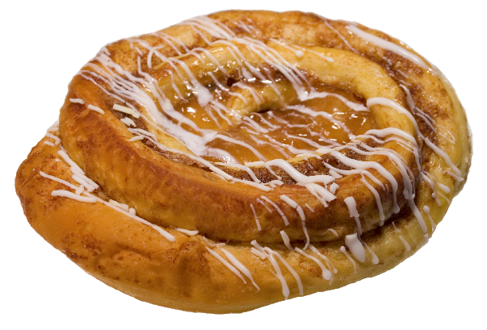
Nongrain Ingredients in Combination Foods
If noncreditable grain ingredients are
NOT part of combination food’s
GRAIN COMPONENT, they do
NOT count toward the
noncreditable grains limit
If a product contains an ingredient that contains two or more ingredients itself, these ingredients will be LISTED IN PARENTHESES after the name of the ingredient
Notes:
The only exception to the noncreditable grains limit is fortified breakfast cereals that contain a whole grain as the first ingredient. The USDA does not require these cereals to limit the amount of noncreditable grains such as bran or germ.
To be considered WGR, ready-to-eat breakfast cereals must list a whole grain as the first ingredient and the cereal must be fortified. Cereals are not required to be fortified if they are 100 percent whole grain.
If a cereal bar is made with a fortified breakfast cereal that contains a whole grain as the first ingredient, any noncreditable grains listed in the ingredients for the cereal do not count toward the limit for noncreditable grains. Noncreditable grains are not limited for cereals that list a whole grain as the first ingredient and are fortified.

Slide 78

Combination Food Example: Apple Breakfast Bun
Ingredients: 100% WHOLE-GRAIN WHITE WHEAT FLOUR,
APPLE FILLING (corn syrup, MODIFIED FOOD STARCH, evaporated apples, cinnamon, lemon juice, locust bean gum, erythorbic acid and potassium sorbate [used as preservatives]), water, margarine (palm oil, soybean oil, whey [milk], mono and diglycerides, soybean lecithin [soy], natural butter flavor, colored with beta carotene, vitamin A palmitate added), sugar, contains 2% or less of: dough conditioner (RYE FLOUR, MALTED BARLEY FLOUR, ascorbic acid, enzymes, guar and/or arabic gums, WHEAT FLOUR), nonfat dry milk (nonfat dry milk, whey [milk]), natural orange emulsion (natural flavor, propylene glycol, gum), salt, eggs, egg replacer (WHOLE SOY FLOUR, wheat gluten, corn syrup solids, algin), yeast (leavening), mold inhibitor (cultured organic spelt flour, lactic acid).
APPLE FILLING (corn syrup, MODIFIED FOOD STARCH, evaporated apples, cinnamon, lemon juice, locust bean gum, erythorbic acid and potassium sorbate
[used as preservatives]),
This product contains APPLE FILLING (nongrain ingredient)
and BUN (grain component)
The modified food starch in the apple filling does NOT count toward noncreditable grains limit
The FOUR NONCREDITABLE GRAINS in the bun (rye flour, malted barley flour wheat flour, whole soy flour) count toward noncreditable grains limit
Notes:
The only exception to the noncreditable grains limit is fortified breakfast cereals that contain a whole grain as the first ingredient. The USDA does not require these cereals to limit the amount of noncreditable grains such as bran or germ.
To be considered WGR, ready-to-eat breakfast cereals must list a whole grain as the first ingredient and the cereal must be fortified. Cereals are not required to be fortified if they are 100 percent whole grain.
If a cereal bar is made with a fortified breakfast cereal that contains a whole grain as the first ingredient, any noncreditable grains listed in the ingredients for the cereal do not count toward the limit for noncreditable grains. Noncreditable grains are not limited for cereals that list a whole grain as the first ingredient and are fortified.

Slide 79
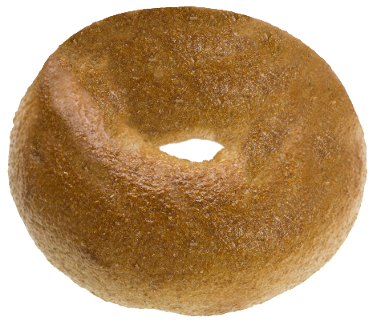
“Contains 2% or less”
If product lists only ONE noncreditable grain after “contains 2% or less” PFS NOT NEEDED
WHOLE-WHEAT BAGEL
Ingredients: WHOLE WHEAT FLOUR, sugar, wheat gluten.
Contains 2% or less of each of the following: honey, salt, YELLOW CORN FLOUR, yeast, molasses, diacetyl tartaric acid esters of mono-diglycerides (datem), ascorbic acid, mono-and diglycerides, l-cysteine, enzymes
Notes:
This slide shows an example of an ingredients statement that states “contains 2% or less of each of the following.” When you see this statement on a label followed by only ONE noncreditable grain ingredient, the noncreditable grain ingredient is low enough that it does not exceed the required limit (3.99 grams for groups A-G or 6.99 grams for groups H-I).
This ingredients statement shows an example. This whole-wheat bagel contains whole wheat flour as the first and only grain ingredient (indicated in green). This product contains only one source of noncreditable grains (yellow corn flour, indicated in red uppercase), listed after the statement “contains 2% or less of.” Therefore, this product meets the WGR requirement and a PFS is not required.

Slide 80
“Contains 2% or less”
If product lists TWO OR MORE noncreditable grains after “contains 2% or less,” PFS REQUIRED
  Must document combined weight
  of all noncreditable grains
WHOLE-GRAIN BAGEL
Ingredients: WHOLE WHEAT FLOUR, enriched bromated
wheat flour (niacin [a-B vitamin], thiamine mono nitrate [vitamin B-1], ferrous sulfate [iron], potassium bromate, riboflavin [vitamin B-2], and folic acid), water, brown sugar granulated sugar. Contains 2% or less of the following ingredients: salt, vital wheat gluten, mono & diglycerides, honey, CORN MEAL, calcium propionate, MALTED BARLEY FLOUR, molasses powder (molasses, WHEAT STARCH), ammonium chloride, ascorbic acid (vitamin C), l-cysteine hydrochloride, azodicarbonamide (ADA), calcium sulfate, enzymes
Notes:
However, if you see two or more noncreditable grain ingredients after the statement that says “contains 2% or less of each of the following,” it is not possible to know if the combined weight of all noncreditable grains is less than 2 percent. Therefore, you must obtain a PFS from the manufacturer to document the combined weight of all noncreditable grains.
This ingredients statement shows an example. This whole-wheat bagel contains whole wheat flour as the first ingredient and the only other grain ingredient is enriched bleached flour (indicated in green). However, this product contains three sources of noncreditable grains (corn meal, malted barley flour and wheat starch), indicated in red uppercase.
To determine whether this product meets the WGR requirement, schools must obtain a PFS that documents that the combined weight of all three noncreditable grains is less than 3.99 grams.

Slide 81
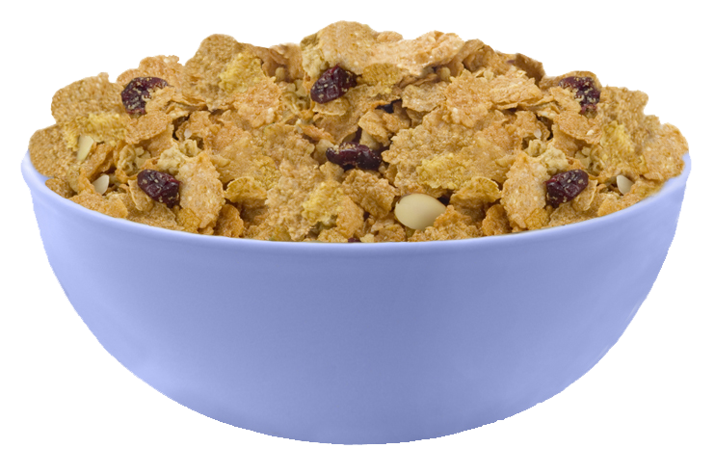
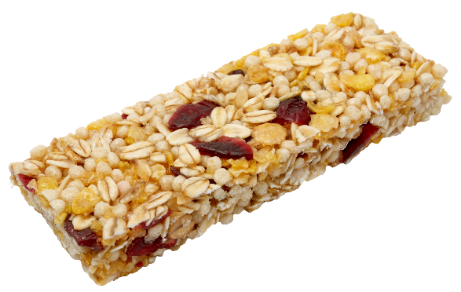
Two Exemptions for Noncreditable Grains
FORTIFIED BREAKFAST
CEREALS that contain
a WHOLE GRAIN as the
first ingredient
CEREAL BARS made from a
fortified breakfast cereal
that contains a whole grain
as the first ingredient
  Only CEREAL PORTION of ingredients is exempt
Notes:
The only exception to the noncreditable grains limit is fortified breakfast cereals that contain a whole grain as the first ingredient. The USDA does not require these cereals to limit the amount of noncreditable grains such as bran or germ.
To be considered WGR, ready-to-eat breakfast cereals must list a whole grain as the first ingredient and the cereal must be fortified. Cereals are not required to be fortified if they are 100 percent whole grain.
If a cereal bar is made with a fortified breakfast cereal that contains a whole grain as the first ingredient, any noncreditable grains listed in the ingredients for the cereal do not count toward the limit for noncreditable grains. Noncreditable grains are not limited for cereals that list a whole grain as the first ingredient and are fortified.

Slide 82
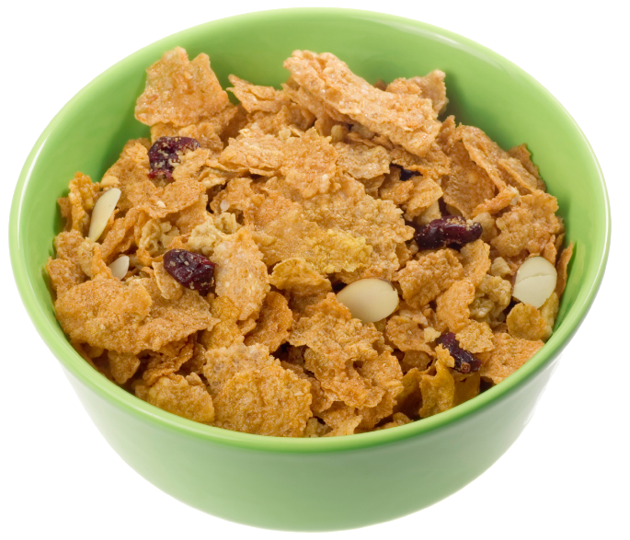
Identifying Fortified Cereals
ENRICHED | FORTIFIED
Iron Thiamin Riboflavin Niacin Folic acid | Iron Thiamin Riboflavin Niacin Folic acid Additional vitamins and minerals *
* Manufacturers choose which ones and how much
Notes:
How do you know if a breakfast cereal is fortified? Fortified breakfast cereals contain the five enrichment nutrients lost during the refining process (iron, thiamin, riboflavin, niacin and folic acid), as well as additional vitamins and minerals that do not exist naturally in grains.
This slide shows the difference between enrichment and fortification. To determine whether a ready-to-eat breakfast cereal is fortified, check the ingredients statement. Fortified cereals must contain:
the five enrichment nutrients (iron, thiamin, riboflavin, niacin and folic acid); and
additional nutrients such as calcium and vitamins A and C.
When fortification nutrients are added to cereals, they will either be listed directly in the ingredients statement or in the ingredients statement under “Vitamins and Minerals.”
Manufacturers can choose which additional nutrients to use for fortification. Different cereal brands may list different fortification nutrients. The USDA does not specify a minimum number of nutrients or a minimum percentage for the level of fortification for breakfast cereals.

Slide 83
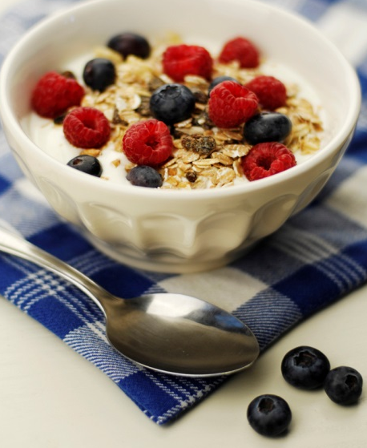
Ready-to-Eat Breakfast Cereals
Cereals containing ONLY
ENRICHED GRAINS, BRAN OR GERM are not WGR and do not credit
Cereals that contain MORE THAN 2 PERCENT of these ingredients only credit if
  whole grain is first ingredient AND
  cereal is fortified
Notes:
Effective with this current school year (2014-15), cereal products that contain only enriched grains, bran or germ no longer credit toward the grains component because they are not WGR. Examples include:
enriched cream of wheat;
enriched farina;
100 percent bran cereals (not fortified raisin bran cereals); and
wheat germ.
Bran is a noncreditable grain ingredient. Ready-to-eat breakfast cereals containing 100 percent bran are not creditable, even if they are fortified.
However, cereals such as raisin bran or bran flakes that contain bran at levels of more than two percent of the product formula are creditable if the cereal contains a whole grain as the first ingredient and the cereal is fortified.

Slide 84
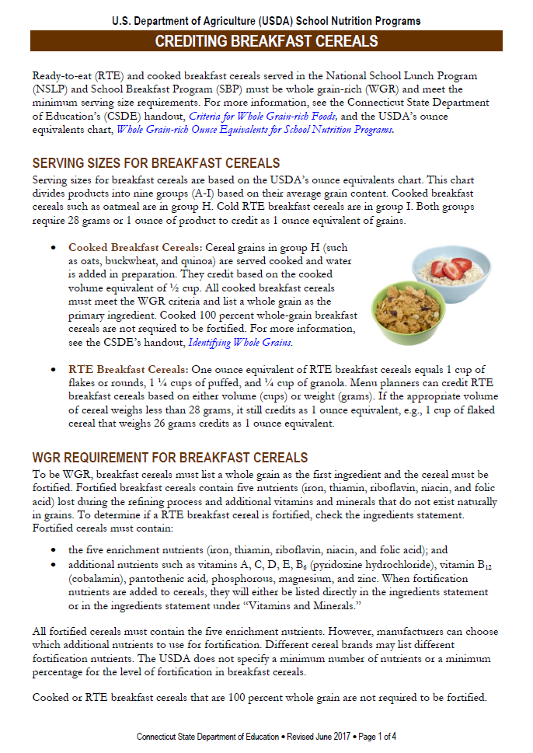
CSDE Resource
Crediting Breakfast Cereals
www.sde.ct.gov/sde/lib/sde/pdf/deps/nutrition/nslp/crediting/creditcereals.pdf
Notes:
This handout provides more information on identifying breakfast cereals that meet the WGR requirement. It is available on the CSDE’s Crediting Foods Web page, at the link indicated on this slide.

Slide 85

Worksheet 3: Is it WGR?
Indicate if each food item meets the WGR requirements for school meals OR if you need to obtain a PFS from the manufacturer to provide more information
Notes:
Now let’s evaluate some products to see whether they meet the WGR requirements for school meals.
Take out worksheet 3 – Is it whole grain-rich? In your small group, look at each food item and determine if it meets the WGR requirements or if you need to obtain a PFS from the manufacturer to provide more information.
INSTRUCTOR NOTES:
Divide participants into seven groups (number off). Assign one food to each group.
Give groups a few minutes to review the ingredients list for their food, and determine if the product is WGR.
When the groups are done, have each group report their answers. The tallest person is the reporter.
Modification: If time is short, have people stay in table groups or do the activity together as one large group. You can also make fewer groups and do some foods together, for example, make five groups and do the last two together as one large group.

Slide 86

Product 1 – WGR?
Whole Wheat Bagel
Ingredients: Whole wheat flour, sugar, wheat gluten. Contains 2% or less of each of the following: honey, salt, yellow corn flour, yeast, molasses, diacetyl tartaric acid
esters of mono-diglycerides (datem),
ascorbic acid, mono-and diglycerides,
l-cysteine, enzymes
  □ Criterion 1 WHOLE GRAIN
  □ Criterion 2 ENRICHED
  □ Criterion 3 NONCREDITABLE
Notes:
Does the whole-wheat bagel meet the WGR definition?

Slide 87
Product 1 – WGR?
YES
Whole Wheat Bagel
Ingredients: WHOLE WHEAT FLOUR, sugar, wheat gluten. Contains 2% or less of each of the following: honey, salt, YELLOW CORN FLOUR, yeast, molasses, diacetyl tartaric acid
esters of mono-diglycerides (datem),
ascorbic acid, mono-and diglycerides,
l-cysteine, enzymes
  ☑ Criterion 1 WHOLE GRAIN
  ☑ Criterion 2 ENRICHED
  ☑ Criterion 3 NONCREDITABLE
Notes:
Yes. This product is WGR. Whole wheat flour is the first and only grain ingredient. This product contains one source of noncreditable grains (yellow corn flour), listed after the statement “contains 2% or less of.” This product meets the WGR requirement and a PFS is not required.
INSTRUCTOR NOTES: The definition below is only for your background information. You do not need to provide this information unless someone asks a question about it.
Wheat gluten is the protein component of the wheat grain, that helps baked goods hold their shape. It is neither a creditable or noncreditable grain. When the glutens in wheat are stretched out through the kneading or mixing process, they form little pockets which can then be inflated by the gases released by the leavening agent. When these air pockets inflate, the dough expands or rise. When baked, gluten hardens, which allows the bread to hold its shape and gives it its firm texture.

Slide 88

Product 2 – WGR?
BRAND A White Whole-Wheat Bread Sticks
Ingredients: Water, whole wheat flour, unbleached unbromated enriched wheat flour (wheat flour, niacin, reduced iron, thiamine mononitrate, riboflavin, enzymes, folic acid), honey, yeast, salt, dough conditioners (mono & diglycerides, datem, l-cysteine, ascorbic acid, enzymes), modified
food starch, fava bean flour, flavor
(natural flavor, modified vegetable
gum, hydrolyzed starch, maltodextrin),
malted barley flour, dextrose, rye flour.
  □ Criterion 1 WHOLE GRAIN
  □ Criterion 2 ENRICHED
  □ Criterion 3 NONCREDITABLE
Notes:
Does Brand A of the white whole-wheat bread sticks meet the WGR definition?

Slide 89
Product 2 – WGR?
Need PFS *
BRAND A White Whole-Wheat Bread Sticks
Ingredients: Water, WHOLE WHEAT FLOUR, UNBLEACHED UNBROMATED ENRICHED WHEAT FLOUR (WHEAT FLOUR, NIACIN, REDUCED IRON, THIAMINE MONONITRATE, RIBOFLAVIN, ENZYMES, FOLIC ACID), honey, yeast, salt, dough conditioners (mono & diglycerides, datem, l-cysteine, ascorbic acid, enzymes), MODIFIED
FOOD STARCH, FAVA BEAN FLOUR, flavor
(natural flavor, modified vegetable
gum, hydrolyzed starch, maltodextrin),
MALTED BARLEY FLOUR, dextrose, RYE FLOUR.
  ☑ Criterion 1 WHOLE GRAIN
  ☑ Criterion 2 ENRICHED
  □ Criterion 3 NONCREDITABLE
* PFS must document that combined weight of modified food starch, fava bean flour, malted barley flour and rye flour is less than 3.99 grams
Notes:
This product may or may not meet the WGR definition.
This product lists a whole grain (whole-grain wheat flour) as the first ingredient after water. However, it contains four sources of noncreditable grains: modified food starch, fava bean flour, malted barley flour, rye flour.
If the combined weight of all noncreditable grains is less than 3.99 grams, the product meets the WGR definition. This must be documented by a PFS from the manufacturer that is on company letterhead and is signed by an official company representative.

Slide 90
Product 3 – WGR?
BRAND B White Whole-Wheat Bread Sticks
Ingredients: whole wheat flour, water, enriched unbleached wheat flour (wheat flour, malted barley flour, niacin, iron as ferrous sulfate, thiamine mononitrite, enzyme, riboflavin, folic acid), yeast, sugar, wheat gluten. Contains less than 2% of the following: soybean oil, salt, oat fiber,
honey, sodium stearoyl lactylate,
datem, ascorbic acid, enzyme. May
contain milk, soy, egg and sesame.
  □ Criterion 1 WHOLE GRAIN
  □ Criterion 2 ENRICHED
  □ Criterion 3 NONCREDITABLE
Notes:
Does Brand B of the white whole-wheat bread sticks meet the WGR definition?

Slide 91
Product 3 – WGR?
YES
BRAND B White Whole-Wheat Bread Sticks
Ingredients: WHOLE WHEAT FLOUR, water, ENRICHED UNBLEACHED WHEAT FLOUR (WHEAT FLOUR, MALTED BARLEY FLOUR, NIACIN, IRON AS FERROUS SULFATE, THIAMINE MONONITRITE, ENZYME, RIBOFLAVIN, FOLIC ACID), yeast, sugar, wheat gluten. Contains less than 2% of the following: soybean oil, salt, OAT FIBER,
honey, sodium stearoyl lactylate,
datem, ascorbic acid, enzyme. May
contain milk, soy, egg and sesame.
  ☑ Criterion 1 WHOLE GRAIN
  ☑ Criterion 2 ENRICHED
  ☑ Criterion 3 NONCREDITABLE
Notes:
Yes. This product is WGR. Whole wheat flour is the first ingredient. The remaining grain is enriched flour.
This product contains one noncreditable grain (oat fiber) but it is listed after “2 percent or less” of the product formula, so there is no need to request additional information from the manufacturer. Therefore, this product meets the WGR requirement and a PFS is not required.
This shows the importance of checking each individual product. You cannot assume that similar products are the same. Even though products 4 and 5 are both white whole-wheat bread sticks, they have different ingredients and one requires a PFS while the other does not.
INSTRUCTOR NOTES: The definition below is only for your background information. You do not need to provide this information unless someone asks a question about it.
Wheat gluten is the protein component of the wheat grain, that helps baked goods hold their shape. It is neither a creditable or noncreditable grain. When the glutens in wheat are stretched out through the kneading or mixing process, they form little pockets which can then be inflated by the gases released by the leavening agent. When these air pockets inflate, the dough expands or rise. When baked, gluten hardens, which allows the bread to hold its shape and gives it its firm texture.

Slide 92
Product 4 – WGR?
Whole-Grain Cereal Bar
Ingredients: whole grain rolled oats, brown sugar, crisp brown rice, whole grain rolled wheat, soybean oil, whole wheat flour, almonds, water, freeze dried bananas, whole corn flour, sodium
bicarbonate, malted barley extract,
soy lecithin, natural flavor, caramel
color, alpha tocopherol acetate, BHT.
  □ Criterion 1 WHOLE GRAIN
  □ Criterion 2 ENRICHED
  □ Criterion 3 NONCREDITABLE
Notes:
Does the whole-grain cereal bar meet the WGR definition?

Slide 93
Product 4 – WGR?
YES
Whole-Grain Cereal Bar
Ingredients: WHOLE GRAIN ROLLED OATS, brown sugar, CRISP BROWN RICE, WHOLE GRAIN ROLLED WHEAT, soybean oil, WHOLE WHEAT FLOUR, almonds, water, freeze dried bananas, WHOLE CORN FLOUR, sodium
bicarbonate, malted barley extract,
soy lecithin, natural flavor, caramel
color, alpha tocopherol acetate, BHT.
  ☑ Criterion 1 WHOLE GRAIN
  ☑ Criterion 2 ENRICHED
  ☑ Criterion 3 NONCREDITABLE
Notes:
Yes. This product is WGR.
This cereal bar contains a whole grain as the first ingredient (whole-grain oats), and all other grains (crisp brown rice, whole-grain rolled wheat, whole-wheat flour and whole corn flour) listed are also whole. There are no noncreditable grains.

Slide 94
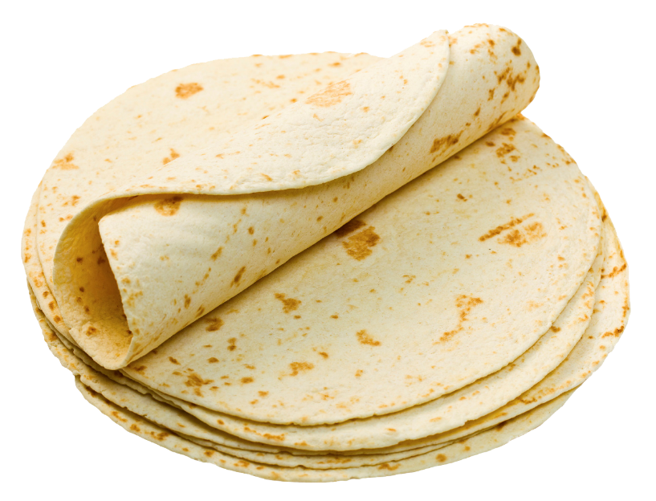
Product 5 – WGR?
Reduced Carb Wheat Tortilla
Ingredients: Water, modified food starch, whole-wheat flour, wheat gluten, powdered cellulose, hydrogenated soybean oil, caramel color, wheat protein isolate (wheat gluten, lactic acid, sulfite),
sodium bicarbonate, contains 1%
or less of salt, cellulose gum,
cornstarch, distilled monoglycerides.
  □ Criterion 1 WHOLE GRAIN
  □ Criterion 2 ENRICHED
  □ Criterion 3 NONCREDITABLE
Notes:
Does the reduced carb wheat tortilla meet the WGR definition?

Slide 95
Product 5 – WGR?
NO
Reduced Carb Wheat Tortilla
Ingredients: Water, MODIFIED FOOD STARCH, WHOLE-WHEAT FLOUR, wheat gluten, powdered cellulose, hydrogenated soybean oil, caramel color, wheat protein isolate (wheat gluten, lactic acid, sulfite),
sodium bicarbonate, contains 1%
or less of salt, cellulose gum,
CORNSTARCH, distilled monoglycerides.
  □ Criterion 1 WHOLE GRAIN
  ☑ Criterion 2 ENRICHED
  □ Criterion 3 NONCREDITABLE
Notes:
No. This product is not WGR.
This product contains modified food starch as the first ingredient after water, and also contains cornstarch. Modified food starch and cornstarch are noncreditable grains, and must be less than 2 percent of the product formula for the product to count as the grains component.

Slide 96
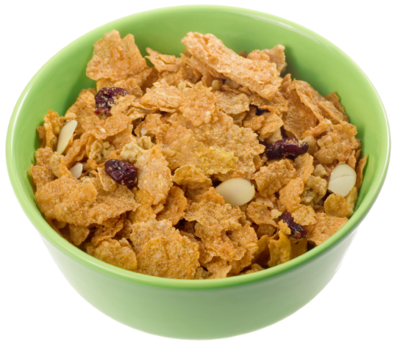
Product 6 – WGR?
Whole-GrainReady-to-Eat Cereal
Ingredients: whole grain wheat, sugar, brown rice flour, whole grain oats, honey, canola oil, maltodextrin, salt, corn syrup, cinnamon, barley malt syrup, barley malt extract, color added, soy lecithin, artificial flavor, baking soda, trisodium phosphate, vitamin E (mixed tocopherols) and BHT added to preserve freshness.
Vitamins and Minerals: Calcium Carbonate, Vitamin E acetate, a B vitamin (niacinamide), Vitamin C (sodium ascorbate), Iron (a mineral
nutrient), Vitamin B6 (pyridoxine hydrochloride,
Vitamin B2 (riboflavin), Vitamin B1 (thiamin mononitrate),
Vitamin A (palmitate), Vitamin B12, Vitamin D3.
  □ Criterion 1 WHOLE GRAIN
  □ Criterion 2 ENRICHED
  □ Criterion 3 NONCREDITABLE
Notes:
Does the whole-grain cereal meet the WGR definition?

Slide 97
Product 6 – WGR?
YES
Whole-Grain Ready-to-Eat Cereal
Ingredients: WHOLE GRAIN WHEAT, sugar, BROWN RICE FLOUR, WHOLE GRAIN OATS, honey, canola oil, maltodextrin, salt, corn syrup, cinnamon, barley malt syrup, barley malt extract, color added, soy lecithin, artificial flavor, baking soda, trisodium phosphate, vitamin E (mixed tocopherols) and BHT added to preserve freshness.
Vitamins and Minerals: Calcium Carbonate, Vitamin E acetate, a B vitamin (niacinamide), Vitamin C (sodium ascorbate), Iron (a mineral
nutrient), Vitamin B6 (pyridoxine hydrochloride,
Vitamin B2 (riboflavin), Vitamin B1 (thiamin mononitrate),
Vitamin A (palmitate), Vitamin B12, Vitamin D3.
  ☑ Criterion 1 WHOLE GRAIN
  ☑ Criterion 2 ENRICHED
  ☑ Criterion 3 NONCREDITABLE
Notes:
Yes. This product is WGR.
To meet the WGR criteria, ready-to-eat (RTE) breakfast cereals must list a whole grain first in the ingredient list and the cereal must be fortified. This cereal meets both requirements.

Slide 98

Product 7 – WGR?
Whole-Grain Blueberry Muffin
Ingredients: whole wheat flour, sugar, eggs, water, blueberries, enriched flour (flour, malted barley flour, niacin, reduced iron, thiamin mononitrate, riboflavin, folic acid), invert sugar, soybean oil, contains 2% or less of: palm oil, canola oil, propylene glycol mono- and diesters of fats and fatty acids, oat fiber, leavening (baking soda, sodium aluminum phosphate, monocalcium phosphate), mono- and diglycerides, modified food starch, potassium sorbate (preservative), sodium alginate, salt, soy lecithin, natural and artificial flavor, sodium
stearoyl lactylate, wheat starch, blackberry juice concentrate,
blueberry juice concentrate, malic acid, enzymes.
Contains: wheat, egg, soy.
  □ Criterion 1 WHOLE GRAIN
  □ Criterion 2 ENRICHED
  □ Criterion 3 NONCREDITABLE
Notes:
Does the whole-grain blueberry muffin meet the WGR definition?

Slide 99
Product 7 – WGR?
Need PFS *
Whole-Grain Blueberry Muffin
Ingredients: WHOLE WHEAT FLOUR, sugar, eggs, water, blueberries, ENRICHED FLOUR (FLOUR, MALTED BARLEY FLOUR, NIACIN, REDUCED IRON, THIAMIN MONONITRATE, RIBOFLAVIN, FOLIC ACID), invert sugar, soybean oil, contains 2% or less of: palm oil, canola oil, propylene glycol mono- and diesters of fats and fatty acids, OAT FIBER, leavening (baking soda, sodium aluminum phosphate, monocalcium phosphate), mono- and diglycerides, MODIFIED FOOD STARCH, potassium sorbate (preservative), sodium alginate, salt, soy lecithin,
natural and artificial flavor, sodium stearoyl lactylate, WHEAT
STARCH, blackberry juice concentrate, blueberry juice concentrate,
malic acid, enzymes. Contains: wheat, egg, soy.
  ☑ Criterion 1 WHOLE GRAIN
  ☑ Criterion 2 ENRICHED
  □ Criterion 3 NONCREDITABLE
* PFS must document that combined weight of oat fiber, modified food starch and wheat flour is less than 3.99 grams
Notes:
This product may or may not meet the WGR definition.
This product lists a whole grain (whole-wheat flour flour) as the first ingredient and contains enriched flour. However, it contains three sources of noncreditable grains: oat fiber, modified food starch and wheat starch.
If the combined weight of the three noncreditable grains is less than 3.99 grams, the product meets the WGR definition. This must be documented by a PFS from the manufacturer that is on company letterhead and is signed by an official company representative.

Slide 100

Product 8 – WGR?
Whole-Grain Waffles
Ingredients: whole wheat flour, unbleached, enriched wheat flour (wheat flour, niacin, iron, thiamin mononitrate, riboflavin, folic acid), water, lecithin, eggs, sugar, baking powder, whey, soy flour, salt, natural flavor.
  □ Criterion 1 WHOLE GRAIN
  □ Criterion 2 ENRICHED
  □ Criterion 3 NONCREDITABLE
Notes:
Do the whole-grain waffles meet the WGR definition?

Slide 101
Product 8 – WGR?
Need PFS *
Whole-Grain Waffles
Ingredients: WHOLE WHEAT FLOUR, UNBLEACHED, ENRICHED WHEAT FLOUR (WHEAT FLOUR, NIACIN, IRON, THIAMIN MONONITRATE, RIBOFLAVIN, FOLIC ACID), water, lecithin, eggs, sugar, baking powder, whey, SOY FLOUR, salt, natural flavor.
  ☑ Criterion 1 WHOLE GRAIN
  ☑ Criterion 2 ENRICHED
  □ Criterion 3 NONCREDITABLE
* PFS must document that soy flour weighs less than 3.99 grams
Notes:
This product may or may not meet the WGR definition.
Whole wheat flour is the first ingredient (criterion 1) and the product contains enriched flour (criterion 2).
This product contains one noncreditable grain (soy flour). To determine if this product meets criterion 3, the menu planner must obtain a PFS from the manufacturer.
If the combined weight of the soy flour is less than 3.99 grams, this product complies with the noncreditable grains limit (criterion 3) and meets the WGR definition.
Products containing noncreditable grains in amounts more than 2 percent of the product formula (3.99 grams for groups A-G) cannot contribute toward the reimbursable meal.

Slide 102
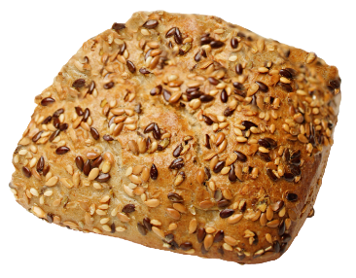


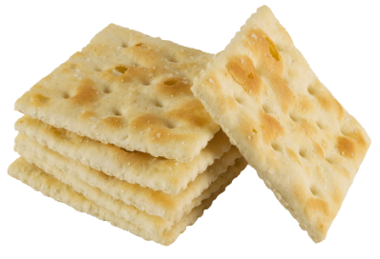






Purchasing specifications are critical to ensure compliance with
WGR requirements
Notes:
Because the crediting the requirements for grains are complicated, it is important for schools to ensure that all grains products used on school menus comply.
The procurement process is the best time to address the WGR requirements and ensure that grain products comply with the limit for noncreditable grains. Schools can explicitly include the WGR requirements, including the limit for noncreditable grains, in their bid solicitation documents and accompanying bid specifications.
It is also advisable to include a copy of the USDA PFS for grains so that bidders are aware of the information required to document meal pattern compliance.

Slide 103
Serving Sizes for Grains
  Menu planner determines SERVING SIZES and NUMBER of servings
  Minimum of ¼ OUNCE EQUIVALENT to count toward daily total
    Amounts less than ¼ ounce equivalent NOT included in daily and weekly grains
  Can offer COMBINATION of various grains to meet daily total
Notes:
After you have determined that a product meets the WGR criteria, you must ensure that the serving size meets the meal pattern requirements for the grains component.
The menu planner determines the serving sizes and the number of servings of grains needed to meet the meal pattern requirement 1 ounce equivalent daily for grades K-5 and 6-8, and 2 ounce equivalents daily for grades 9-12).
A minimum of ¼ ounce equivalent must be served to count toward the total grains, with the rest of the minimum required portion coming from other grains in the meal. Grains offered in amounts less than ¼ ounce equivalent are not included in the calculation of daily and weekly grain offerings.
You can serve smaller portions of grains to meet the total grains requirement. For example, for grades 9-12, you can choose to offer 1 ounce equivalent of pasta (½ cup) and a 1-ounce equivalent whole-grain roll. The menu planner determines the number of grains offered, keeping in mind that the smallest creditable amount is ¼ ounce equivalent.
When we talk about offer versus serve later on, you will see that you may want to offer the minimum daily required serving size for each grade group as one food item.

Slide 104
Two Methods to Determine Serving Sizes for Baked Goods (Groups A-G)
  METHOD 1
  Use WEIGHT OR VOLUME in USDA ounce equivalents chart
  To use this method
  all grains must be CREDITABLE (whole grain or enriched)
  combined total of any noncreditable grains must be no more than 3.99 grams
Notes:
The menu planner has two choices for determining the appropriate serving size for grain products in groups A-G of the USDA ounce equivalents chart. One method uses the weights or volumes in the USDA ounce equivalents chart and the other uses the total weight of creditable grains.
Method 1 Weights or Volumes: Use either the weights or volumes listed in the USDA ounce equivalents chart to determine the appropriate serving size. This method can be used only if all grains in the product are creditable (i.e., whole or enriched) and the combined total of any noncreditable grains is no more than 3.99 grams.

Slide 105
Two Methods to Determine Serving Sizes for Baked Goods (Groups A-G)
METHOD 2
Determine WEIGHT of CREDITABLE grains
  Requires MANUFACTURER DOCUMENTATION (PFS) for commercial products
  Requires STANDARDIZED RECIPE for school-made products
Notes:
Method 2 Creditable Grains: Determine the ounce equivalents of a product by calculating the creditable grains per serving.
For commercial products, this method requires documentation from the manufacturer to certify the grams of creditable grains per portion, i.e., a product formulation statement.
Ask participants: Does anyone bake lunch items from scratch, such as muffins or breads? For school-made products, this method requires a standardized recipe.
The combined total of any noncreditable grains must be less than 3.99 grams. Menu planners must use method 2 if:
the manufacturer claims that a product can provide the minimum creditable grains per portion using a serving size less than the weights given in the USDA ounce equivalents chart;
a product is made from scratch on site and the menu planner calculates the serving size based on grams of creditable grains instead of using ounce equivalents; or
a product does not fit into one of the groups of the USDA ounce equivalents chart.

Slide 106

For both methods, round DOWN all calculations to nearest ¼ ounce equivalent
Whole-wheat Roll, 1.49 ounces
Group B: 1 ounce equivalent = 28 grams (1 ounce)
Credits as 1.25 ounce equivalents of grains
Notes:
For both methods, menu planners must round down all amounts to the nearest ¼ ounce equivalent when counting grains toward the daily and weekly requirements.
Here is an example. The menu planner want to use a 1.49-ounce whole-wheat roll for the grains component.
Ask participants: How many ounce equivalents of grains can the menu planner meet with this roll?
Rolls are in group B, with all other bread items. For group B, 1 ounce of product provides 1 ounce equivalent of grains.
The menu planner can credit the roll as 1.25 ounce equivalents of grains (1.49 ounces rounded down to the nearest quarter).
INSTRUCTOR NOTES: Click to show the answer.

Slide 107

For both methods, round DOWN all calculations to nearest ¼ ounce equivalent
WGR Waffles, 2.6 ounces
Group C:
1 ounce equivalent = 34 grams (1.2 ounces)
2.6 ounces ÷ 1.2 ounces = 2.2 ounce equivalents
Credits as 2 ounce equivalents of grains
Notes:
The menu includes 2.6 ounces of WGR waffles.
Ask participants: How many ounce equivalents of grains?
Look at your ounce equivalent chart. Waffles are in Group C, which requires 1.2 ounces to equal 1 ounce equivalent. The two waffles weigh 2.6 ounces. Divide 2.6 ounces by 1.2 ounces per ounce equivalent to equal 2.2 ounce equivalents, which rounds down to 2 ounce equivalents (2.2 ounces rounded down to the nearest quarter).
Key message: 1 ounce of a product is not always 1 ounce equivalent.
INSTRUCTOR NOTES: Click to show the answer.

Slide 108
Method 1 – Ounce Equivalents Chart
Use serving sizes (WEIGHTS) in USDA ounce equivalents chart
Nine groups based on amount that provides
1 OUNCE EQUIVALENT of grains
Notes:
For method 1, schools must use the USDA ounce equivalents chart, Whole Grain-rich Equivalents Requirements for School Nutrition Programs. Take a look at your ounce equivalents chart.
The USDA ounce equivalents chart provides minimum serving sizes (ounce equivalents) for a wide variety of grain products. It divides products into nine groups (A-I) based on their average grain content.
The weight needed for each group to provide 1 ounce equivalent of grains varies because different types of foods contain different concentrations of whole and enriched grains. Grains with fillings, frosting, toppings, nuts, chocolate chips, dried fruit and other similar ingredients require a larger serving to meet the minimum grain content.
For groups A-G, 1 ounce equivalent of grains must provide 16 grams of creditable grains. This can be either at least 16 grams of whole grains or at least 8 grams of whole-grains and 8 grams of enriched grains.
For groups H-I, 1 ounce equivalent of grains must provide 28 grams of creditable grains or meet the specified weights and volumes.

Slide 109







Weight Required for 1 Ounce Equivalent
Cereal 1 ounce
(1 cup for flakes and rounds, 1 ¼ cups for puffed cereal and ¼ cup for granola)
Toast
1 ounce
Graham Crackers
1 ounce
Corn muffin 1.2 ounces
Waffles
1.2 ounces
Blueberry Muffin
2 ounces
French Toast
2.4 ounces
Frosted Sweet Roll
2.4 ounces
Notes:
This slide shows some examples of the amounts of different grain products that are required to meet 1 ounce equivalent.
For example, looking at the ounce equivalents chart handout, you will see that toast is in Group B where 1 ounce of bread equals 1 ounce equivalent, while a blueberry muffin is in Group D where 2 ounces of weight is needed to equal 1 ounce equivalent.
Ask participants: Why do you think a corn muffin needs only 1.2 ounces to provide 1 ounce equivalent but other muffins such as blueberry muffins need 2 ounces to provide 1 ounce equivalent? The servings sizes in the ounce equivalents chart are based on the amount of the product that provides a specific amount of creditable grains (16 grams for groups A-G and 28 grams for groups H-I). Additional ingredients such as fruits dilute the grains so you need a larger serving size to provide the minimum amount of grains.

Slide 110

How much equals 1 ounce equivalent?
Whole-wheat Bagel
GROUP B
1 ounce equivalent equals 28 grams (1 ounce)
Notes:
Let’s look at some more examples. Refer to your handout, ounce equivalents chart.
Ask participants: What is serving size of whole-wheat bagel equals 1 ounce equivalent of grains?
Bagels are in group B: 28 grams (1 ounce) provide 1 ounce equivalent of grains.
INSTRUCTOR NOTES: Click to show the answer.

Slide 111

How much equals 1 ounce equivalent?
Granola Bars, Plain
GROUP D
1 ounce equivalent =55 grams (2 ounces)
Notes:
Let’s look at some more examples. Refer to your HANDOUT, ounce equivalents chart.
Ask participants: What serving size of plain granola bars equals 1 ounce equivalent of grains?
Plain granola bars are in group D: 55 grams (2 ounces) provides 1 ounce equivalent of grains.
INSTRUCTOR NOTES: Click to show the answer.

Slide 112

How much equals 1 ounce equivalent?
Oatmeal
GROUP H
1 ounce equivalent = ½ cup cooked or
28 grams (1 ounce) dry
Notes:
Ask participants: What serving size of oatmeal equals 1 ounce equivalent of grains?
Oatmeal is in group H: ½ cup cooked or 28 grams (1 ounce) dry provide 1 ounce equivalent of grains.
INSTRUCTOR NOTES: Click to show the answer.

Slide 113
Method 2 – Creditable Grains
Calculate GRAMS OF CREDITABLE GRAINS per serving
Requires documentation from
  an original CN LABEL from the product carton if the grains are part of a meat/meat alternate product
  OR
  a PFS signed by an official of the manufacturer
Notes:
For method 2, creditable grains, the school food authority must determine the ounce equivalents of a product by calculating the creditable grains per serving. This method requires documentation from the manufacturer to certify the grams of creditable grains per portion. Creditable grains are whole or enriched.
This documentation must be either:
an original CN label from the product carton if the grains are part of a meat/meat alternate product; or
a PFS signed by an official of the manufacturer.
There are several situations when you must use method 2. Menu planners must use method 2 if:
the manufacturer claims that a product can provide the minimum creditable grains per portion using a serving size less than the weights given in the USDA ounce equivalents chart;
a product is made from scratch on site and the menu planner calculates the serving size based on grams of creditable grains instead of using ounce equivalents; or
a product does not fit into one of the groups of the USDA ounce equivalents chart.

Slide 114

CSDE Resource
Calculation Methods for Crediting Grains
www.sde.ct.gov/sde/lib/sde/pdf/deps/nutrition/nslp/crediting/graincalc.pdf
Notes:
We won’t be doing any crediting calculations with these methods today, but the CSDE’s handout, “Calculation Methods for Crediting Grains,” describes the two methods schools must use to determine whether grains are creditable and how much to serve to meet the minimum serving size requirements. It is available on the CSDE’s Crediting Foods webpage, at the link indicated on this slide.

Slide 115

MEAT/MEAT ALTERNATE (M/MA) SUBSTITUTIONS

Slide 116

M/MA Grain Substitutes
Optional
Can only be offered after MINIMUM DAILY grains (1 ounce equivalent)
Minimum of ¼ OZ EQ to count toward daily total
Schools can choose
to offer
  IN PLACE of grains
  as an EXTRA item
Notes:
The breakfast meal pattern does not require meat/meat alternates. However, menu planners can choose to offer meat/meat alternates as a grain substitution after offering the minimum daily grains (1 ounce equivalent). One ounce equivalent of meat/meat alternate substitutes for 1 ounce equivalent of grains. A minimum of ¼ ounce equivalent must be served to count toward the total requirements. Meat/meat alternate substitutions offered in amounts less than ¼ ounce equivalent are not included in the calculation of daily and weekly grain offerings.
There are two options for crediting meat/meat alternates served at breakfast:
Offer a serving of meat/meat alternate in place of a serving of grains as long as 1 ounce equivalent of grains is also served. For this option, the meat/meat alternate counts with grains toward the weekly grains range. Meat/meat alternates offered in place of grains count as grain food items for OVS.
Offer a serving of meat/meat alternate as an extra food that does not count toward the weekly grains range. Meat/meat alternates offered as extras do not count as a food item for OVS.
For both options, meat/meat alternates must count toward the weekly dietary specifications.
Why are there both options? USDA offers the option to count or not count meat/meat alternates because there is no meat/meat alternates component requirement and therefore no requirement schools to credit meat/meat alternates if served. The USDA does not encourage or discourage one approach over the other.

Slide 117



M/MA Serving Sizes
Products WITHOUT binders and extenders credit based on SERVING WEIGHT
Products WITH binders and extenders credit based only on ACTUAL AMOUNT OF MEAT
  Require PFS from manufacturer
Notes:
Meat products without binders and extenders credit on an ounce-per-ounce basis (actual serving weight). This means that 1 ounce of the meat product provides 1 ounce equivalent of meat/meat alternates.
Meat products with binders and extenders credit based only on the actual amount of meat without the weight of the binders and extenders.
For example, if a turkey sausage weighs 1 ounce and contains modified food starch as an ingredient, it cannot credit as 1 ounce equivalent of meat/meat alternates. This product would credit based on the actual percentage of ground meat (such as beef, chicken, turkey or pork) in the product formula. To determine this information, schools must obtain a product formulation statement from the manufacturer.
To credit based on actual serving weight, luncheon meats, cold cuts, hot dogs, knockwurst and Vienna sausage must be all meat without binders or extenders or added ingredients such as water or meat broth.

Slide 118

1 Ounce Equivalent of M/MA
1 ounce of cooked lean
meat, poultry or fish
1 ounce of natural or process cheese *
2 ounces of cottage or ricotta cheese, cheese food/spread and cheese substitute *
¼ cup of cooked beans
and peas (legumes)
½ large egg
2 tablespoons of nut butters
1 ounce of nuts or seeds
2.2 ounces (¼ cup) of commercial tofu (containing at least 5 grams of protein)
½ cup of yogurt or soy yogurt *
1 ounce of alternate protein products (APP)
* Low-fat recommended
Notes:
The serving sizes for meat/meat alternates are provided in ounce equivalents, which is the amount of meat or meat alternate that is equivalent to one ounce of cooked lean meat, poultry or fish.
For example, 1 ounce equivalent of meat/meat alternates equals:
1 ounce of lean meat, poultry or fish;
1 ounce of cheese (low-fat recommended);
¼ cup of cooked beans and peas (legumes);
½ large egg;
2 tablespoons of nut or seed butters (such as almond butter, cashew nut butter, peanut butter, reduced-fat peanut butter, sesame seed butter, soy nut butter and sunflower seed butter);
1 ounce of nuts/seeds (such as include almonds, Brazil nuts, cashews, filberts, macadamia nuts, peanuts, pecans, walnuts, pine nuts, pistachios and soynuts);
2.2 ounces of tofu;
½ cup of yogurt or soy yogurt; and
1 ounce of alternate protein products (APP).
Choose low-fat dairy products to help school meals comply with the saturated fat limits of the dietary specifications.

Slide 119

M/MA at Breakfast
  EXAMPLE OF OPTION 1
  Offer M/MA IN
  PLACE of grains
Planned Menu | Meal Pattern Components | Food Items
Whole-wheat toast (1-ounce slice) | Grains, 1 ounce equivalent | 1
Low-fat cheese stick (1 ounce) | Grains, 1 ounce equivalent (M/MA substitution) | 1
Banana (½ cup) | Fruits, ½ cup | 1
Orange juice (½ cup) | Fruits, ½ cup | 1
Milk choice (1 cup) | Milk, 1 cup | 1
TOTAL |  | 5
Notes:
Depending on how the meat/meat alternate substitution is planned, it may or may not count as a food item. This slide shows an example of the first option: Offer a serving of meat/meat alternates in place of a serving of grains and count it toward the weekly grains range. Meat/meat alternates offered in place of grains count as a grains food item.
In this example, the menu planner plans the string cheese as grain substitution so it counts as a food item for OVS.

Slide 120

M/MA at Breakfast
  EXAMPLE OF OPTION 2
  Offer M/MA as
  EXTRA FOOD
Planned Menu | Meal Pattern Components | Food Items
Hard-boiled egg (½ egg) | None (extra food) | 0
Whole-wheat blueberry muffin (2 ounces) | Grains, 1 ounce equivalent | 1
Canned peaches (½ cup) | Fruits, ½ cup | 1
Strawberries (½ cup) | Fruits, ½ cup | 1
Milk choice (1 cup) | Milk, 1 cup | 1
TOTAL |  | 4
Notes:
This slide shows an example of the second option: Offer a serving of meat/meat alternates as an extra food that does not count toward the weekly grains range.
In this example, the menu planner plans the egg as an “extra” foods so it does not count as a food item.
As a reminder, for both options, the meat/meat alternates must count toward the weekly dietary specifications. The inclusion of meat/meat alternates cannot cause the breakfast menu to exceed the average weekly calorie, saturated fat and sodium limits.

Slide 121

NONCREDITABLE FOODS
www.sde.ct.gov/sde/lib/sde/pdf/deps/nutrition/nslp/crediting/noncredsnp.pdf
Notes:
Ask participants: Before we move on to noncreditable foods, what questions do you have about the grains component?
INSTRUCTOR NOTES: Ask group 1 to report on noncreditable foods. Use slides to briefly confirm correct information that the group identified about noncreditable foods and share any information that was not included in the group’s list. Do not spend any time on information that has already been discussed.
Take out your handout, Noncreditable Foods.
There are many foods that do not credit in school nutrition programs. You can see some of them on this slide, for example: bacon, cream cheese, potato chips, popcorn, pudding, white rice and condiments, such as ketchup, mustard, mayonnaise and salad dressing.

Slide 122

Noncreditable Foods
CANNOT CREDIT toward meal pattern
LIMIT frequency and amount
  Often contain little nutritional value
Must count toward weekly DIETARY SPECIFICATIONS (nutriton standards)
Notes:
Noncreditable foods are foods and beverages that cannot credit toward the USDA meal patterns for school nutrition programs. Schools and institutions may serve noncreditable foods in addition to the meal components to add variety, help improve acceptability in the meal and satisfy appetites. Some examples include maple syrup on pancakes, salad dressing on salad and condiments such as ketchup or mustard on a hotdog, sandwiches and other entrees.
Menu planners should limit noncreditable foods in school menus. These foods often contain little nutritional value and are high in fat, sugars and sodium. Menu planners should read labels, be aware of the ingredients in foods and limit the frequency and amount of less nutritious choices.
Noncreditable foods that are offered as part of reimbursable meals must be counted toward the weekly dietary specifications. If noncreditable foods are served, they must contain zero trans fat and their inclusion cannot cause the menu to exceed the average weekly limits for calories, saturated fat and sodium.
Let’s look at some of the noncreditable foods in each meal component.

Slide 123

Noncreditable Fruits *
Snack-type foods made from fruits dried banana chips fruit snacks, e.g., fruit drops, roll-ups, wrinkles, twists and yogurt-covered fruit snacks 100% fruit strips Jam or jelly Home-canned products (for food safety reasons) Juice drinks that are not 100 percent juice, e.g., grape juice drink, orange juice drink, cranberry juice cocktail, lemonade
* This list is not all-inclusive
Notes:
These are some of are the fruit products that are not creditable in school meals. This list is not all inclusive.
Snack-type foods made from fruits do not qualify as fruits and cannot be credited toward meeting the fruits requirement in any of the USDA meal patterns, including dried banana chips; fruit snacks (e.g., roll-ups, wrinkles, twists and yogurt-covered fruit snacks); and 100% fruit strips. This applies to all fruit snacks, even if they meet the USDA Smart Snacks nutrition standards for competitive foods (a la carte sales). These foods cannot be used to count as the fruits component for school meals.
Jam or jelly;
Home-canned products (for food safety reasons); and
Juice drinks that are not 100 percent juice, e.g., Grape juice drink, orange juice drink, pineapple-grapefruit drink, cranberry juice cocktail, lemonade.

Slide 124

Noncreditable Vegetables*
Snack-type foods made from vegetables, such as potato chips or popcorn Pickle relish Tomato catsup and chili sauce Home-canned products (for food safety reasons) Dehydrated vegetables used for seasoning
* This list is not all-inclusive
Notes:
The following products do not qualify as vegetables and cannot credit toward meeting the vegetables component:
snack-type foods made from vegetables, such as potato chips or popcorn;
pickle relish;
jam or jelly;
tomato catsup and chili sauce;
Home-canned products (for food safety reasons); and
dehydrated vegetables used for seasoning.
This list is not all inclusive.

Slide 125

Noncreditable M/MA *
Shelf-stable, DRY OR SEMI-DRY meat snacks Smoked snack sticks made with beef and chicken Summer sausage Pepperoni sticks Meat, poultry or seafood jerky Meat or poultry nuggets (similar to jerky) Bacon Cream Cheese
* This list is not all-inclusive
Notes:
These foods cannot credit toward the meat/meat alternates component. This list is not all inclusive.
Shelf-stable, dry or semi-dry meat snacks including smoked snack sticks made with beef and chicken; summer sausage; pepperoni sticks; meat, poultry or seafood jerky such as beef jerky, turkey jerky and salmon jerky; and meat or poultry nuggets (shelf-stable, nonbreaded, dried meat or poultry snack made similar to jerky) such as turkey nuggets. These snack products do not meet the usual and customary function of the meat/meat alternates component as either an entree or side dish of a meal. In addition, dried meat, poultry or seafood snacks do not qualify for the USDA CN Labeling Program because they cannot contribute to the meat/meat alternate component. Therefore, menu planners cannot accept fact sheets or company certified product formulation statements for these products.
Bacon and cream cheese do not count as a meat/meat alternate or any other component in the USDA meal patterns. They are low in protein and high in fat
INSTRUCTOR NOTES: Some meat-stick type products may credit in school nutrition programs with authorized CN labels or a company certified product formulation statement (see CSDE Operational Memorandum 27-11:Shelf-stable, Dried Snacks Made from Meat, Poultry or Seafood).
cooked, cured meat and/or poultry sausages without byproducts, cereals, binders or extenders such as bologna, frankfurters, knockwurst and Vienna sausage as listed in the meat/meat alternates section of the Food Buying Guide;
extended meat or poultry “pattie-like” products shaped into sticks that are usually breaded and either frozen or refrigerated; and
dried pepperoni when used as a topping on a CN labeled pizza.

Slide 126



Noncreditable Grains *
Products that are not WGR Products that are only enriched Products that contain more than 3.99 grams of noncreditable grains for groups A-G or 6.99 grams for groups H and I
* This list is not all-inclusive
Notes:
As we just saw with the grains component, any grain products that do not meet the WGR definition are not creditable.
Remember that to be WGR, grain product must contain at least 50 percent whole grains by weight, any remaining grain ingredients are enriched and any noncreditable grain ingredients are less than 2 percent of the product formula (no more than 3.99 grams for groups A-G or 6.99 grams for groups H and I).
This is the reverse of the WGR definition.

Slide 127

Dietary Specifications
(Nutrition Standards)
Notes:
That concludes the discussion of the meal components. We will now focus on the dietary specifications (nutrition standards) within the meal pattern.
Ask participants: Before we move on, do you have any questions about noncreditable foods?
INSTRUCTOR NOTES: Ask group 4 to report on the dietary specifications. Use slides to briefly confirm correct information that the group identified the dietary specifications and share any information that was not included in the group’s list. Do not spend any time on information that has already been discussed.

Slide 128
Dietary Specifications
(Nutrition Standards) for Breakfast
School Year 2017-18
Daily Amount Based on Weekly Average
NUTRIENTS | GRADES K-5 | GRADES 6-8 | GRADES 9-12
Calories | 350-500 | 400-550 | 450-600
Saturated Fat | < 10 % | < 10 % | < 10 %
Sodium * | ≤ 540 mg | ≤ 600 mg | ≤ 640 mg
Trans Fat | Nutrition label or manufacturer specifications must indicate zero grams of trans fat per serving
* First sodium target extended through June 30, 2018
Notes:
This chart shows the dietary specifications (nutrition standards) for breakfast. These are based on the weekly average of a five-day or seven-day week.
Take a look at your breakfast meal pattern handout.
Ask participants: Do you see these on your meal pattern handout?
You will find it just below the meal components. Notice that this chart is part of the meal pattern. The dietary specifications are right under the meal components and serving sizes, and are part of the meal pattern requirements.
In addition to complying with the meal pattern components, schools must also meet four dietary specifications. This is intended to improve the consistency of school meals with the Dietary Guidelines and the Dietary Reference Intakes.
These specifications are calories, sodium, saturated fat and trans fat. Let’s look at each nutrition standard in more detail.

Slide 129
Four Dietary Specifications
(Nutrition Standards)
WEEKLY average requirements for calories, saturated fat and sodium
DAILY requirement for trans fat (all foods)
Notes:
The nutrition standards must be met on average over the school week. This means that the levels of calories, saturated fat and sodium in any one meal could exceed the standard as long as the average over the week meets the standard.
Fro example, menu planners may be able to offer a meal or food that is relatively high in saturated fat or sodium at some point during the week, if meals with lower to moderate saturated fat or sodium content are offered the rest of the week.
However, for trans fat, all food products and ingredients used daily must contain zero grams of trans fat per serving.

Slide 130
Calorie Ranges
MINIMUM and MAXIMUM calorie levels averaged over the week
NUTRIENT-DENSE menus (more fruits, vegetables and whole grains)
  Avoiding foods high in fats and added sugars
Notes:
The first dietary specification is calorie ranges, including minimums and maximums for each grade group. Schools must meet the calorie ranges on average over the school week. The weekly calorie ranges apply to the school meal offered on average over the week, not per student.
The specified calorie ranges are based on evidence about children’s intakes at meals and snacks, and were designed based on age-appropriate nutrition and physical activity habits of the average student. The USDA’s intent is not to reduce the amount of food but to avoid excessive calories by serving more nutrient-dense foods.
The meal patterns provide more fruits, vegetables and whole grains to provide nutrient-dense school meals. The required maximum calorie levels are expected to drive menu planners to select nutrient-dense foods and ingredients to prepare meals, and avoid products that are high in fats and added sugars.

Slide 131
Saturated Fat
Limit saturated fat to LESS THAN 10 PERCENT of total calories
Notes:
The next dietary specification is saturated fat. Average weekly meals must contain less than 10 percent of calories.
Schools are not required to meet a total fat standard. The Dietary Guidelines emphasize that the type of fat consumed is more important than total fat in terms of preventing diet-related disease such as heart diseases, cancer and stroke.
Ask participants: Why are we concerned about children's saturated fat intake? Saturated fat, and particularly trans fat, have the most negative health consequences, which is why the USDA dietary specifications focus on reducing these two types of fat.
Saturated fats are harmful to our health. Research shows that eating high amounts of saturated fat is associated with higher levels of blood total cholesterol and low-density lipoprotein (LDL) cholesterol, the “bad” cholesterol. Higher total and LDL cholesterol levels are risk factors for cardiovascular disease.

Slide 132

Sodium
Sodium Reduction Timeline for Breakfast
Grade Group | Target 1 (mg) | Target 2 (mg) | Final Target (mg)
 | Meet by July 1, 2014 (SY 2014-15) | Meet by July 1, 2017 (SY 2017-18) | Meet by July 1, 2022 (SY 2022-23)
K-5 | < 540 | < 485 | < 430
6-8 | < 600 | < 535 | < 470
9-12 | < 640 | < 570 | < 500
* First sodium target extended through June 30, 2018
www.sde.ct.gov/sde/lib/sde/pdf/deps/nutrition/nslp/sodiumtimeline.pdf
Notes:
The next standard is for sodium. This chart summarizes the required sodium reductions at lunch. The sodium limit includes both naturally occurring sources (like milk and bread) and added sources, e.g., salt in processed foods.
You can see the gradual phase-in of the three targets for each grade group. The first sodium target took effect on July 1, 2014. The second sodium target takes effect July 1, 2017, and the third and last sodium target takes effect July 1, 2022.
Ask participants: Why are we concerned about children's sodium intake? In some people, sodium increases blood pressure because it holds excess fluid in the body, creating an added burden on the heart. Since blood pressure rises with age, helping children eat less sodium now will help curb that increase and reduce children’s risk of developing other conditions associated with too much sodium, such as stroke, heart failure, osteoporosis, stomach cancer and kidney disease.* This is why the USDA dietary specifications focus on reducing sodium in school meals.
* Source: About Sodium (Salt). American Heart Association. https://www.heart.org/HEARTORG/GettingHealthy/NutritionCenter/HealthyEating/About-Sodium-Salt_UCM_463416_Article.jsp)

Slide 133

Sodium Intake
75% from processed and prepared foods
12% naturally occurring in foods
13% added during cooking and at the table
Get the Facts: Sources of Sodium in Your Diet (CDC, 2012). www.cdc.gov/salt/pdfs/sources_of_sodium.pdf
Notes:
Let’s briefly review some information and resources to help schools plan menus to meet the sodium target.
Most sodium (about 75 percent) in our diet comes from eating processed and prepared foods, such as canned vegetables, soups, luncheon meats, and frozen entrees. Food manufacturers use salt or other sodium-containing compounds to preserve food as well as to modify the taste and texture.
Sodium that naturally occurs in foods such as meat, poultry, dairy products and vegetables accounts for only about 12 percent of our sodium intake.
About 13 percent is added during cooking or at the table.
Ask participants: So what does this tell us?
We can have the greatest impact on the amount of salt in school menus by being careful about what we purchase, e.g., reading product labels and specifying foods that are lower in sodium.
When cooking, we can limit ingredients that are higher in sodium, for example, condiments such as soy sauce and ketchup. Adding them while cooking or at the table can raise the sodium content of meals.

Slide 134
Children's Average Daily Sodium Intake
General Population
Special Populations *
* Special populations include children who are African American and children who have hypertension, diabetes or chronic kidney disease
Source: U.S. Department of Agriculture, Agricultural Research Service and U.S. Department of Health and Human Services, Centers for Disease Control and Prevention. What We Eat in America, NHANES 2009-2010. http://seprl.ars.usda.gov/SP2UserFiles/Place/12355000/pdf/0910/Table_1_NIN_GEN_09.pdf
Notes:
Most Americans, including children, consume more sodium than they need. This chart show the average daily sodium intake of boys and girls, ages 2 to 19.
Based on the 2010 Dietary Guidelines for Americans, the recommended daily sodium limit is no more than 2,300 milligrams and no more than 1,500 milligrams for special populations such as children who are African American and children who have hypertension, diabetes or chronic kidney disease.
You can see that for both boys and girls, all ages significantly exceed this limit, and the older children get, the more sodium they consume. For example:
Boys and girls ages 6-11 consume about one-third more than the recommended limit.
Adolescent boys consume 4,211 milligrams daily – almost double the recommended limit.
Adolescent girls consume 2,958 milligrams daily – almost one-third more than the recommended limit.

Slide 135

Sodium Content of Typical Breakfast Menus
SODIUM LIMITS
(through June 30, 2017)
K-5 540
6-8 600
9-12 640
Food | Portion Size | Sodium (milligrams) *
Honey Oat Cereal | 1 ounce (1 cup) | 160
Graham crackers | 3 pack | 100
Orange juice | ½ cup | 1
Fresh banana | 1 medium | 1
Fat-free milk | 8 fluid ounces | 130
 | TOTAL | 392
* Sodium values represent typical sodium content of these foods but are not valid for all varieties or brands
* When evaluating school menus, use sodium content of actual foods purchased and prepared
Source: Product labels and USDA National Nutrient database (http://ndb.nal.usda.gov/)
Notes:
Let’s look at the sodium content of some typical breakfast menus.
These nutrition values are based on product labels from manufacturers and the USDA National Nutrient database.
It is important to note that the sodium values for these menus are representative of typical sodium content of these foods but are not valid for all varieties or brands of these foods. When evaluating school menus for compliance with the sodium standard, menu planners should use the sodium content of the actual foods purchased and prepared for the breakfast menu.
This menu contains Honey Nut Cheerios, graham crackers, orange juice, banana and low-fat milk. The total sodium content is 392 milligrams. This amount is well below the first required sodium limit for each grade group, which is in effect through June 30, 2017:
540 milligrams for grades K-5;
600 milligrams for grades 6-8; and
640 milligrams for grades 9-12.

Slide 136

Sodium Content of Typical Breakfast Menus
SODIUM LIMITS
(through June 30, 2017)
K-5 540
6-8 600
9-12 640
Food | Portion Size | Sodium (milligrams) *
Whole-wheat toast | 2 slices | 300
Peanut butter | 2 tablespoons | 150
Fresh orange, wedges | One 138-count | 1
Apple juice | ½ cup (4 fluid ounces) | 5
Fat-free milk | 8 fluid ounces | 130
 | TOTAL | 586
* Sodium values represent typical sodium content of these foods but are not valid for all varieties or brands
* When evaluating school menus, use sodium content of actual foods purchased and prepared
Source: Product labels and USDA National Nutrient database (http://ndb.nal.usda.gov/)
Notes:
This menu contains peanut butter on whole-wheat toast with fresh orange wedges, apple juice and low-fat milk. The total sodium content is 586 milligrams. This amount meets the sodium limit for grades 6-8 and 9-12 but exceeds the sodium limit for grade K-5.
However, remember that the sodium limits are based on the weekly average of all menus. This menu could still be served if the other menus served during the same week are low enough in sodium that the average of all menus is below the weekly limits.
Ask participants: Can you think of a way to reduce the sodium in this menu? Decreasing the peanut butter to one tablespoon reduces the sodium by 75 milligrams down to 511 milligrams total. This brings the menu into the appropriate range for grades K-5, as well as the other grade groups. In this case, the peanut butter would not provide the full serving of meat/meat alternate so it would have to be served as an “extra” item (not counted for OVS).

Slide 137

Trans Fat
Restriction for ARTIFICIAL trans fat only
  Excludes naturally occurring trans fat, e.g., beef, lamb, dairy products
Nutrition label or
manufacturer’s
specifications must
indicate ZERO GRAMS
of trans fat per serving
(less than 0.5 gram)
Notes:
The last dietary specification is trans fat. This standard is different than the others because it applies to all food products and ingredients used to prepare school meals, not the weekly average of school meals. Menu planners should develop food procurement specifications and recipes to meet this standard.
The requirement applies only to artificial trans fat, not the naturally occurring trans fat found in products such as beef, lamb and dairy products. Schools must ensure that the nutrition label or manufacturer specifications for food products and ingredients used to prepare meals indicates zero grams of trans fat per serving. The USDA trans fat standard uses the Food and Drug Administration's (FDA) definition of “zero trans fat” for food labeling, which allows manufacturers to claim “0” on the food label if the product contains less than 0.5 gram of trans fat per serving.
When foods contain both added and naturally occurring fats, schools must obtain additional information from the manufacturer to determine if the artificial trans fat meets the requirements for zero (less than 0.5 grams) trans fat. For example, a burrito could have partially hydrogenated oil in the tortilla shell (artificial source), as well as trans fat from the beef (natural source).
Ask participants: Why do the USDA dietary specifications focus on reducing trans fat?
Trans fats are a type of saturated (solid) fat made from vegetable oils through the process of hydrogenation – a process used by food manufacturers to make products containing unsaturated fats solid at room temperature (i.e., more saturated) and therefore more resistant to becoming spoiled or rancid. Partial hydrogenation means that some of the unsaturated fat in the oil is converted to saturated fat. This results in the creation of trans fats, which cause significant health risks.
The Dietary Guidelines recommend keeping trans fats as low as possible because there is a very strong association between increased trans fats and increased risk of cardiovascular (heart) disease. Trans fats raise the “bad” LDL cholesterol, which increases this risk.

Slide 138

Guidance on Dietary Specifications
Menu Planning Guide for School Meals (Section 5)
www.sde.ct.gov/sde/lib/sde/pdf/deps/nutrition/mpg/mpg5.pdf
Notes:
Section 5 of the CSDE’s Menu Planning Guide for School Meals contains guidance on limiting calories, saturated fat, trans fats and sodium in school meals. It is available at the link indicated on this slide.

Slide 139

Guidance on Dietary Specifications
Menu Planning Resources for School Meals
www.sde.ct.gov/sde/lib/sde/pdf/deps/nutrition/nslp/MPResources.pdf
Notes:
In addition, there are other useful resources for schools. Several of these are included in your Resources handout.
INSTRUCTOR NOTES:
Hold up the Resources for School Meals handout. Remind participants that the bolded resources are key resources for schools to use.

Slide 140
Offer versus Serve (OVS) at Breakfast
www.sde.ct.gov/sde/lib/sde/pdf/deps/nutrition/sbp/OVSSBP.pdf
Notes:
Ask participants: Before we begin, do you have any questions on the dietary specifications?
Now we will take a look at the requirements for offer versus serve (OVS) at breakfast.
The CSDE’s handout, Offer versus Serve in the School Breakfast Program, summarizes the requirements for OVS at breakfast. It is available on the CSDE’s Meal Pattern Web page.

Slide 141

OVS at Breakfast
OPTIONAL for all grades
Meals must include at
least 4 ITEMS from
the 3 required food
components (milk,
fruits, grains)
Students must select at least 3 FOOD ITEMS including ½ CUP OF FRUIT (or vegetable substitution)
Same meal price if student declines any items
Notes:
OVS is a concept that applies to menu planning and the determination of reimbursable school meals. The goals of OVS are to minimize plate waste and food costs by allowing students to select the foods they prefer to eat, and encourage schools to offer more food choices.
At breakfast, OVS allows students to decline a certain number of food items in the meal. The following criteria apply to OVS:
OVS is optional in the SBP for all grades.
Meals must include at least four items from the three required food components (milk, fruits and grains). A food item is a specific food offered within the food components.
Students must select at least three food items including at least ½ cup of fruit (or vegetable substitutions, if offered). Students can take ½ cup of fruits or ½ cup of vegetables offered in place of fruits or any combination of ½ cup of fruits and vegetables, e.g., ¼ cup of tomato salsa and ¼ cup of oranges or ½ cup of salsa made with tomatoes and pineapple.
The meal must be priced as a unit (minimum of four food items). The meal price is the same if a student declines a food item.

Slide 142



Student Selections
Students must select at least the DAILY MINIMUM required by the meal pattern to count as a food item for OVS (except for
fruits component)
Notes:
To count as a food item under OVS, students must take at least the daily minimum required by the meal pattern, except for the fruits component (including vegetable substitutions). Students must take at least ½ cup of fruits, which is less than the full daily component of 1 cup.
Students cannot take less than 1 ounce equivalent of grains (or meat/meat alternates as grain substitutions).
Students can’t take less than 1 cup (8 fluid ounces) of milk.

Slide 143

Components versus Items
FOOD COMPONENT |  | FOOD ITEM
One of the THREE food groups that make up the reimbursable breakfast GRAINS (with optional M/MA as grains substitution) FRUITS (with optional vegetable substitutions) MILK |  | A SERVING of food offered within the three food components
Notes:
It is important to understand the difference between food components and food items. These terms are often used interchangeably but they do not mean the same thing.
They are also different for breakfast than lunch because breakfast uses food items for offer versus serve but lunch uses food components for offer versus serve.
A food component is one of the three food groups that comprise reimbursable breakfasts, including:
grains (with optional meat/meat alternate as grains substitution):
fruits (with optional vegetable substitutions);
and milk).
Schools must always offer all three food components in at least the minimum required amounts.

Slide 144

Components versus Items at Breakfast
+How
Whole-grain 2-ounce bagel (2 oz eq)
1 Food Component (GRAINS)
How many food items?
2 food items (2 grains)
Notes:
Let’s look at some examples. How many food items are provided by a whole-grain
2-ounce bagel?
A 2-ounce bagel is one food component (grains) that contains two food items (two grains) for OVS.

Slide 145

Components versus Items at Breakfast
+How
Variety of assorted fruit choices
(½ cup each)
1 Food Component (FRUITS)
How many food items?
4 food items (4 fruits)
Notes:
How many food items are provided by a variety of assorted fruit choices that includes four separate ½-cup servings of fruit?
Offering a variety of assorted fruit choices that includes four separate ½-cup servings of blueberries, grapes, apple and orange slices is one food component (fruits) that contains four food items (four fruits) for OVS at breakfast.

Slide 146

Components versus Items at Breakfast
+How
School-made smoothie with milk (1 cup) and fruit (½ cup)
2 Food Components
(MILK AND FRUIT)
How many food items?
2 food items (1 milk and 1 fruit)
Notes:
How many food items are provided by a school-made smoothie containing 1 cup of milk and ½ cup of fruit?
A school-made milk (1 cup) and fruit (½ cup) smoothie is two food components (milk and fruit) that contains two food items (one milk and one fruit) for OVS.

Slide 147

Components versus Items at Breakfast
+How
½ cup of yogurt (1 oz eq) and fruit (½ cup) with
¼ cup of granola (1 oz eq)
2 Food Components
(GRAINS AND FRUIT)
How many food items?
3 food items (2 grains* and 1 fruit)
* Includes 1 M/MA (yogurt) as grain substitution
Notes:
How many food items are provided by a school-made yogurt parfait containing ½ cup of yogurt, ½ cup of fruit and ½ cup of granola?
A yogurt (½ cup) and fruit (½ cup) parfait with granola (¼ cup) is two food components (grains and fruit) that contains three food items (two grains and one fruit) for OVS. The two grains are from the granola and the yogurt (meat/meat alternate as grain substitution).

Slide 148


Menu Planning Decisions
Notes:
Before we talk about OVS, we need to understand how menu planning decisions affect the allowable selections for a reimbursable breakfast.

Slide 149



Menu Planning for OVS at Breakfast
Without OVS (Minimum of 3 Food Items) | With OVS (Minimum of 4 Food Items)
Milk Fruits (or vegetable substitutions) Grains | Milk Fruits (or vegetable substitutions) Grains Additional item from fruits (including vegetable substitutions) or grains (including M/MA substitutions)
Student CANNOT decline any food items | Student must take AT LEAST 3 FOOD items including AT LEAST ½ CUP OF FRUIT
Notes:
This slide shows the difference between meals without OVS and meals with OVS. Without OVS, schools must offer at least three food items from the three meal pattern components and students must select all three. There is no option to decline any food items.
To implement the OVS option in the SBP, schools must offer a minimum of four food items from the three food components including:
milk;
fruits (or vegetable substitutions);
grains (1 ounce equivalent); and
an additional food item, e.g., 1 ounce equivalent of grains, 1 ounce equivalent of meat/meat alternate as a grain substitution or ½ cup of fruit. The fourth food item cannot be another serving of milk.
For a reimbursable meal, students must select at least three food items including at least ½ cup of fruit. The selections of the other food items besides fruit must be the minimum required daily serving size.

Slide 150


Menu Planning for OVS at Breakfast
Acceptable Menus (Plan a MINIMUM OF 4 Food Items) *
Grains Grains (or M/MA substitutions) Fruits Milk | Grains Fruits (or vegetable substitutions) Fruits (or vegetable substitutions) Milk
*The four food items cannot include two servings of milk
Notes:
This slide shows the acceptable options menu planning for OVS.
Meals must always include at least four food items from three food components: milk; fruits (or vegetable substitutions); and grains (with optional meat/meat alternate as grains substitution). Schools can choose to substitute a meat/meat alternate in place of grains after the minimum daily grains requirement (1 ounce equivalent) is met.
Acceptable menus include:
two grains (or one grain and one meat/meat alternate substitution), fruits (or vegetable substitutions); and milk; or
one grain, two fruits (or vegetable substitutions) and milk.
The four food items can include two servings of grains or two servings of fruits but not two servings of milk. Under OVS, double servings are allowed for both the fruits and the grains component, e.g., two servings of the same food item such as two servings of cereal or two servings of applesauce. Credited meat/meat alternates may also be in double servings when substituted for grains (after the minimum daily grains requirement (1 ounce equivalent) is met.
Schools can also choose to offer more than four food items.

Slide 151
Menu Planning at Breakfast
The menu OFFERINGS determine what students can SELECT for a reimbursable breakfast under OVS
Notes:
The menu offerings are what determine the allowable selections for a reimbursable meal.
The way the food items are offered may affect the selections the student takes in order to have a reimbursable meal under OVS. These are important considerations for the menu planner.

Slide 152
Menu Planning at Breakfast
Menu planner determines HOW TO OFFER food items
  Be consistent
  Communicate with staff
  and students
Notes:
The menu planner determines how to offer the food items. This determines how food items credit toward a students required selections for OVS.
Consistency is important to help minimize confusion among students and staff. Menu planners should be consistent in how they plan and credit food items for breakfast menus. For example, if meat/meat alternates are served, choose whether to credit them as a grain substitute or extra food, and then do this consistently.
It is also important that the menu planner clearly communicates this information to the school food service staff and students.

Slide 153
Foods with More than 1 Oz Eq Grains
2 oz eq muffin = 3 oz eq muffin =
2 food items (grains) 3 food items (grains)
Notes:
Products that contain more than 1 ounce equivalent of grains or meat/meat alternates can count as more than one food item for OVS at breakfast if the additional amount of grains or meat/meat alternates equals the full 1 ounce equivalent.
Amounts less than 1 full ounce equivalent do not count as a food item for OVS. When counting grains and meat/meat alternates as a food item for OVS, menu planners must round down to the nearest whole number of ounce equivalents. For example, a muffin that contains 1 ½ ounce equivalents of grains counts as only one food item (one grain) for OVS.
This slide shows how the menu planner could credit a muffin containing 2 ounce equivalents of grains as two food items (two grains), and a muffin containing 3 ounce equivalents of grains as three food items (three grains).

Slide 154

Foods with More than 1 Oz Eq Grains
2 oz eq omelet = 2 food items
(M/MA as grain substitution)
Notes:
Another example is an omelet containing 2 ounce equivalents of meat/meat alternate as a grains substitution, which the menu planner can credit as two food items (two grain substitutions). One egg provides 2 ounce equivalents of meat/meat alternate.
The menu planner could also choose to offer the omelet as an “extra” food item.

Slide 155
Menu Planning at Breakfast
Menu planner decides whether to count 1 cup of fruit as ONE item or TWO items
Notes:
The menu planner decides whether to count 1 cup of fruit as one item or two items.
Foods that are offered in large enough quantities can credit as two food items. For example, an apple that is large enough to credit for 1 cup of fruit, based on the Food Buying Guide, can credit as two food items.
This practice is at the discretion of the menu planner and must be clearly communicated to staff and students to minimize confusion and ensure students are selecting reimbursable meals. The USDA allows these decisions for maximum flexibility.
One example of when you might want to count 1 cup of fruit as one item is an apple. The Food Buying Guide indicates that one 125-138 count apple credits as 1 cup of fruit. However, one banana (150 count) credits as ½ cup of fruit and most oranges (138-count) credits as ½ cup of fruit (a 125-count orange or 113-count orange equals 5/8 cup of fruit). If you are serving assorted fresh fruit choices, it could be confusing to staff and students to say that one apple equals two fruits, while one banana and one orange equal 1 fruit. It would be simpler to count all fresh fruit choices as one fruit.

Slide 156



Counting One Fruit as TWO Items
PLANNED BREAKFAST MENU
2 oz eq (2 Grains) | 1 cup (2 Fruits) | 1 cup (1 Milk)
STUDENT SELECTS
2 Fruits | 1 Milk
REIMBURSABLE MEAL
Notes:
This slide shows an example of counting one serving (1 cup) of fruit as two items. This meal includes four items that meet the minimum required serving sizes and meal components for the SBP:
two grains from 2.4 ounces of whole-grain waffles (2 ounce equivalents);
two fruits from 1 cup of blueberries; and
one milk from choice of 1 cup of fat-free unflavored or favored milk or low-fat unflavored milk.
In this menu, the menu planner has chosen to count the 1 cup of blueberries as two food items instead of one. This is acceptable because the total serving size is one cup, i.e., two ½-cup servings. At breakfast, foods that are planned and offered in large enough quantities can credit as two food items.
A student could select the blueberries and milk (three food items including two fruits and one milk) for a reimbursable meal.

Slide 157
Counting One Fruit as ONE Item
PLANNED BREAKFAST MENU
2 oz eq (2 Grains) | 1 cup (1 Fruit) | 1 cup (1 Milk)
STUDENT SELECTS
1 Fruit | 1 Milk
NOT REIMBURSABLE MEAL
Notes:
This slide shows an example of counting one serving (1 cup) of fruit as one item. This meal includes four items that meet the minimum required serving sizes and meal components for the SBP:
two grains from 2.4 ounces of whole-grain waffles (2 ounce equivalents);
one fruit from 1 cup of blueberries; and
One milk from choice of 1 cup of fat-free unflavored or favored milk or low-fat unflavored milk.
In this menu, the menu planner has chosen to count the 1 cup of blueberries as one food item. If the student selects the same two items as before, the meal is not reimbursable because the student has only two food items.
This example shows why it is advantageous to count the 1 cup of fruit as two food items, either 1 cup of the same fruit or two ½ cups of different fruits.

Slide 158
Best Practice for Fruits with OVS
Offer all fruits (and vegetable substitutions)
in ½-CUP SERVINGS
Notes:
The simplest method of helping students choose the required ½-cup serving of fruits (or vegetable substitutions) for OVS is to offer all fruits (and vegetable substitutions) at breakfast in ½-cup portions.

Slide 159
Meeting Juice Limits with OVS
No more than HALF of daily 1 cup fruit offerings can come from juice
If menu offers 1 cup requirement as VARIETY of ½-cup fruit and juice choices and allows TWO SELECTIONS, students can take only ONE JUICE
Notes:
As we saw earlier when we reviewed the fruits component, no more than half of the daily fruit offerings can come from juice. If a school serves the required 1 cup of fruits daily, then no more than ½ cup of juice can be offered to students daily.
Therefore, if the menu offers a variety of ½-cup fruit and juice choices and allows students to select two choices to meet the daily 1 cup requirements, students can select only one juice (½-cup serving) to comply with the weekly juice limit (½ cup of juice is half of 1 cup of fruit).
Students cannot be allowed to select two ½-cup servings of juice (1 cup total) unless the menu planner offers 2 cups of fruits daily ( 1 cup of juice is half of 2 cups of fruit).

Slide 160
Sample Language for Assorted
Fruit and Juice Choices with OVS
FRUITS * Choose 2 fruits OR Choose 1 fruit and 1 juice
Fresh fruit Canned fruit Fruit or vegetable juice Fresh vegetables
* ½-cup servings
FRUITS * Choose up to 2 fruits (no more than 1 juice)
Fresh fruit Canned fruit Fruit or vegetable juice Fresh vegetables
* ½-cup servings
Notes:
This slide shows sample language that can be used when the menu planner offers all fruits (and vegetable substitutions) in ½-cup servings and allows students to take a total of 1 cup (the minimum daily fruits requirement for breakfast). The menu planner must communicate to students that no more than one juice (½ cup ) can be selected.
Students can choose either two fruits or one fruit and one juice. They cannot select two servings of juice, as this would exceed the limit of no more than half of weekly fruit offerings.
If a school served more than 1 cup of fruits daily, the maximum amount of juice that can be served also increases. For example, if the menu planner offers 2 cups of fruits daily, then 1 cup (8 fluid ounces) of juice could be served daily because this would meet the weekly limit of no more than half.

Slide 161
Menu Planning at Breakfast
Schools must IDENTIFY CONTENT of reimbursable meals NEAR OR AT THE BEGINNING of serving lines so students know what to select
  Schools decide HOW to identify meals
Notes:
With OVS, you can see how important it is to communicate information to students about the menu choices and what they are allowed to select for a reimbursable meal.
The USDA requires schools to identify the foods that are part of the reimbursable meal near or at the beginning of all serving lines. If schools offer choices of food items within the components, the menu must indicate what choices or combination of choices are available each day and what students may select. These requirements apply to all schools, including those that implement family-style meal service. In this case, you may consider options like table tents or posters.
Schools have discretion as to how to identify the foods that are part of the reimbursable meal depending on their menu, facilities, layout, age of children and other considerations. Some examples include posters, plastic frames, plastic frames, static clings or signs on sneeze guards or serving areas above the food items.
This requirement is to ensure that students understand the components of the reimbursable meal and do not make unintentional purchases of a la carte foods. This signage is also very important when schools implement OVS.
Ask Participants: What signage strategies do you use to help implement OVS at breakfast in your schools?

Slide 162



Identify Reimbursable Breakfasts
Breakfast includes 5 food items: 2 grains, 2 fruits and 1 milk
Choose 3 or more items including fruit
GRAINS: Choose up to 2 Whole-grain cereal, whole-wheat bagel, whole-grain corn muffin, yogurt, hard-boiled egg, whole-grain waffles FRUITS: Choose 2 fruits OR 1 fruit and 1 juice Fresh fruit, canned fruit, assorted juices MILK: Choose 1 Low-fat plain and fat-free plain or flavored
Notes:
This slide shows an example of signage. Here is a simple breakfast menu that offers choices and includes five food items:
choice of two grains with meat/meat alternate substitutions;
choice of two fruits; and
one milk choice
In this example:
all grains (and meat/meat alternate substitutions) are offered in serving sizes of at least 1 ounce equivalent; and
all fruits and juices are offered in ½-cup servings.
The menu tells students that they must select three or more items including fruit. It also specifies the limit for fruit juice, i.e., students can choose two fruits or one fruit and one juice.

Slide 163
Best Practice for Signage
Provide signage THROUGHOUT serving line
to guide student selections
Select
1 MILK
Fat-free,
Low-fat or Fat-free Chocolate
Select
1 or 2
GRAINS
Select
1 or 2 FRUITS *
*A complete meal includes at least
1 fruit!
Notes:
Best practice is to provide signage throughout the serving line to guide students as they make their selections.

Slide 164
Menu Planning at Breakfast
  Menu planner decides whether to allow students to select DUPLICATE food items (except milk)
Notes:
The menu planner decides whether to allow students to select duplicate food items such as two pieces of toast or two servings of fruit. The menu planner cannot allow students to select two serving of milk.
This information must be clearly communicated to staff and students, through the menu and other signage.

Slide 165
Sample Breakfast Menu 1
Choose AT LEAST 1 FRUIT and 2 OTHER food items. For best nutrition, choose all 5!
 | MILK |  | FRUITS |  | GRAINS AND MEAT/MEAT ALTERNATES
 | CHOOSE 1 |  | CHOOSE UP TO 2 * |  | CHOOSE UP TO 2
 | Low-fat (1%) Fat-free Fat-free chocolate Fat-free strawberry |  | Fresh cut-up fruit Canned fruit Whole fruit 100 percent fruit juice Fresh veggies * Choose 2 fruits OR 1 fruit and 1 juice |  | Whole-grain cereals, assorted Oatmeal Whole-grain toast Whole-grain muffins, assorted Whole-grain mini bagel Whole-grain mini pancakes | Yogurt, assorted flavors Peanut butter Low-fat cheese stick
Notes:
This sample breakfast menu shows how the menu planner could communicate the OVS requirements when breakfast includes meat/meat alternates as grain substitutions. This menu includes five food items and is planned to allow students to select from several choices within each meal pattern component, including meat/meat alternates as grain substitutions. Students can select:
one food item from the milk component (1 cup each);
two food items from the fruits component (½ cup each for 1 cup total); and
two food items from the grains and meat/meat alternates components combined
(1 ounce equivalent each for a total of 2 ounce equivalents), including meat/meat alternates as grains substitutions. This could be one grain and one meat/meat alternate, two grains or two meat/meat alternates.
The menu clearly communicates that students are allowed to select all five food items but must select at least three food items including one serving (½ cup) of fruit.
In this example, students could select duplicate food items from the grains component (including meat/meat alternate substitutions) such as two bagels or two cheese sticks because the menu is planned to allow two choices (two food items).

Slide 166

Student Selects
Reimbursable Meal
Notes:
In this example, the student has chosen three food items, including ½ cup of fruit and two other food items.
A student could select two yogurts (duplicate food items, i.e., two meat/meat alternates as grain substitutes) and juice (one fruit) for a reimbursable breakfast because the menu is planned to allow two choices (two food items) from the grains (with meat/meat alternates substitutions) component.

Slide 167

Student Selects
Reimbursable Meal
Notes:
In this example, the student has chosen three food items.
A student could select two pieces of toast (duplicate food items, i.e., two grains) and apple (fruit) for a reimbursable breakfast because the menu is planned to allow two choices (two food items) from the grains (with meat/meat alternates substitutions) component.

Slide 168

Student Selects
Reimbursable Meal
Notes:
In this example, the student has chosen three food items.
A student could select two apples (duplicate food items, i.e., two fruits) and milk because the menu is planned to allow any two choices (two food items) from the fruits component.

Slide 169
Student Selects
NOT Reimbursable Meal
Notes:
A student could NOT select two servings of juice because no more than half of the fruit offerings can come from juice. Since this menu offers 1 cup of fruit, allowing selections of two juices provides 1 cup of juice, which exceeds the limit of no more than half.

Slide 170
Sample Breakfast Menu 2
Choose AT LEAST 1 FRUIT and 2 OTHER food items. For best nutrition, choose all 5!
 | MILK |  | FRUITS |  | GRAINS |  | MEAT/MEAT ALTERNATES
 | CHOOSE 1 |  | CHOOSE up to 2 * |  | CHOOSE 1 |  | CHOOSE 1
 | Low-fat (1%) Fat-free Fat-free chocolate Fat-free strawberry |  | Fresh cut-up fruit Canned fruit Whole fruit 100 percent fruit juice Fresh veggies * Choose 2 fruits OR 1 fruit and 1 juice |  | Whole-grain cereals, assorted Oatmeal Whole-grain toast Whole-grain muffins, assorted Whole-grain mini bagel Whole-grain mini pancakes |  | Yogurt, assorted flavors Peanut butter Low-fat cheese stick
Notes:
This sample breakfast menu shows how the menu planner could communicate the OVS requirements when breakfast includes meat/meat alternates as grain substitutions. This menu includes five food items and is planned to allow students to select from several choices within each meal pattern component, including meat/meat alternates as grain substitution. Students can select:
one food item from the milk component (1 cup each);
two food items from the fruits component (½ cup each for 1 cup total);
one food item from the grains component (1 ounce equivalent each); and
one food item from the meat/meat alternates component as a grains substitution (1 ounce equivalent each).
This menu clearly communicates that students are allowed to select all five food items but must select at least three food items including at least one serving (½ cup) of fruit.
In this example, students cannot select duplicate food items from the grains (and meat/meat alternates as grain substitutions) component, such as two yogurts or two bagels because the menu is planned to allow only one choice (food item) from each component. However, they could select duplicate food items from the fruits component, such as two servings of canned fruit or two servings of whole fruit, because the menu planner allows two choices from the fruits category.

Slide 171
Student Selects
NOT Reimbursable Meal
Notes:
This slide shows an example of a student selection from Sample Breakfast Menu 2. In this example, the student has chosen only two food items.
A student could not select two yogurts (duplicate food items) and juice for a reimbursable breakfast because the menu is planned to allow only one choice (one food item) from the grains (with meat/meat alternates substitutions) component.

Slide 172
Student Selects
NOT Reimbursable Meal
Notes:
In this example, the student has chosen only two food items.
A student could NOT select two pieces of toast (duplicate food items) as two grain items and apple (fruit) for a reimbursable breakfast because the menu is planned to only allow one choice (one food item) from the grains (with meat/meat alternates substitutions) component.

Slide 173
Student Selects
Reimbursable Meal
Notes:
In this example, the student has chosen three food items.
A student could select two apples (duplicate food items, i.e., two fruits) and milk because this menu is planned to allow any two choices (two food items) from the fruits component.

Slide 174
Breakfast Edition
⬇
⬇
Let’s Play
⬇
Worksheet 4
MEAL or NO MEAL
⬇
⬇
⬇
⬇
⬇
⬇
⬇
⬇
Notes:
Now we’re going to test your skill at identifying reimbursable meals under OVS. Let’s play Meal or No Meal! Take out worksheet 4 – Meal or No Meal.
As a group, we will review some planned breakfast menus and various student selections to see if the student choices are reimbursable meals. You will see several breakfast menus that are all planned to meet the meal pattern requirements. There are no tricks here – each menu includes all required components in the minimum required serving sizes for lunch.
For each of the breakfast selections, you need to indicate “meal” or “no meal.”
Note that for this activity, we are only looking at the DAILY requirements and are not concerned with the weekly requirements.
INSTRUCTOR NOTES:
Do this activity with all participants together as one large group. Have participants take out worksheet 4 – Meal or No Meal.
For each meal, participants will indicate either “meal” or “no meal.” Tell participants that they just have a few seconds to decide the answer, just as cashiers do when students come through the lunch line.
After they have answered, click to bring in the answer on the slide. Refer to answer key for worksheet 4.

Slide 175



Planned Breakfast
BREAKFAST MENU
Food and Amount | Food Items
Whole-grain 2-ounce bagel (2 oz eq) | 2 grains
Fresh orange (½ cup) | 1 fruit
Banana (½ cup) | 1 fruit
Milk choice (1 cup) | 1 milk
TOTAL FOOD ITEMS | 5
Notes:
This meal is planned to include five food items:
two grains from the 2-ounce whole-grain bagel (2 ounce equivalents);
two fruits from ½ cup of fresh orange (one fruit) and ½ cup of fresh banana (one fruit); and
one milk from the choice of 1 cup of fat-free unflavored or favored milk or low-fat unflavored milk.

Slide 176

Student Selects
YES
Reimbursable Meal?
Contains 3 food items
(2 grains and 1 fruit)
Notes:
The student selects the 2-ounce bagel and orange. Is this a reimbursable meal?
Yes. The selected meal contains three food items:
two grains from the 2-ounce bagel (2 ounce equivalents); and
one fruit (½ cup of fruit).

Slide 177

Student Selects
NO
Reimbursable Meal?
Contains 3 food items (2 grains and 1 milk) but MISSING at least ½ cup of fruit
Notes:
The student selects the 2-ounce bagel and milk. Is this a reimbursable meal?
No. The selected meal contains three food items (two grains and one milk) but is missing at least ½ cup of fruit.

Slide 178

Student Selects
YES
Reimbursable Meal?
Contains 4 food items
(2 grains, 1 fruit and 1 milk)
Notes:
The student selects the 2-ounce bagel, banana and milk. Is this a reimbursable meal?
Yes. The selected meal contains four food items, including two grains from the
2-ounce bagel (2 ounce equivalents), one fruit from the ½ cup of fruit and one milk.

Slide 179
Student Selects
NO
Reimbursable Meal?
Contains only 2 food items
(1 fruit and 1 milk)
Notes:
The student selects the orange and milk. Is this a reimbursable meal?
No. The selected meal contains two food items: one fruit (½ cup of fruit) and milk. Students must select a minimum of three food items including at least ½ cup of fruit. The student must select at least one other food item to make a reimbursable meal.

Slide 180
Student Selects
YES
Reimbursable Meal?
Contains 3 food items
(2 fruits and 1 milk)
Notes:
The student selects the orange, banana and milk. Is this a reimbursable meal?
Yes. The selected meal contains three food items (two fruits and one milk).

Slide 181



Planned Breakfast
BREAKFAST MENU
Food and Amount | Food Items
Whole-grain waffles, 2.4 ounces (2 oz eq) | 2 grains
Orange juice (½ cup) | 1 fruit
Green grapes (½ cup) | 1 fruit
Milk choice (1 cup) | 1 milk
TOTAL FOOD ITEMS | 5
Notes:
This meal is planned to include five food items:
Two grains from 2.4 ounces whole-grain waffles (1.2 ounces of waffles provide
1 ounce equivalent therefore 2.4 ounces provide two grain items);
two fruits from ½ cup of orange juice (one fruit) and ½ cup of grapes (one fruit); and
one milk from choice of 1 cup of fat-free unflavored or favored milk or low-fat unflavored milk.

Slide 182
Student Selects
YES
Reimbursable Meal?
Contains 3 food items
(2 grains and 1 fruit)
Notes:
The student selects the waffles and orange juice. Is this a reimbursable meal?
Yes. The selected meal contains three food items (two grains and one fruit).

Slide 183
Student Selects
NO
Reimbursable Meal?
Contains 3 food items (2 grains and 1 milk) but MISSING at least ½ cup of fruit
Notes:
The student selects the waffles and milk. Is this a reimbursable meal?
No. The selected meal contains three food items (two grains and milk) but is missing at least ½ cup of fruit.

Slide 184
Student Selects
NO
Reimbursable Meal?
Contains only 2 food items
(1 fruit and 1 milk)
Notes:
The student selects the orange juice and milk. Is this a reimbursable meal?
No. The selected meal contains only two food items (one fruit and one milk). The student must select at least one other food item to make a reimbursable meal.

Slide 185

Student Selects
YES
Reimbursable Meal?
Contains 3 food items
(2 fruits and 1 milk)
Notes:
The student selects the grapes, orange juice and milk. Is this a reimbursable meal?
Yes. The selected meal three food items (two fruits and one milk).

Slide 186



Planned Breakfast
BREAKFAST MENU
Food and Amount | Food Items
Strawberry smoothie with ½ cup of low-fat milk ½ cup of pureed strawberries ½ cup of yogurt M/MA substitution (1 oz eq) | 1 fruit 1 grain
Corn muffin, 1.2 ounces (1 oz eq) | 1 grain
Orange wedges (½ cup) | 1 fruit
Milk choice (1 cup) | 1 milk
TOTAL FOOD ITEMS | 5
Notes:
This meal is planned to include five food items:
two fruits from ½ cup of orange wedges (one fruit) and ½ cup of pureed strawberries in the smoothie (one fruit);
two grains – one grain from the ½ cup of yogurt as a meat/meat alternate substitution and one grain from 2-ounce corn muffin; and
one milk from choice of 1 cup of fat-free unflavored or favored milk or low-fat unflavored milk.
Remember that corn muffins credit based on 1.2 ounces weight equals 1 ounce equivalent. All other muffins credit based on 2 ounces weight equaling 1 ounce equivalent of grains.
Pureed fruit in school-made smoothies credits only as juice toward the daily and weekly meal pattern requirements for fruits. Menu planners must include these amounts in the calculation of the weekly juice limits at breakfast.
The milk in this smoothie does not credit because it is less than 1 cup. Remember that the milk in smoothies credits toward the fluid milk requirement only if it includes the full 1-cup serving. When smoothies are offered on the serving line in school meal programs, the fluid milk component must also be offered on the serving line to meet the requirement for a variety of milk options.

Slide 187
Student Selects
YES
Reimbursable Meal?
Contains 3 food items (2 grains including 1 M/MA substitution and 1 fruit)
Notes:
The student selects the corn muffin and smoothie. Is this a reimbursable meal?
Yes. The selected meal contains three food items, including:
two grains, including one grain from the 2-ounce corn muffin (1 ounce equivalent) and one grain from the ½ cup of yogurt (1 ounce equivalent) in the smoothie, which is a meat/meat alternate as a grain substitution; and
one fruit from the ½ cup of pureed strawberries in the smoothie.

Slide 188

Student Selects
YES
Reimbursable Meal?
Contains 3 food items (1 grain as M/MA substitution and 2 fruits)
Notes:
The student selects the corn muffin and smoothie. Is this a reimbursable meal?
Yes. The selected meal contains three food items, including:
one grain from the ½ cup of yogurt (1 ounce equivalent) in the smoothie, which is a meat/meat alternate as a grain substitution); and
two fruits from the ½ cup of pureed strawberries in the smoothie and the ½ cup of sliced oranges.

Slide 189
Student Selects
NO
Reimbursable Meal?
Contains only 2 food items
(1 grain and 1 fruit)
Notes:
The student selects the smoothie. Is this a reimbursable meal?
No. The selected meal contains only two food items, including:
one grain from the ½ cup of yogurt (1 ounce equivalent) in the smoothie, which is a meat/meat alternate as a grain substitution; and
one fruit from the ½ cup of pureed strawberries in the smoothie.

Slide 190
Student Selects
YES
Reimbursable Meal?
Contains 3 food items (1 grain as M/MA substitution, 1 fruit and 1 milk)
Notes:
The student selects the smoothie and milk. Is this a reimbursable meal?
Yes. The selected meal contains three food items, including:
one grain from the ½ cup of yogurt (1 ounce equivalent) in the smoothie, which is a meat/meat alternate as a grain substitution);
one fruit from the ½ cup of pureed strawberries in the smoothie; and
one milk

Slide 191



Planned Breakfast
BREAKFAST MENU
Food and Amount | Food Items
Whole-grain 2-ounce blueberry muffin (1 oz eq) | 1 grain
Whole-grain cereal flakes (1 cup) | 1 grain
Kiwi slices (1 cup) | 1 fruit
Milk choice (1 cup) | 1 milk
TOTAL FOOD ITEMS | 4
Notes:
This meal is planned to include four food items that meet the minimum required serving sizes and meal components for the SBP:
two grains from the 2-ounce whole-grain blueberry muffin (one grain) 1 cup of whole-grain flaked cereal (one grain);
one fruit from the ½ cup of kiwi slices; and
one milk from the choice of 1 cup of fat-free unflavored or favored milk or low-fat unflavored milk (1 milk).
Remember that all muffins except corn muffins credit based on 2 ounces weight equaling 1 ounce equivalent of grains. Corn muffins credit based on 1.2 ounces weight equals 1 ounce equivalent.
Note that the menu planner chose to count the 1 cup-serving of kiwi as one food item. The menu planner could also have chosen to count the 1 cup kiwi as two food items (two ½-cup servings of fruit).

Slide 192

Student Selects
YES
Reimbursable Meal?
Contains 3 food items
(1 grain, 1 fruit and 1 milk)
Notes:
The student selects the muffin, kiwi and milk. Is this a reimbursable meal?
Yes. The selected meal contains three food items, including one grain from the 2-ounce muffin (1 ounce equivalent), one fruit from the ½ cup of kiwi and one milk.

Slide 193

Student Selects
NO
Reimbursable Meal?
Contains 3 food items (2 grains and 1 milk) but MISSING at least ½ cup of fruit
Notes:
The student selects the muffin, cereal and milk. Is this a reimbursable meal?
No. The selected meal contains three food items: two grains from the muffin (1 ounce equivalent) and the cereal (1 ounce equivalent) and one milk, but is missing at least
½ cup of fruit.

Slide 194
Student Selects
NO
Reimbursable Meal?
Contains only 2 food items
(1 grain and 1 fruit)
Notes:
The student selects the muffin and kiwi. Is this a reimbursable meal?
No. The selected meal contains only two food item (one grain and one fruit). The
2-ounce muffin counts as only 1 ounce equivalent, and therefore as only one grain item.
The student must select at least one other food item to make a reimbursable meal.

Slide 195
Student Selects
NO
NO
Reimbursable Meal?
Contains only 2 food items (2 grains) and MISSING at least ½ cup of fruit
Notes:
The student selects the muffin and cereal. Is this a reimbursable meal?
No. The selected meal contains only two food items (two grains) and is missing ½ cup of fruit.

Slide 196
Student Selects
NO
Reimbursable Meal?
Contains only 2 food items (1 grain and
1 milk) and MISSING at least ½ cup of fruit
Notes:
The student selects the muffin and milk. Is this a reimbursable meal?
No. The selected meal contains only two food items (one grain and one milk) and is missing at least ½ cup of fruit.

Slide 197



Planned Breakfast
BREAKFAST MENU
Food and Amount | Food Items
Blueberry yogurt (½ cup) * * M/MA substitution (1 oz eq) | 1 grain
Whole-grain granola cereal (¼ cup) | 1 grain
Strawberries (1 cup) | 1 fruit
Milk choice (1 cup) | 1 milk
TOTAL FOOD ITEMS | 4
Notes:
This meal is planned to include four food items:
two grains from ½ cup of blueberry yogurt (meat/meat alternate substitution that counts as one grain) and ¼ cup of granola (one grain);
one fruit from 1 cup of sliced strawberries; and
one milk from choice of 1 cup of fat-free unflavored or favored milk or low-fat unflavored milk.
Note that the menu planner chose to count the 1 cup-serving of strawberries as one food item. The menu planner could also have chosen to count the 1 cup of strawberries as two food items (two ½-cup servings of fruit).
Remember that ¼ cup of granola cereal provides 1 ounce equivalent of grains.

Slide 198

Student Selects
YES
Reimbursable Meal?
Contains 3 food items
(1 grain, 1 fruit and 1 milk)
Notes:
The student selects the granola, strawberries and milk. Is this a reimbursable meal?
Yes. The selected meal contains three food items: one grain, one fruit and one milk.

Slide 199
Student Selects
YES
Reimbursable Meal?
Contains 3 food items
(1 grain from M/MA substitution,
1 fruit and 1 milk)
Notes:
The student selects the yogurt, strawberries and milk. Is this a reimbursable meal?
Yes. The selected meal contains three food items (one grain from the yogurt as a meat/meat alternate substitution), one fruit (½ cup strawberries) and one milk.

Slide 200
Student Selects
YES
Reimbursable Meal?
Contains 3 food items
(2 grains including 1 from M/MA substitution and 1 fruit)
Notes:
The student selects the yogurt, granola and strawberries. Is this a reimbursable meal?
Yes. The selected meal contains three food items (two grains from the granola and the yogurt as a meat/meat alternate substitution) and one fruit (½ cup strawberries).

Slide 201
Student Selects
NO
Reimbursable Meal?
Contains only 2 food items (2 grains including 1 M/MA as grain substitution) and MISSING ½ cup of fruit)
Notes:
The student selects the yogurt and granola. Is this a reimbursable meal?
No. The selected meal contains only two food items (two grains from the granola and the yogurt as a meat/meat alternate substitution) and is missing ½ cup of fruit.

Slide 202




Planned Breakfast
BREAKFAST MENU
Food and Amount | Food Items
Sunflower butter (1 tablespoon) * * M/MA substitution (½ oz eq) | 0
Whole-wheat toast (1 oz eq) | 1 grain
Crunchy red apple slices (½ cup) | 1 fruit
Red grapes (½ cup) | 1 fruit
Milk choice (1 cup) | 1 milk
TOTAL FOOD ITEMS | 4
Notes:
This meal is planned to include four food items:
one grain from one slice of whole-wheat toast (1 ounce equivalent)
two fruits from ½ cup of red apple and ½ cup of purple grapes; and
one milk from choice of 1 cup of fat-free unflavored or favored milk or low-fat unflavored milk (1 milk).
Note that in this example, the sunflower butter does not count as a food item because the menu planner chose to offer ½ ounce (1 tablespoons), which is less than the full minimum required daily serving of 1 ounce equivalent.
Remember that amounts less than 1 full ounce equivalent do not count as a food item for OVS. When counting grains and meat/meat alternates as a food item for OVS, menu planners must round down to the nearest whole number of ounce equivalents. Since the toast and peanut butter together provide 1 ½ ounce equivalents, this rounds downs to 1 ounce equivalent.
The menu planner would have to serve 2 tablespoons of sunflower butter to provide
1 ounce equivalent and count as one food item (meat/meat alternate as grains substitution).

Slide 203

Student Selects
NO
Reimbursable Meal?
  Contains only 2 food items
  (1 grain and 1 fruit)
Notes:
The student selects the toast with sunflower butter and apple. Is this a reimbursable meal?
No. The selected meal contains only two food items: one grain from the toast and one fruit (½ cup of apple). The student must select at least one other food item to make a reimbursable meal.
Remember that the sunflower butter does not count as a food item because the menu planner choose to offer ½ ounce (1 tablespoons), which is less than the full minimum required serving of 1 ounce equivalent.

Slide 204
Student Selects
NO
Reimbursable Meal?
Contains only 2 food items (1 grain and
1 milk) and MISSING at least ½ cup of fruit
Notes:
The student selects the toast with sunflower butter and milk. Is this a reimbursable meal?
No. The selected meal contains only two food items (one grain and milk) and is missing at least ½ cup of fruit.
Remember that the sunflower butter does not count as a food item because the menu planner choose to offer ½ ounce (1 tablespoons), which is less than the full minimum required serving of 1 ounce equivalent.

Slide 205

Student Selects
NO
Reimbursable Meal?
  Contains only 2 food items
  (1 grain and 1 fruit)
Notes:
The student selects the toast with sunflower butter and grapes. Is this a reimbursable meal?
No. The selected meal contains only two food items: one grain from the toast and one fruit (grapes). The student must select at least one other food item to make a reimbursable meal.
Remember that the sunflower butter does not count as a food item because the menu planner choose to offer ½ ounce (1 tablespoons), which is less than the full minimum required serving of 1 ounce equivalent.

Slide 206
Student Selects
YES
Reimbursable Meal?
Contains 3 food items
(2 fruits and 1 milk)
Notes:
The student selects the apple, grapes and milk. Is this a reimbursable meal?
Yes. The selected meal contains three food items (two fruits and one milk).

Slide 207


Planned Breakfast
BREAKFAST MENU
Food and Amount | Food Items
Egg, Cheese and Ham * on 2-ounce WGR English muffin (2 oz eq) * * ½ egg, ½ ounce cheese and ½ ounce ham as M/MA substitution | 4 grains
Fruit cup (1 cup) | 2 fruits
Milk choice (1 cup) | 1 milk
TOTAL FOOD ITEMS | 7
Notes:
This meal is planned to include seven food items :
four grains from the 2-ounce English muffin (two grains) and two grains from meat/meat alternate substitutions including ½ egg (one grain), ½ ounce of cheese
(½ ounce equivalent, which equals ½ grain) and ½ ounce of ham (½ ounce equivalent, which equals ½ grain);
two fruits from 1 cup of fruit salad (two ½-cup servings); and
one milk from choice of 1 cup of fat-free unflavored or favored milk or low-fat unflavored milk.
Note that in this example, the menu planner chose to count the 1 cup-serving of fruit salad as two food items (two ½-cup servings of fruit).
In this example, the menu planner choose to count the 1 cup-serving of fruit salad as two food items (two ½-cup servings of fruit). The menu planner also could have chosen to count it as one food item. USDA allows this flexibility, but for practical purposes of increasing reimbursable meals, it makes the most sense to offer all fruits (and vegetable substitutions) in ½-cup servings and count each one as one fruit item.

Slide 208

Student Selects
NO
Reimbursable Meal?
Contains 5 food items (4 grains including 2 M/MA substitutions and 1 milk) but MISSING at least ½ cup of fruit
Notes:
The student selects the English muffin breakfast sandwich and milk. Is this a reimbursable meal?
No. The selected meal contains three food items (milk and two grains from the English muffin) but is missing at least ½ cup of fruit.

Slide 209

Student Selects
YES
Reimbursable Meal?
Contains 6 food items (4 grains including 2 M/MA substitutions and 2 fruits)
Notes:
The student selects the English muffin breakfast sandwich and fruit salad. Is this a reimbursable meal?
Yes. The selected meal contains six food items: four grains from the English muffin (two grains and two grains from meat/meat alternate substitutions) and two fruits.

Slide 210
Student Selects
YES
Reimbursable Meal?
Contains 3 food items
(2 fruits and 1 milk)
Notes:
The student selects fruit salad and milk. Is this a reimbursable meal?
Yes. The selected meal contains three food items (two fruits and one milk).

Slide 211



Planned Breakfast
BREAKFAST MENU
Food and Amount | Food Items
Whole-wheat 2-ounce bagel (2 oz eq) | 2 grains
Whole-grain cereal flakes (1 cup) | 1 grain
Raisins (½ cup) * * Dried fruit credits at twice the volume served | 2 fruits
Milk choice (1 cup) | 1 milk
TOTAL FOOD ITEMS | 6
Notes:
This meal is planned to include six food items that meet the minimum required serving sizes and meal components for the SBP:
three grains from a 2-ounce whole-wheat bagel (two grains) and 1 cup of whole-grain flaked cereal (one grain);
two fruits from ½ cup of raisins (1 cup total); and
one milk from choice of 1 cup of fat-free unflavored or favored milk or low-fat unflavored milk.
Remember that dried fruit credits as twice the volume served, e.g., ½ cup of raisins equal 1 cup of fruit. In this example, the menu planner choose to count the ½ cup-serving of raisins as two food items (two ½-cup servings of fruit). The menu planner also could have chosen to count it as one food item. USDA allows this flexibility, but for practical purposes of increasing reimbursable meals, it makes the most sense to offer all fruits (and vegetable substitutions) in ½-cup servings and count each one as one fruit item.

Slide 212
Student Selects
NO
Reimbursable Meal?
Contains only 2 food items (1 grain and
1 milk) and MISSING at least ½ cup of fruit
Notes:
The student selects the cereal and milk. Is this a reimbursable meal?
No. The selected meal contains only two food items (one grain and one milk) and is missing at least ½ cup of fruit.

Slide 213

Student Selects
YES
Reimbursable Meal?
  Contains 4 food items
  (2 grains and 2 fruits)
Notes:
The student selects the bagel and raisins. Is this a reimbursable meal?
Yes. The selected meal contains four food items: two grains from the 2-ounce bagel
(2 ounce equivalents) and 1 fruit. The menu planner chose to count the ½ cup-serving of raisins as two food items (two ½-cup servings of fruit).

Slide 214
Student Selects
YES
Reimbursable Meal?
  Contains 3 food items
  (1 grain and 2 fruits)
Notes:
The student selects the cereal and raisins. Is this a reimbursable meal?
Yes. The selected meal contains three food items (one grain and two fruits). The menu planner chose to count the ½ cup-serving of raisins as two food items
(two ½-cup servings of fruit).

Slide 215
Student Selects
YES
Reimbursable Meal?
  Contains 3 food items
  (2 fruits and 1 milk)
Notes:
The student selects the raisins and milk. Is this a reimbursable meal?
Yes. The selected meal contains three food items (two fruits and one milk). The menu planner chose to count the ½ cup-serving of raisins as two food items (two ½-cup servings of fruit).

Slide 216
Student Selects
YES
Reimbursable Meal?
  Contains 5 food items
  (3 grains and 2 fruits)
Notes:
The student selects the bagel, cereal and raisins. Is this a reimbursable meal?
Yes. The selected meal contains five food items: three grains (two grains from the bagel and one grain from the cereal) and two fruits. The menu planner chose to count the ½ cup-serving of raisins as two food items (two ½-cup servings of fruit).

Slide 217
Student Selects
YES
Reimbursable Meal?
  Contains 4 food items
  (1 grain, 2 fruits and 1 milk)
Notes:
The student selects the cereal, raisins and milk. Is this a reimbursable meal?
Yes. The selected meal contains four food items (one grain, two fruits and one milk). The menu planner chose to count the ½ cup-serving of raisins as two food items (two ½-cup servings of fruit).

Slide 218




Planned Breakfast
BREAKFAST MENU
Food and Amount | Food Items
Whole-grain bread (2 oz eq) | 2 grains
Scrambled egg (1 egg) * * M/MA substitution (1 egg = 2 oz eq) | 2 grains
Tomato salsa (½ cup)** **vegetable substitution | 1 fruit
Fresh peaches (½ cup) | 1 fruit
Milk choice (1 cup) | 1 milk
TOTAL FOOD ITEMS | 7
Notes:
This meal is planned to include seven food items that meet the minimum required serving sizes and meal components for the SBP:
four grains from a 2-ounce whole-grain bread (2 ounce equivalents which equals two grains) and one scrambled egg (2 ounce equivalents) as a meat/meat alternate planned as grains substitution (two grains);
two fruits from ½ cup of cup of fresh peaches and ½ cup of salsa as a vegetable substitution); and
one milk from choice of 1 cup of fat-free unflavored or favored milk or low-fat unflavored milk.

Slide 219


Student Selects
YES
Reimbursable Meal?
  Contains 4 food items
  (2 grains as M/MA substitution,
  1 fruit and 1 milk)
Notes:
The student selects scrambled eggs, peaches and milk. Is this a reimbursable meal?
Yes. The selected meal contains four food items: two grains from one egg as a meat/meat alternate substitution, one fruit and one milk.

Slide 220

Student Selects
YES
Reimbursable Meal?
  Contains 3 food items (2 grains from M/MA substitution and 1 fruit from vegetable substitution)
Notes:
The student selects scrambled eggs and salsa. Is this a reimbursable meal?
Yes. The selected meal contains three food items: two grains from one egg as a meat/meat alternate substitution and one fruit from salsa as a vegetable substitution.

Slide 221

Student Selects
NO
Reimbursable Meal?
Contains 5 food items (1 milk and 4 grains including 2 M/MA as grain substitution) but MISSING at least ½ cup of fruit
Notes:
The student selects scrambled eggs, bread and milk. Is this a reimbursable meal?
No. The selected meal contains five food items: four grains (two grains from the whole-grain roll and two grains from eggs as meat/meat alternate substitution) and one milk). However, it is missing at least ½ cup of fruit.

Slide 222
Student Selects
YES
Reimbursable Meal?
  Contains 3 food items (2 fruits including 1 vegetable substitution and 1 milk)
Notes:
The student selects the salsa, peaches and milk. Is this a reimbursable meal?
Yes. The selected meal contains three food items: two fruits (including one vegetable substitution) and one milk.

Slide 223
Student Selects
YES
Reimbursable Meal?
  Contains 4 food items
  (2 grains, 1 fruit and 1 milk)
Notes:
The student selects the bread, peaches and milk. Is this a reimbursable meal?
Yes. The selected meal contains four food items: two grains from the 2-ounce equivalent roll, one fruit and one milk.

Slide 224
Student Selects
YES
Reimbursable Meal?
  Contains 3 food items
  (2 grains and 1 fruit)
Notes:
The student selects the bread and peaches. Is this a reimbursable meal?
Yes. The selected meal contains three food items: two grains from the 2-ounce equivalent roll and one fruit.

Slide 225
Student Selects
NO
Reimbursable Meal?
Contains 4 food items (4 grains including 2 M/MA as grain substitution) but MISSING at least ½ cup of fruit
Notes:
The student selects the scrambled eggs and bread. Is this a reimbursable meal?
No. The selected meal contains four food items: four grains (two grains from whole-grain roll and two grains from one egg as meat/meat alternate substitution). However, it is missing at least ½ cup of fruit.

Slide 226



Planned Breakfast
BREAKFAST MENU
Food and Amount | Food Items
Oatmeal (½ cup) | 1 grain
Blueberry muffin, 4 ounces (2 oz eq) | 2 grains
Cantaloupe (1 cup) | 2 fruits
Milk choice (1 cup) | 1 milk
TOTAL FOOD ITEMS | 6
Notes:
This meal is planned to include six food items:
three grains from ½ cup of oatmeal (1 ounce equivalent) and a 4-ounce blueberry muffin (2 ounce equivalents);
two fruits from 1 cup of cantaloupe (one fruit); and
one milk from choice of 1 cup of fat-free unflavored or favored milk or low-fat unflavored milk.
Remember that all muffins except corn muffins credit based on 2 ounces weight equaling 1 ounce equivalent of grains. Corn muffins credit based on 1.2 ounces weight equals 1 ounce equivalent.
In this example, the menu planner choose to count the 1 cup of cantaloupe as two fruit items (two ½-cup servings). The menu planner also could have chosen to count it as one food item. USDA allows this flexibility, but for practical purposes of increasing reimbursable meals, it makes the most sense to offer all fruits (and vegetable substitutions) in ½-cup servings and count each one as one fruit item.

Slide 227

Student Selects
YES
Reimbursable Meal?
  Contains 5 food items
  (3 grains and 2 fruits)
Notes:
The student selects the oatmeal, blueberry muffin and cantaloupe. Is this a reimbursable meal?
Yes. The selected meal contains five food items: three grains (one grain from the
½ cup of oatmeal and two grains from the 4-ounce blueberry muffin) and two fruits
(1 cup of cantaloupe).

Slide 228
Student Selects
YES
Reimbursable Meal?
  Contains 4 food items
  (2 grains and 2 fruits)
Notes:
The student selects the blueberry muffin and cantaloupe. Is this a reimbursable meal?
Yes. The selected meal contains three food items: two grains from the 4-ounce blueberry muffin and two fruits (1 cup of cantaloupe).

Slide 229
Student Selects
YES
Reimbursable Meal?
  Contains 3 food items
  (1 grain and 2 fruits)
Notes:
The student selects the oatmeal and cantaloupe. Is this a reimbursable meal?
Yes. The selected meal contains three food items: one grain from the ½ cup of oatmeal and two fruits (1 cup of cantaloupe).

Slide 230
Wrap-Up:
Menu Planning Strategies
for the SBP
Notes:
We have discussed a lot of information today about the meal pattern requirements for the SBP. This activity will help us review the key strategies regarding how to plan meals to meet the SBP requirements and encourage student selections of reimbursable meals under OVS.
Take out your handout, Menu Planning for the School Breakfast Program.
Instructions:
Pair up with someone that you have not partnered with before. Together, take three minutes to review the handout – Menu Planning for the SBP. The person with the darkest shoes reads page 1 and the other person reads page 2.
Share with each other one thing about menu planning strategies that is either new to you or a good reminder to use in your programs.
Modification: If time is short, have participants partner with someone at their table.
Ask a few teams to share their information. Adjust the number of people you ask to share as needed to accommodate the schedule.
Remind participants about the handout in their packet, “Resources for School Meals,” containing links to many key resources to assist with menu planning for the NSLP and SBP.

Slide 231
Menu Planning Guide for School Meals
www.sde.ct.gov/sde/cwp/view.asp?a=2626&q=334320
Notes:
The CSDE’s Menu Planning Guide for School Meals contains comprehensive information and guidance on planning menus to meet the USDA meal patterns for the National School Lunch Program (NSLP), School Breakfast Program (SBP) and Seamless Option (SSO) of the NSLP, based on USDA regulations and policy and Connecticut statutes and regulations.
Remember to use this guide as the definitive resource to help menus comply with the meal pattern requirements. It is available at the link indicated on this slide.

Slide 232

Connecticut Breakfast Expansion Team (CBET)
CBET can provide assistance with your School Breakfast Program
Contact Jackie Schipke at
860-807-2123 • jackie.schipke@ct.gov

Slide 233

CSDE School Nutrition Programs Staff
COUNTY | CONSULTANT
Fairfield County | Fionnuala Brown fionnuala.brown@ct.gov • 860-807-2129
Hartford County | Teri Dandeneau teri.dandeneau@ct.gov • 860-807-2079
Middlesex County Windham County | Susan Alston susan.alston@ct.gov • 860-807-2081
Litchfield County | Allison Calhoun-White allison.calhoun-white@ct.gov • 860-807-2008
New Haven County | Jackie Schipke jackie.schipke@ct.gov • 860-807-2123
New London County Tolland County | Monica Pacheco monica.pacheco@ct.gov • 860-807-2073
Nutrition Education Coordinator
Susan Fiore | susan.fiore@ct.gov • 860-807-2075
Connecticut State Department of Education
Bureau of Health/Nutrition, Family Services and Adult Education
25 Industrial Park Road • Middletown, CT 06457
Notes:
Please contact your assigned consultant with any questions.

Slide 234
THANK YOU!
Please return evaluations
Notes:
Thank you for participating in today's workshop.
Before you leave, please complete and return your evaluation. When you give us your evaluation, you will receive a certificate of attendance.
INSTRUCTOR NOTES: Position yourself near the exit and hand out certificates only when you receive an evaluation.

