Slide 1
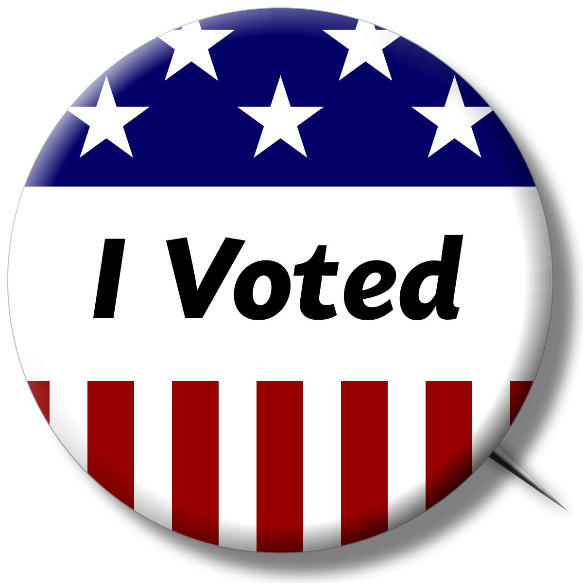
SECRETARY OF THE STATE CONFERENCE
REGISTRARS OF VOTERS
MARCH 28, 2016

Slide 2
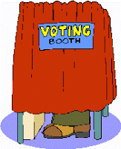
Purpose
The presidential preference primary does not directly select actual delegates to the national party conventions.
Rather, it determines the number of delegate positions allocated to each Presidential candidate, statewide and/or by Congressional District.
This apportionment of delegate seats is done according to the proportional representation formula or “winner take all” basis as prescribed by party rules.
The Secretary of the State tabulates the primary returns, calculates the allocation of delegate position to candidates, and certifies the results to the national and state parties and to the candidates.

Slide 3

Process
Qualification on a party’s primary ballot can be achieved in two ways:
  (1) by the Secretary of the State, if in the Secretary's opinion the person's candidacy for the party's presidential nomination is generally and seriously advocated or recognized according to reports in the national or state news media; OR
  (2) by petition signed by at least one per cent of the enrolled members of the party in the state according to the most recent active-list enrollment records on file in this office.
If two or more candidates have qualified for a party's primary ballot, then the Secretary will determine the order of all candidates on such ballot by lot in a public ceremony.
The category "Uncommitted" will appear last on each party's ballot.
If fewer than two candidates have qualified for a party's ballot, that party's primary is cancelled.

Slide 4

Calendar of Events
March 21, 2016 – deadline for withdrawal of candidates placed on the ballot by the Secretary of the State.
March 22, 2016 – Secretary of the State determines order of candidates on the ballot by lot in a public ceremony.
April 5, 2016 – Absentee ballots become available.
April 12, 2016 – mandatory enrollment session for primary in all towns.
April 21, 2016 – Mail-in voter registration deadline.
April 25, 2016 (12 noon) – In-person voter registration deadline.
April 26, 2016 – Presidential Preference Primary.
April 27, 2016 (2 p.m.) – Deadline for delivery of head moderator’s return.

Slide 5
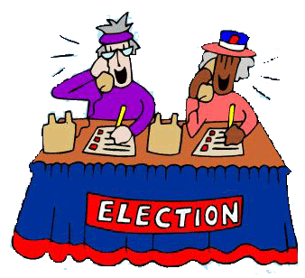
Registrar’s Duties
If two parties hold primaries in your municipality, remember that this constitutes two separate and distinct primaries even though they are held on the same day in the same location(s), and the registrar's duties must be performed by each of you separately.
Each registrar performs these functions in connection with his or her own party's primary.

Slide 6
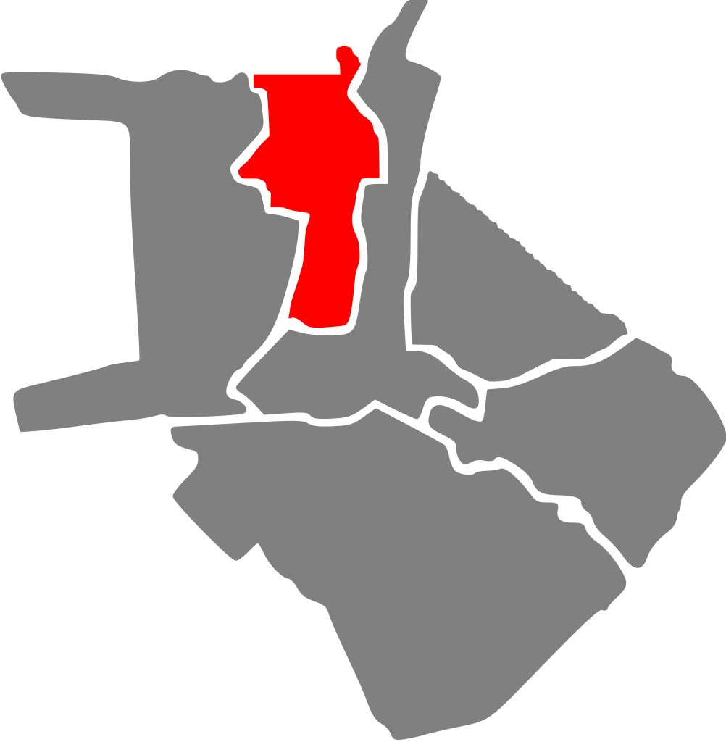
Voting Districts
No changes in the boundaries of voting districts may be made within ninety days prior to the primary.
If two parties are holding primaries, the same voting districts apply to both.
The presidential preference primary will be conducted on the basis of state election voting districts.

Slide 7
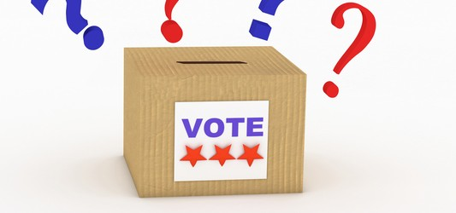
Polling Places
Generally, each voting district must have its own, separate polling place.
Polling places are designated by the registrars and may not be changed within the period of thirty-one days before a primary. The only exception to this rule is the case in which a polling place has for some reason (a fire, for example) become unusable, in which case the municipal clerk and the registrars, acting unanimously, must designate a new polling place.
If both parties are holding primaries, the same polling place is used for both parties.
Two polling places in one building: If your town has validly provided for two polling places in one building, and if, at the primary, the ballot labels for the two polling places in that one building are exactly the same and the law does not require separate returns, then the law allows the registrars to combine those two polling places into one polling place.
Towns that are split between Congressional Districts may not combine voting districts split by such congressional district because the law requires separate returns by congressional district.
Except in the case of two polling places in one building, Section 9-438 requires that polling places for primaries be the same as those used for the election to be held.
Arrangement of polling place: We strongly recommend that in any polling place where two primaries are being held, each party's enrollment lists, ballots, and official checkers be kept as separate as possible. However, it is permissible to use a single optical scan machine for both primaries.

Slide 8

Primary Officials
Reduction of Primary Officials: When both parties are having a Presidential Preference Primary, the law allows for the reduction in primary officials. The required poll workers are:
  1 Moderator
  1 Checker
  1 Tabulator Tender for every two tabulators in use
Moreover, when two parties are holding presidential preference primaries the registrars may jointly appoint (A) one enrolled member of either party to serve as polling place moderator of both primaries and (B) one enrolled member of either party to serve as head moderator of both primaries.
Additional Officials and Explanation: In the situation of two presidential preference primaries the statute permits (but does not require) the appointment of:
  1 or 2 Assistant Registrars (if the registrar will not be on duty at the polling place)
  1 additional Checker (for a total of two checkers for each line of electors)
  1 or 2 additional tabulator tenders
  1 or 2 Challengers
At least 2 Absentee Ballot Counters (unless there is central counting of absentee ballots in which case there are at least 2 Absentee Ballot Counters for the town or part of a town holding the primary)
Any duty required of assistant registrars, absentee ballot counters and other primary officials, in the case of reduction of primary officials, may be performed by one or more primary officials, at the direction of the registrar of voters of the party of such officials.
The law prohibits any known candidate in a primary from serving as a primary official on primary day or serving at the polls in any capacity.

Slide 9

Candidate Checkers
Each Presidential candidate on the primary ballot is entitled to designate one "candidate checker" to be present in each polling place.
The designation must be submitted in writing to the registrar, by any authorized or known representative of the candidate, at least 48 hours before the primary.
The Secretary of the State's Office will notify all candidates in the presidential primary on behalf of the registrars of this option.
The candidate checker must be an enrolled party member in the town.
In addition, any person who is not a candidate or an election official may serve as a runner.

Slide 10

Supervised Absentee Voting
The law requires supervised absentee voting if an application for an absentee ballot is received from a qualified resident of an institution and "if twenty or more of the patients in...(the) institution...are electors" regardless of whether the twenty electors in the institution are eligible to vote in the primary.
Whenever there is supervised absentee balloting at a presidential preference primary, this office advises the registrar of the party holding the primary to designate an enrolled elector of his town and political party (other than an employee of the institution) from two contestants in the primary to supervise.
The Secretary of the State's Office, on behalf of the Registrars, will notify all candidates in the presidential primary that they may submit to the registrar the name of an enrolled elector of the town to be a potential designee to supervise absentee voting. If no such lists are submitted within said period, this office advises such registrar to try to appoint one official from the supporters of two presidential candidates, if this is practical. If this is not practical, the registrar of voters of the party may supervise absentee voting himself.

Slide 11

Voter ID Provisions
Each voter who is subject to the identification provisions of the Help America Vote Act (and required to submit identification at the polls) must present to the checker, before the elector votes, either a current and valid photo identification that shows the elector’s name and address or a copy of a current utility bill, bank statement, government check, paycheck or other government document that shows the name and address of the elector.
Each other elector shall present one of the following: (1) social security card, or (2) pre-printed form of identification which shows (a) his name and address, or (b) his name and signature, or (c) his name and photograph.
If a voter not subject to the provisions of the Help America Vote Act does not present one of the above, he must sign a statement under penalty of false statement that he is the elector whose name appears on the official checklist.
Voters subject to the identification provisions of the Help America Vote Act who do not present identification (and are required to do so at the polls) may not sign the statement but may vote by provisional ballot.

Slide 12
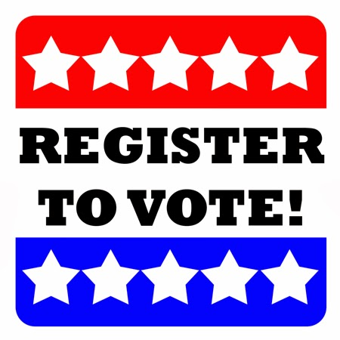
New Voters
There is no waiting period in the case of the new voter who applies for enrollment.
Six exceptions: (1) One who applies for enrollment in person to the registrars or town clerk after 12:00 noon on the last business day before a primary obtains his enrollment privileges immediately after the primary;
(2) The person who applies for enrollment in person to his registrars of voters or town clerk on the day of a caucus or convention receives his privileges immediately after the caucus or convention;
(3) A person who is pre-registering as a seventeen year old and who designates a party upon his registration form, if found qualified, has his name added to the enrollment list, together with the effective date of his registration (18th birthday); consequently, he acquires party rights on his birthday even if that day is the day of a caucus, convention or primary. They may also participate in a party primary in certain circumstances.;
(4) A person who is registered door-to-door and who designates a party upon his registration form does not acquire enrollment privileges until he acquires electoral privileges when his application for admission is approved. Any such person approved after 12:00 noon on the last business day before a primary or on the day of a caucus or convention does not acquire enrollment privileges until after the primary, caucus or convention;
(5) A member of the armed forces or related group or citizen overseas who applies for absentee admission and who designates a party upon his registration form does not acquire enrollment privileges until he acquires electoral privileges when his application for admission is approved by the town clerk. Any such person approved on the day of a primary, caucus or convention does not acquire enrollment privileges until after the primary, caucus or convention;
(6) A person who applies on a mail-in registration form and designates a party upon his registration form does not acquire enrollment privileges until he acquires electoral privileges on the day the registrar of the town of voting residence approves the application. A person who applies for admission and enrollment by the mail-in procedure obtains electoral and enrollment privileges on the day after the primary if (1) the mail-in application is postmarked after the fifth day before the primary, (2) the mail-in application is received by the DMV or a voter registration agency after the fifth day before the primary, or (3) the mail-in application is delivered to the office of the registrars by someone other than the applicant after the fifth day before the primary.

Slide 13

Unaffiliated Voters
An unaffiliated voter may at any time make application for enrollment to the registrars of voters. Upon making application he becomes immediately entitled to all party privileges including the right to vote in primaries and caucuses, to be an opposition candidate by petition, to sign a primary petition, to serve as a circulator of a primary petition and to be appointed a primary official.
There are four exceptions: (1) If the unaffiliated voter files his application in person with the registrar of voters after 12:00 noon on the last business day before a primary, he receives his privileges immediately after the primary;
(2) if the unaffiliated voter files such application, otherwise than in person, with the registrar of voters after the fifth day before the primary, he does not acquire enrollment privileges until after the primary;
(3) if the unaffiliated voter is overseas or a serviceman or related group who files such application with the town clerk on the day of the primary, he does not acquire enrollment privileges until after the primary;
(4) if the unaffiliated voter files his application with the registrar of voters after 5:00 p.m. on the last business day before a caucus or convention, he receives his rights immediately after the caucus or convention.

Slide 14
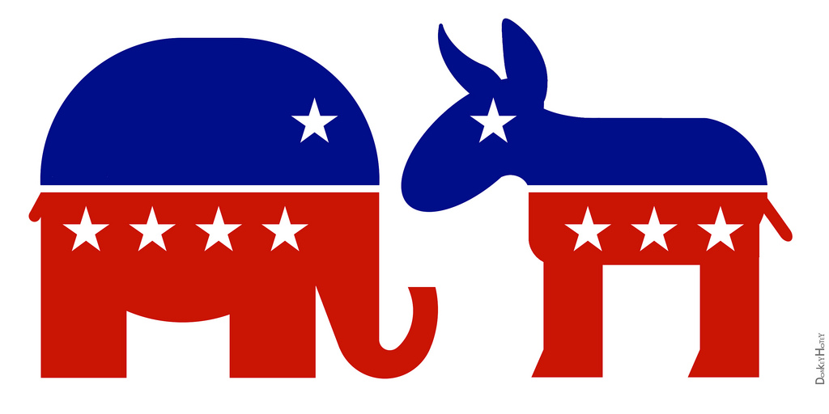
Transfer
An elector who applies for a transfer of his name from one party list to another immediately loses all rights in his former party.
Moreover, he may not vote in a primary or caucus or exercise any other rights of enrollment in any party for a period of three months from the date of filing of his application for transfer.

Slide 15
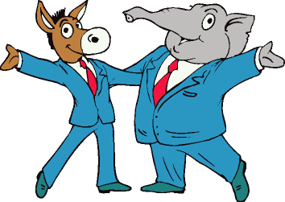
Erasure
An individual who applies for erasure of his name from a party enrollment list immediately loses all the rights accompanying enrollment in his party, and he becomes an unaffiliated voter.
If an erasee later applies for enrollment in the same or another party, he is in the same situation as a transferee, i.e., he does not acquire the rights of enrollment until the expiration of three months from the date of the filing of his application for erasure.

Slide 16
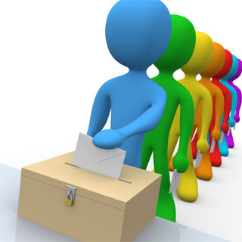
The End
Thank you for your attention.

